Slide 1

Trade-Remedy Laws
Notes:
Deep Dive: Public Procurement
Day Two Presentation

Slide 2
The Meaning of “Trade-Remedy Laws”
The underlying idea is to provide a legal means to address
problems that may arise in trade, without resorting to
the unilateral imposition of higher tariffs by legislatures.
These laws can however be abused for protectionist purposes, and are sometimes described instead as a system of “contingent protection.” Some also see a double-meaning in “unfair trade laws.”
They can also be used to coerce competitors by threatening to raise the price of competing in the import market. It can be extremely costly to hire the lawyers needed to defend against AD and CVD cases, and firms will sometimes threaten to file such cases in an effort to force their competitors either to raise their prices or even stay out of the market.
Notes:
Deep Dive: Public Procurement
Day Two Presentation

Slide 3

Typology of Trade-Remedy Laws
Imports Are Unfairly Traded
Trade May Be Fair But Is Problematic
Firms Are Unfair: Antidumping
Government Makes Trade Unfair: Countervailing Duty
Trade Threatens National Security
Trade is Injurious:
Safeguards
Import Restrictions (e.g., §232 in United States)
Global Safeguards (e.g., §201 in United States)
Some countries also have other trade-remedy, “reciprocity,” or foreign policy laws not shown here, dealing with specific issues such as violations of intellectual property laws, foreign investment, etc.
Export Restrictions (numerous laws)
Safeguards in RTAs
Notes:
Deep Dive: Public Procurement
Day Two Presentation

Slide 4
Typology of Trade-Remedy Laws
Imports Are Unfairly Traded
Trade May Be Fair But Is Problematic
Firms Are Unfair: Antidumping
Government Makes Trade Unfair: Countervailing Duty
Trade Threatens National Security
Trade is Injurious:
Safeguards
Import Restrictions (e.g., §232 in United States)
Global Safeguards (e.g., §201 in United States)
Export Restrictions (numerous laws)
Safeguards in RTAs
Notes:
Deep Dive: Public Procurement
Day Two Presentation

Slide 5
Antidumping Law
Notes:
Deep Dive: Public Procurement
Day Two Presentation

Slide 6
Main Points about Antidumping
Dumping is the sale of goods at less than fair
value (LTFV), which is usually calculated as a price
lower than the price for which it is sold in the home
market of the exporter (the “normal value”), after adjustments for differences in the merchandise, quantities purchased, and circumstances of sale. (There are some variations on this.)
Duties can be imposed if (a) LTFV sales are found and (b) these imports cause “material injury” to domestic producers.
There is a special methodology that applies to non-market economies such as China, in which surrogate prices are used.
The U.S. policy is to impose an AD order (often at the level of individual firms) that is equal to the dumping margin.
The E.U. policy is to issue orders at a level needed to remedy the injury done to domestic firms.
Notes:
Deep Dive: Public Procurement
Day Two Presentation

Slide 7
Antidumping and Non-Market Economies
China is one of many countries formally designated
by some countries as an NME. In the United States,
the others are Armenia, Azerbaijan, Belarus, Georgia,
Kyrgyz Republic, Moldova, Russia, Tajikistan, Turkmenistan, Uzbekistan, and Vietnam.
For these countries, the price comparison is not between the import price and the price in their markets, but between the import price and the prices for other firms charge in a comparable, market economy. For example, a Chinese firm’s price might be compared to the prices of a Brazilian firm.
This methodology makes it much easier to find high dumping margins. The NMEs account for a very high share of all orders.
Notes:
Deep Dive: Public Procurement
Day Two Presentation

Slide 8
Antidumping Orders by Importing and Exporting Countries
About half of all orders are imposed by five economies:
17.6% are imposed by India.
34.7% are imposed by Argentina, Brazil, the European Union, and the United States.
India
United States
Orders Imposed (Importers)
Countries Above this Line Impose More Orders than They Face
About half of all orders are on five economies:
26.0% of all AD orders are on China.
25.1% are imposed on Japan, Korea, Taiwan, and the United States.
China
Subject to Orders (Exporters)
Calculated from WTO data at https://www.wto.org/english/tratop_e/adp_e/adp_e.htm.
Notes:
Deep Dive: Public Procurement
Day Two Presentation

Slide 9
Antidumping Orders by Importing and Exporting Countries
(With Three Outliers Removed)
Argentina
Brazil
Türkiye
Orders Imposed (Importers)
Canada
Australia
Countries Above this Line Impose More Orders than They Face
South Africa
Mexico
Indonesia
Korea
Malaysia
Thailand
Russia
Taiwan
Japan
Subject to Orders (Exporters)
Calculated from WTO data at https://www.wto.org/english/tratop_e/adp_e/adp_e.htm.
Notes:
Deep Dive: Public Procurement
Day Two Presentation

Slide 10
Antidumping and the WTO
The WTO does not require that countries have
an antidumping law, but if they do have such
laws then they need to comply with the terms of
the Antidumping Agreement.
Antidumping cases account for a large share of the cases that are brought to the Dispute Settlement Body:
  144 out of 624 disputes (23.1%) have cited the Antidumping Agreement
  24 out of 26 complaints (92.3%) brought by China have cited the Antidumping Agreement (sometimes also citing other agreements)
Notes:
Deep Dive: Public Procurement
Day Two Presentation

Slide 11
The Countries that Impose the Most Antidumping Orders also Face the Most Complaints in the WTO
India
USA
Orders Imposed (Importers)
Trendline
European Union
Argentina
Brazil
China
Türkiye
Canada
Korea
Complaints in the WTO’s Dispute-Settlement Body
Calculated from WTO data at https://www.wto.org/english/tratop_e/adp_e/adp_e.htm.
Notes:
Deep Dive: Public Procurement
Day Two Presentation

Slide 12
Countervailing Duties
Notes:
Deep Dive: Public Procurement
Day Two Presentation

Slide 13
Main Points about CVDs
Governments subsidize enterprises or industries
when they provide financial assistance to benefit
the production, or exportation of goods through
(e.g., cash payments, tax credits, loans at favorable terms, etc.).
To be countervailable, a subsidy must involve a government financial contribution that confers a benefit that is specific to a certain enterprise, industry, or region in that country or that is contingent upon export or the use of domestic goods over imported goods in production.
It used to be the case that NMEs were exempt from CVD cases, but that has changed.
Notes:
Deep Dive: Public Procurement
Day Two Presentation

Slide 14
Countervailing Duties and the WTO
The same as for antidumping: The WTO does not
require that countries have a law, but if they do
have such laws then they need to comply with the
Agreement on Subsidies and Countervailing Measures.
CVD cases account for a large share of the cases that are brought to the Dispute Settlement Body:
  138 out of 624 disputes (22.1%) have cited the SCM Agreement (sometimes also citing other agreements)
  5 out of 26 complaints (19.2%) brought by China have cited the SCM Agreement (sometimes also citing other agreements)
Overall, CVDs are less common than ADs. According to the WTO, in the world today there are 1986 AD orders in place versus 294 CVD orders.
Note however that in some countries it is common to impose AD and CVD orders on the same products and firms.
Notes:
Deep Dive: Public Procurement
Day Two Presentation

Slide 15
Data Sources for AD and CVD Cases
Notes:
Deep Dive: Public Procurement
Day Two Presentation

Slide 16
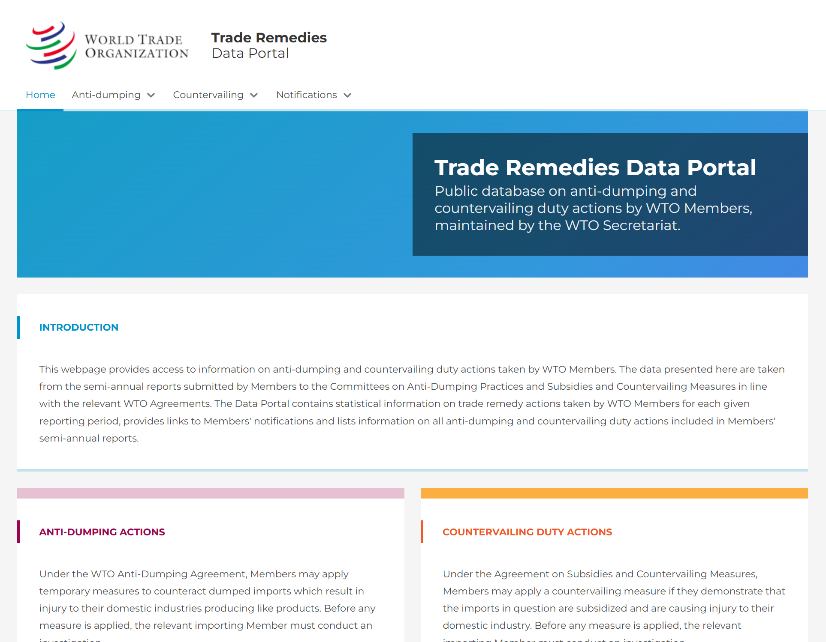
For the WTO: https://trade-remedies.wto.org/en
Notes:
Deep Dive: Public Procurement
Day Two Presentation

Slide 17
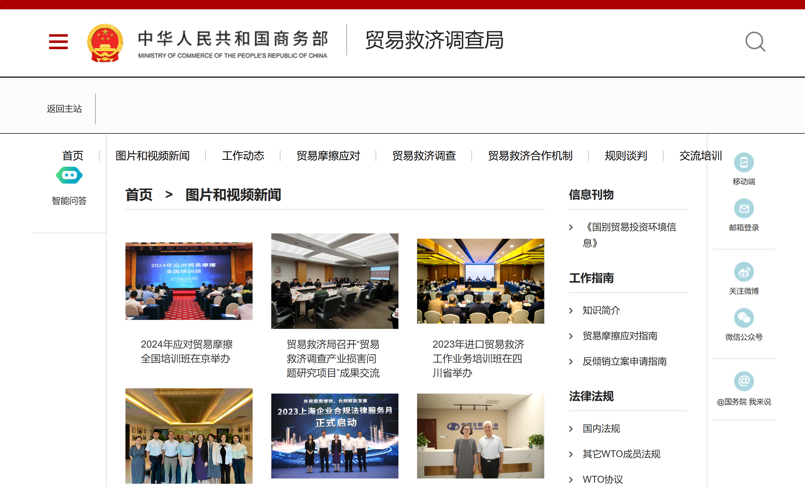
For China: https://trb.mofcom.gov.cn/
Notes:
Deep Dive: Public Procurement
Day Two Presentation

Slide 18
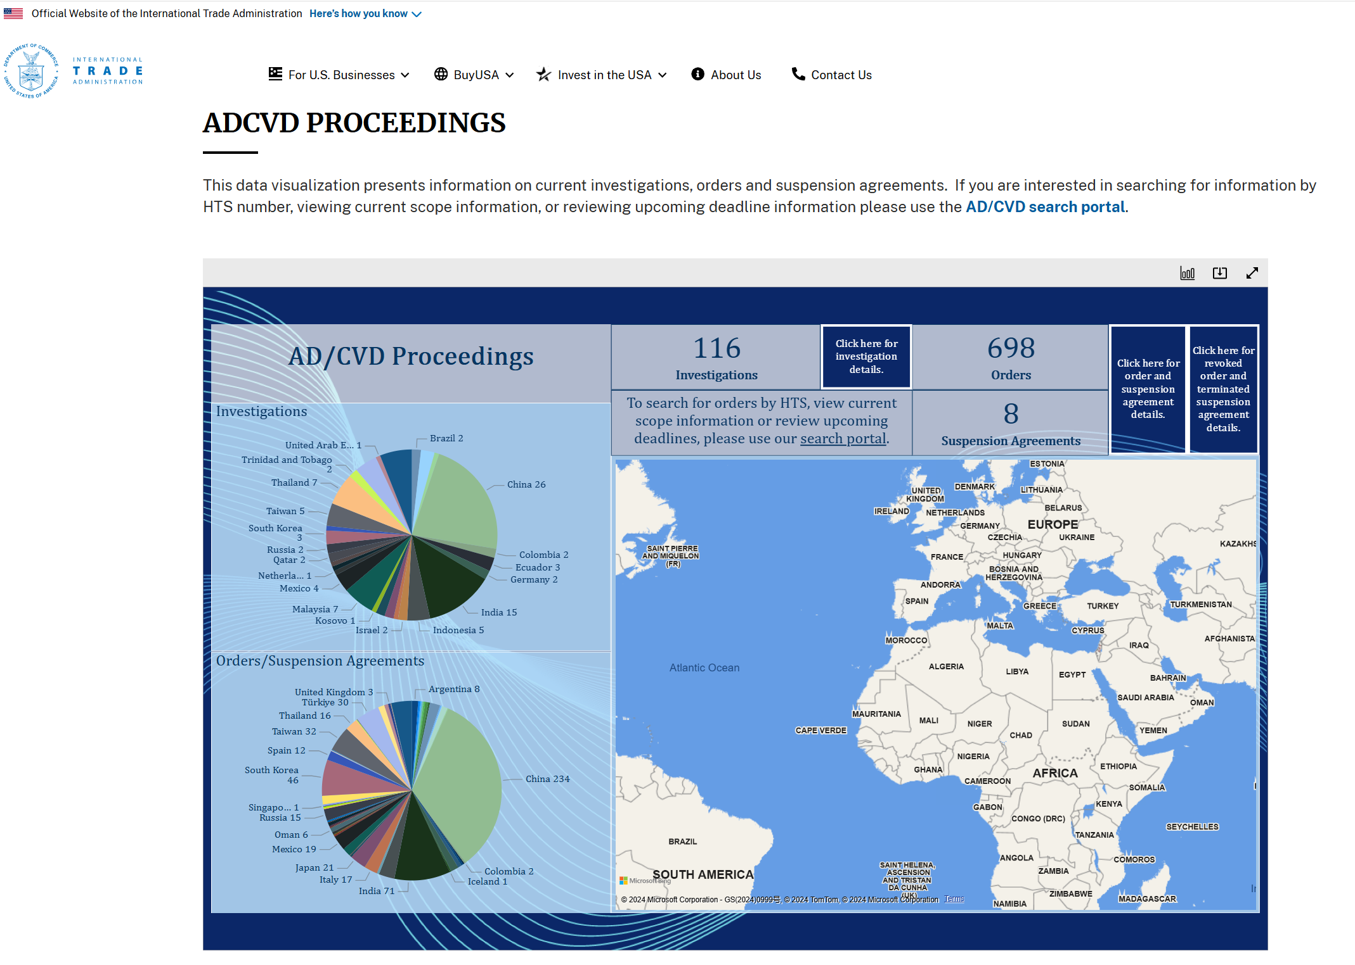
For the United States: https://www.trade.gov/data-visualization/adcvd-proceedings
Notes:
Deep Dive: Public Procurement
Day Two Presentation

Slide 19
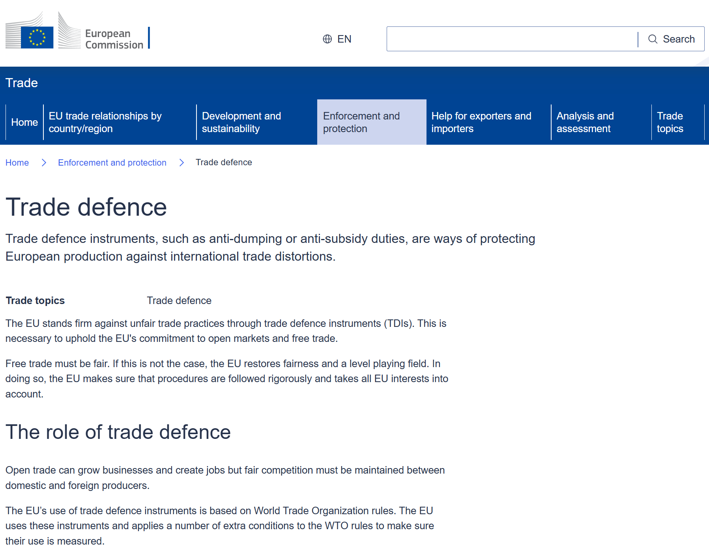
For the European Union: https://policy.trade.ec.europa.eu/enforcement-and-protection/trade-defence_en
Notes:
Deep Dive: Public Procurement
Day Two Presentation

Slide 20
Safeguards
Notes:
Deep Dive: Public Procurement
Day Two Presentation

Slide 21
Main Points about Safeguards
Safeguards were originally intended to encourage
trade liberalization, by giving countries assurance
that if their negotiations are too ambitious then they
can later make temporary adjustments to their commitments.
A country has the right under GATT and WTO law to invoke safeguards when increasing imports have the unanticipated consequence of causing serious injury to domestic industry.
Safeguards allow for the imposition of temporary tariffs; countries have also used it to impose quotas or (probably illegally) to negotiate “voluntary” restraint agreements.
Notes:
Deep Dive: Public Procurement
Day Two Presentation

Slide 22
Safeguards Have Evolved over Time
1940s-1960s: Safeguards were rarely invoked,
and the instrument was mostly tied to trade
agreements (i.e., when a country invoked the provision it suspended a tariff commitment it had made)
1970s-1990s: Safeguards become increasingly used as an instrument of protectionism, no longer tied to agreements
Early WTO period (post-1995): Use of safeguards becomes more restrained due to Appellate Body rulings in WTO
2020s: Countries are back to invoking more frequently
Notes:
Deep Dive: Public Procurement
Day Two Presentation

Slide 23
Safeguards and the WTO
The same as for AD/CVD: The WTO does not
require that countries have a safeguards law, but if
they do have such laws then they need to comply
with the Safeguards Agreement.
Safeguard cases account for a smaller share of the cases brought to the Dispute Settlement Body because it had seemed as if Appellate Body decisions made this instrument illegal:
  62 out of 624 disputes (9.9%) have cited the Safeguards Agreement (sometimes also citing other agreements)
  5 out of 26 complaints (19.2%) brought by China have cited the Safeguards Agreement (sometimes also citing other agreements)
Notes:
Deep Dive: Public Procurement
Day Two Presentation

Slide 24
How Should Countries (and Companies)
Respond to Trade-Remedy Cases?
Notes:
Deep Dive: Public Procurement
Day Two Presentation

Slide 25
Defending One’s Interests against the
Trade-Remedy Laws
Legal defense against these cases can be quite costly, both in
the country where the case is originally brought and (if a
challenge is made) in the WTO, and those expenses are usually borne by the exporting firm. Sometimes an exporter will be so intimidated by the costs that it will opt to leave the market altogether.
Negotiators from developing countries have sought reforms in these laws, but have so far achieved little progress in that direction. The AD laws of the developed countries are one of the most damaging exceptions to the general rule by which those countries have reduced their barriers to trade to a fraction of what they once were.
Notes:
Deep Dive: Public Procurement
Day Two Presentation

Slide 26
Should Developing Countries Adopt their Own Trade-Remedy Laws?
While legitimate concerns may arise over potentially unfair
import competition, it does not necessarily follow that the
AD law is the best response. It might require a half dozen or more highly trained professionals (as well as a substantial budget for travel and other expenses) to carry out the responsibilities of a national AD law. This is not something that can be done “on the cheap,” as any findings of an AD authority can be challenged by the country’s trading partners in the WTO. It can be quite expensive for a country to ensure not only that its AD investigations are properly conducted, but that the results are effectively defended from any legal challenges that might follow.
Notes:
Deep Dive: Public Procurement
Day Two Presentation

Slide 27
Other Measures Enforced at the Border
The non-tariff measures (NTMs) that countries enforce at their
borders may well be more significant in trade, and account for
more energy in negotiations, than do traditional tariffs.
NTMs may include such varied measures as sanitary and
phytosanitary standards for agricultural and food products, technical standards for other goods, pre-shipment inspection, licensing and quotas, price-control measures, etc. (Some analysts will also include in their lists of NTMs other issues that actually merit separate examination, such as intellectual property rights and measures affecting trade in services.)
Unlike tariffs and quasi-tariff measures (e.g., trade-remedy laws), NTMs are more difficult to quantify. Instead of simply counting total measures, countries should take a three-step process of listing and assessing them.
Notes:
Deep Dive: Public Procurement
Day Two Presentation

Slide 28
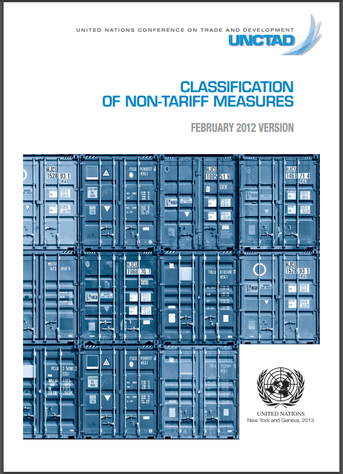
First Step in Assessing NTMs: Definition
An important first step in assessing
NTMs and their impact on a country’s
access to foreign markets is to define
the scope of measures that they will
catalog.
This UNCTAD publication, available on-line at http://wits.worldbank.org/wits/docs/multi-agency_classification_of_ntms.pdf, is a good first step in this process insofar as it provides an expansive definition of policy measures that might affect trade.
Notes:
Deep Dive: Public Procurement
Day Two Presentation

Slide 29
How to Deal with Economic Change
A strategy should provide answers to a series of questions:
Are there “sunset” industries in which the country has lost
competitiveness? Is that the consequence of inexorable
processes or are there identifiable and reversible reasons?
Are there important “sunrise” industries on the horizon, and what might be done to facilitate or promote new investment and productivity in these areas?
Are there steps that the country can take in trade and other areas of public policy that can help to ease the transition or reverse the decline, and to accelerate the development of industries that are on the rise?
In answering these questions, countries should also consider related social matters such as the impact on women or marginalized communities.
Notes:
Deep Dive: Public Procurement
Day Two Presentation

Slide 30
Notes:
Deep Dive: Public Procurement
Day Two Presentation

