Slide 1

Preferential and Non-Preferential
Market-Access Negotiations
Notes:
Deep Dive: Public Procurement
Day Two Presentation

Slide 2
Introductory Comments
Notes:
Deep Dive: Public Procurement
Day Two Presentation

Slide 3
Danger: The Fallacy of Construction
Avoid the common mistake of assuming that an RTA is simply
a smaller version of a multilateral agreement (i.e., like a mini-WTO).
These instruments can differ in the following ways:
Their political intent (diplomatic/security) is typically much higher and more explicit
Their discriminatory effect is greater
The opportunities to exacerbate and exploit that discrimination can be tempting (e.g., rules of origin and other means of managed trade)
An RTA’s issue coverage can be either narrower or (more often) wider
RTAs might be intended either as complements or as substitutes for the multilateral system
On the more specific issue of market access, multilateral agreements are about reducing barriers and RTAs are about eliminating them.
Notes:
Deep Dive: Public Procurement
Day Two Presentation

Slide 4
Principal Differences between Multilateral
and RTA Negotiations on Market Access
Issue | Multilateral Negotiations | RTA Negotiations
Product Coverage | Only products explicitly scheduled in countries’ commitments (or other agreements) are covered. | “Substantially all the trade” between the partners must be covered
What Is Cut | Countries’ commitments are made on their bound rates. | Commitments are typically made on applied rates.
How Far Cut | Bound rates are more typically reduced than eliminated. | Applied rates are supposed to be reduced to zero.
Negotiating Method | Earliest negotiations were request-offer basis, but various forms of formula cut have been more common. | Countries typically bargain over which products will be placed on which phase-out schedule.
Safeguards and Related | WTO provisions allow for safeguards and also for renegotiations and other special treatment. | In addition to exempting some products or sectors, may include provisions such as safeguards, snapbacks, tariff-rate quotas, etc.
Rules of Origin | Such rules are generally not controversial when benefits are extended on an MFN basis. | If these rules are designed to limit benefits to participating countries they may impose costs on third countries from whom trade is diverted.
Notes:
Deep Dive: Public Procurement
Day Two Presentation

Slide 5
Market-Access Negotiations in the WTO
Notes:
Deep Dive: Public Procurement
Day Two Presentation

Slide 6
The Most Important Terms Concerning
The Core Terminology of Tariff Commitments
Applied Rate: The tariff rate that a country actually applies to imports.
Bound Rate: The rate that a country has bound itself to in a trade negotiation
or agreement.
Water: The difference between an applied tariff rate and a bound tariff rate. For example, if the bound rate is 5% and the applied rate is 3% there are two points of water.
Nomenclature: The division and classification of products in a tariff schedule; all WTO members adhere to the Harmonized System.
Harmonized System (HS): Standardized system of nomenclature for tariff schedules.
Notes:
Deep Dive: Public Procurement
Day Two Presentation

Slide 7
The Most Important Terms Concerning
The Types of Tariffs
Specific Tariff: A tariff that is denominated in specific numbers or quantities
(e.g., $1 per liter).
Ad Valorem Tariff: A tariff assessed as a percentage of the value of the goods.
Compound Tariff: A tariff that incorporates both a specific and an ad valorem component.
Ad Valorem Equivalent (AVE): Expression of a specific tariff in the equivalent ad valorem rate. For example, if the tariff is $1 each and the average price is $10 the AVE is 10%.
Tariff-Rate Quota (TRQ): A quantitative restriction providing for a higher rate on imported goods after a specified amount of the item has entered the country at a lower rate.
Tariff Peak: Extraordinarily high tariff rates applied to protected products. There is no universally accepted standard regarding what constitutes a peak rate.
Notes:
Deep Dive: Public Procurement
Day Two Presentation

Slide 8
The Most Important Terms Concerning
The Types of Commitments and Formulas
Request-Offer: Request-offer is the oldest modality in the conduct of tariff
negotiations; the exchange of commitments on a product-by-product basis.
Formula Cuts: Tariffs are reduced according to a mathematical formula.
Horizontal Reduction: Tariffs are cut across-the-board by a percentage. Also called linear.
Back Loading: Most or all liberalization comes at the end of an implementation period.
Coefficient: A variable “plugged into” an equation in a formula. In tariff negotiations, the coefficient is a negotiated value that determines the level of ambition for reductions.
Tiered Formula: A formula approach to tariff negotiations in which different formulas, or different coefficients in a formula, are applied to different types of products or countries.
Notes:
Deep Dive: Public Procurement
Day Two Presentation

Slide 9
Modalities of Market-Access Negotiations
for Goods in the GATT and the WTO
Goods 1946-1961, GATS to this day.
Request-offer: The traditional give-and-take
Sectorals: Zero-for-zero or other, generally ambitious approaches
Simple formulas: Horizontal reductions (a.k.a. “linear” reduction)
Complex formulas: Swiss and others (a.k.a. “non-linear”)
Beef, aircraft, the Information Technology Agreement, etc.
Linear cuts in Kennedy Round (1960s).
Starting with Tokyo Round (1970s).
No matter what approach is taken as the main modality, there is usually some element of request-offer in the end-game to exercise greater or lesser ambition than the chosen method might yield.
Notes:
Deep Dive: Public Procurement
Day Two Presentation

Slide 10
Bound and Applied Rates
Unweighted Averages for All Products, 2022
What would happen to applied rates if we cut every country’s average bound rate by 50%?
Notes:
Deep Dive: Public Procurement
Day Two Presentation

Slide 11
Bound and Applied Rates
Unweighted Averages for All Products, 2022
Developed countries and RAMs would have to cut tariffs, but most others would only remove water.
Notes:
Deep Dive: Public Procurement
Day Two Presentation

Slide 12


The Swiss Formula Deals Best with Peaks
Notes:
Deep Dive: Public Procurement
Day Two Presentation

Slide 13
The Swiss Formula Deals Best with Peaks
Notes:
Deep Dive: Public Procurement
Day Two Presentation

Slide 14
Understanding the Swiss Formula
a x T_{o}
a + T_{o}
T₁ =
T₁ is the new bound rate, T_{o} the existing one.
a is the coefficient of reduction.
That a value is the maximum level that any tariff can be, and the higher the existing tariff the greater the cut.
Some people are initially intimidated by this formula, but they should not. It involves just three simple actions: addition, multiplication, and division.
Notes:
Deep Dive: Public Procurement
Day Two Presentation

Slide 15
Calculating the Swiss Formula
a x T_{o}
a + T_{o}
T₁ =
New rate = (a x current rate) ÷ (a + current rate)
So if a = 15, then:
New rate = (15 x current rate) ÷ (15 + current rate)
Suppose that the existing binding = 20%
New binding = (15 x 20) ÷ (15 + 20)
New binding = 300 ÷ 35
New binding = 8.6%
This can of course be easily done with Excel.
As long as countries continue to place greater emphasis on the negotiation via RTAs than in the WTO, especially for market-access deals, this knowledge of formulas (Swiss and others) will remain more potential than practical. Negotiations in RTAs focus not on how much to cut, but how many products, how fast, and with what special provisions such as safeguards and snap-backs.
Main Points about the Swiss Formula:
It aggressively attacks peak tariffs.
It has little effect on low tariffs.
The ambition of the cut is inversely proportional to the magnitude of the a coefficient, which becomes the highest possible tariff.
Notes:
Deep Dive: Public Procurement
Day Two Presentation

Slide 16
Bound and Applied Rates
Unweighted Averages for All Products, 2022
What would happen to applied rates if we used a Swiss formula with an a coefficient of 15?
Notes:
Deep Dive: Public Procurement
Day Two Presentation

Slide 17
Bound and Applied Rates
Unweighted Averages for All Products, 2022
Every country would either (1) cut its applied rates or (2) remove most of the water from its schedule.
Notes:
Deep Dive: Public Procurement
Day Two Presentation

Slide 18
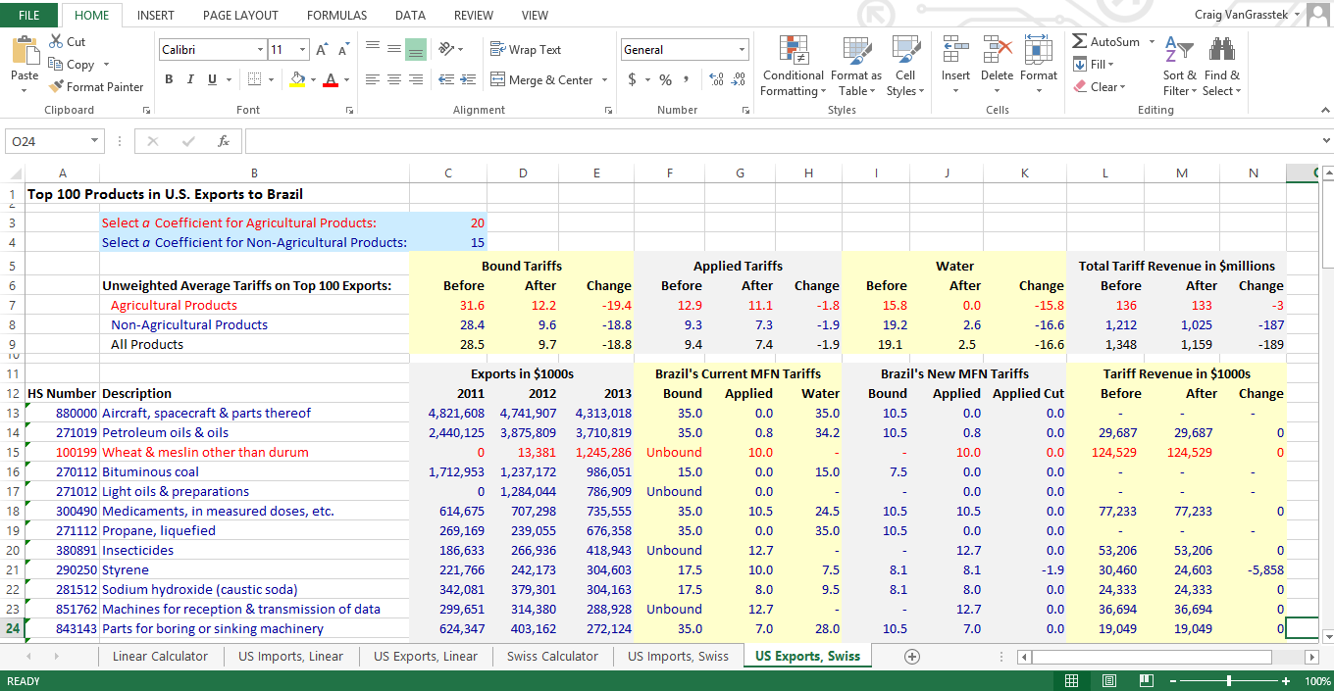
It Is Easy to Construct a Formula Cut Calculator
Notes:
Deep Dive: Public Procurement
Day Two Presentation

Slide 19
Market-Access Negotiations in RTAs
Notes:
Deep Dive: Public Procurement
Day Two Presentation

Slide 20
Outright Exclusions vs. Substantially All
GATT Article XXIV provides that,
“A free-trade area shall be understood to
mean a group of two or more customs territories in which the duties and other restrictive regulations of commerce … are eliminated on substantially all the trade between the constituent territories in products originating in such territories.”
Note that this rule does not apply to those South-South agreements (some of which are designated as “partial scope agreements”) that come under the terms of the Enabling Clause rather than Article XXIV.
Notes:
Deep Dive: Public Procurement
Day Two Presentation

Slide 21
Agricultural Exclusions in E.U. and U.S. FTAs
The E.U. exceptions have grown somewhat narrower over time:
Its oldest FTAs would exclude agriculture altogether
The South African agreement (1999) excluded such goods
as beef, sugar, rice, some dairy products, flowers, wine, etc.
Recent agreements such as Japan (2019) still subject 13% of E.U. agricultural exports to less than fully duty-free treatment (e.g., TRQs)
The U.S. exceptions are variable and negotiable:
The FTA with Canada (1988) excluded dairy
The FTA with Australia (2004) excluded sugar
The FTA with Central America and the Dominican Republic (2005) excluded several items (all agricultural)
Notes:
Deep Dive: Public Procurement
Day Two Presentation

Slide 22
Phase-Out Schedules in Trade Agreements
Some products will be granted duty-free
treatment upon the agreement’s entry into
force (EIF), but others may be phased out in
categories over 5, 10, 12, or even 15+ years.
Some are phased out in equal annual stages, but cuts on the most sensitive goods might be “back-end loaded” such that they are not reduced until the last years — or even the very last — of the phase-down.
Notes:
Deep Dive: Public Procurement
Day Two Presentation

Slide 23
Different Types of Rules of Origin
Non-preferential rules of origin are of
primarily statistical importance, as they
determine which will be identified as the
country-of-origin. They generally attribute 100% of the value of the good to the exporting country.
Preferential rules of origin are necessary to determine whether an import receives preferential treatment under an agreement or program.
Notes:
Deep Dive: Public Procurement
Day Two Presentation

Slide 24
Preferential Rules of Origin
The rules that determine whether a product qualifies
for FTA treatment can exaggerate the trade-diverting
nature of the agreement by discouraging a partner from
sourcing raw materials or other inputs from third countries.
Some rules are so strict that they leave a partner’s products barely competitive. In the case of textiles and apparel, for example, rules might require that all of the fabric ― or even all of the fiber in that fabric ― be sourced within the FTA. Partners in such an agreement sometimes find it more profitable to source those materials elsewhere and pay the full, MFN tariff.
Notes:
Deep Dive: Public Procurement
Day Two Presentation

Slide 25
Market-Access Negotiations on Services
Notes:
Deep Dive: Public Procurement
Day Two Presentation

Slide 26
Introductory Comment
Negotiations over trade in services are much more complex than
those covering trade in goods for several reasons:
Services are regulated by measures that are far more detailed
than simple tariffs, quotas, or other border barriers
A much wider range of stakeholders is involved, with a wide array of agencies, industries, and consumers as well as greater political sensitivities
Data on actual trade in services is less available and reliable
There is no single approach taken to services in all trade agreements, where only some are based on the WTO/GATS approach to scheduling
The points made in this presentation thus offer only a general introduction. Countries are well-advised to engage in extensive internal consultations and capacity-building in this area before undertaking trade negotiations.
Notes:
Deep Dive: Public Procurement
Day Two Presentation

Slide 27
The Most Important Terms Concerning
Negotiations on Trade in Services
Positive List: Countries make commitments only on those items that are
explicitly on their list. This is the GATS approach.
Negative List: Countries make commitments on all items except those that are explicitly listed. This is the approach taken in some FTAs (e.g., those of the United States).
None: In its GATS commitments may indicate that in a sector under one or more mode it makes no limits on its commitments. This is the deepest commitment that can be made.
Unbound: In a GATS schedule, a country may indicate that certain sectors are “unbound” under one or more mode of delivery. The country makes no commitments.
Horizontal Commitments: Under GATS, a commitment that applies to multiple sectors. Horizontal commitments are typically limitations on market access or national treatment.
Some countries negotiate RTA services commitments in a positive-list approach resembling the GATS (usually GATS-Plus).
The United States takes a negative-list approach in its FTAs, with special chapters for some sectors.
The European Union takes a hybrid approach that includes elements of positive and negative lists.
Countries should always examine the most recent RTAs of their negotiating partners for guidance on their preferred services templates, and priority sectors, and exceptions.
Notes:
Deep Dive: Public Procurement
Day Two Presentation

Slide 28
The GATS Approach to Commitments:
A Positive List in Four Modes of Supply
Mode 1, Cross-Border Supply: The supply of a service “from the territory of
one Member into the territory of any other Member.” The service crosses the
border, but both the provider and the consumer stay home.
Mode 2, Consumption Abroad: The supply of a service “in the territory of one Member to the service consumer of any other Member.” The consumer travels to obtain the service.
Mode 3, Commercial Presence: The supply of a service “by a service supplier of one Member, through commercial presence in the territory of any other Member” (i.e., investment through the establishment of a branch, agency, or wholly-owned subsidiary).
Mode 4, Presence of Natural Persons: The supply of a service “by a service supplier of one Member, through presence of natural persons of a Member in the territory of any other Member.” Private persons temporarily enter another country to provide services.
GATS negotiations are conducted on the same request-offer basis that was used for tariffs in the decade before formula cuts.
RTA negotiations are also conducted on a request-offer basis, whether they aim to produce a positive list (where countries bargain over what will be included) or a negative list (where countries bargain over what will be excluded).
Notes:
Deep Dive: Public Procurement
Day Two Presentation

Slide 29
Examples of the Negative-List Approach:
Standard U.S. Reservations in its FTAs
Exports of certain technology require a license.
Only U.S. citizens may operate aircraft in domestic air service.
Department of Transportation authorization is required for the
provision of specialty air services in U.S. territory.
The United States reserves the right to restrict ownership of radio licenses.
Foreign corporations may not acquire rights-of-way for oil/gas pipelines.
Licenses for nuclear facilities may not be issued to any entity owned, controlled, or dominated by an alien, a foreign corporation, or a foreign government.
Only U.S. citizens may obtain a customs broker’s license.
Patent attorneys must be U.S. citizens or lawfully resident aliens.
This negative-list approach makes no mention of the four modes. It tends to emphasize liberalization via what in GATS is called Mode 3 (thus favoring foreign direct investment) while providing little liberalization under Mode 4 (thus generally excluding liberalization in the movement of natural persons).
Note that this is a very partial and illustrative list.
Notes:
Deep Dive: Public Procurement
Day Two Presentation

Slide 30
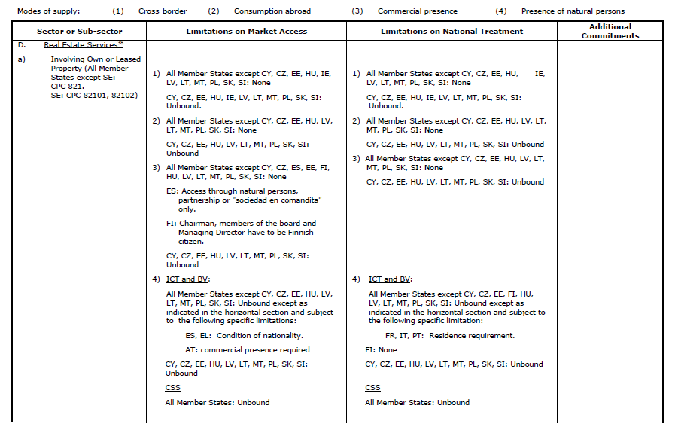
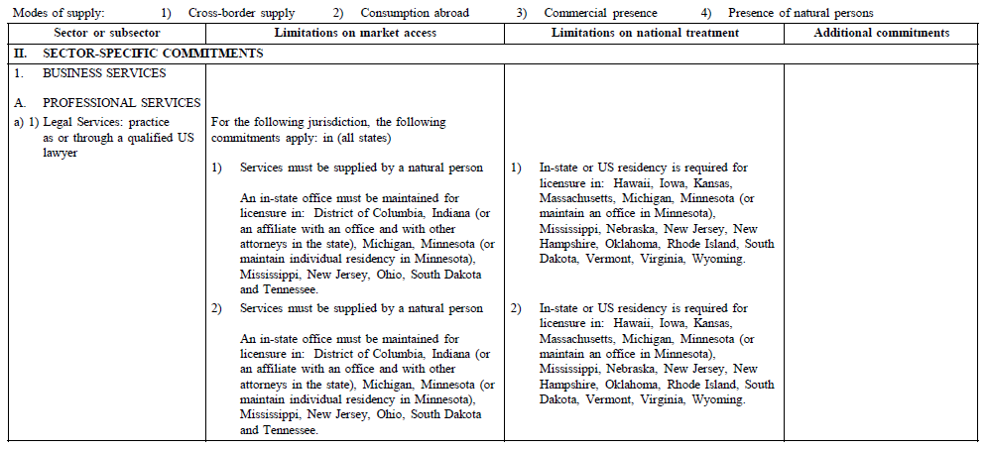
Special Cases: U.S. States, E.U. Members
The United States and the European Union ensure that their services commitments in trade agreements make exceptions for the laws of U.S. states or E.U. member countries, as in this example from the E.U. GATS schedule.
Notes:
Deep Dive: Public Procurement
Day Two Presentation

Slide 31
Review of This Session’s Vocabulary
Applied Rate
Binding (Bound Rate)
Coefficient of Reduction
Formula Cuts
Horizontal (or Linear) Reduction
Request-Offer
Swiss Formula
Tariff Peak
Notes:
Deep Dive: Public Procurement
Day Two Presentation

Slide 32
Notes:
Deep Dive: Public Procurement
Day Two Presentation

