Slide 1

Your Profiling Exercise:
The 3 to 5 recommendations you make to the
CEO should ideally relate to some initiative(s)
that are currently under negotiation or consideration in
the country. These might include national laws, trade agreements, trade disputes, or trade-remedy cases.
If there are not that many relevant initiatives currently under consideration, recommend that she seek (through whatever means you suggest) the removal of existing specific barriers that affect GlobalCorp’s export interests.
Notes:
Deep Dive: Public Procurement
Day Two Presentation

Slide 2
Stages in Multilateral
Trade Negotiations
Notes:
Deep Dive: Public Procurement
Day Two Presentation

Slide 3
Principal Points Made in this Presentation
Knowledge of WTO procedures and terminology is useful for
initiatives not just there, but also for negotiations in other fora
― to a point. Some aspects of negotiations in the WTO are
repeated in RTAs, but others are different or unique.
Unique WTO features include the role of chairmen, coalition diplomacy, formula approaches to tariff cuts, and the dispute-settlement system.
The stages of negotiation in the WTO, and the evolution of documents, are otherwise largely repeated in RTA negotiations.
While the procedures of the WTO began much like the GATT’s, important aspects such as the “Green Room” and rounds have largely disappeared. The single undertaking is also put in doubt by the apparent end of rounds.
Notes:
Deep Dive: Public Procurement
Day Two Presentation

Slide 4
Point 1:
The Vocabulary of the WTO
Notes:
Deep Dive: Public Procurement
Day Two Presentation

Slide 5
Make Sure You Understand the Key Terms
Negotiations Theory:*
Anchoring
Best Alternative to a Negotiated Agreement (BATNA)
Bluffing & Brinkmanship
Good Cop/Bad Cop
Low Ball (or High Ball)
Splitting the Difference
Stalling & Stonewalling
Walking Out
Zone of Possible Agreement (ZOPA)
Negotiations Practice:
Binding
Brackets
Chairman’s Text
Launch
Ministerial
Ministerial Declaration
Modalities
Plurilateral Agreements
Single Undertaking
* : We will not cover the negotiations theory terms in depth in this class, and so you will not be responsible for them in the final examination, but you must learn the terms related to negotiations practice.
Notes:
Deep Dive: Public Procurement
Day Two Presentation

Slide 6
How Would You Translate this Statement so as to Be Understandable to a Non-Expert?
?
?
WE ARE STILL WORKING OUT THE DRAFT, BUT THERE ARE SO MANY BRACKETS LEFT IN THE NAMA MODALITIES THAT IF WE WANT TO LAUNCH AT THE MINISTERIAL WE MAY HAVE TO FALL BACK ON A CHAIRMAN’S MARK.
Veteran Trade Official
New Trade Minister
Notes:
Deep Dive: Public Procurement
Day Two Presentation

Slide 7
The Most Important Terms Concerning
The Conduct of WTO Negotiations
Launch: The formal initiation of new negotiations, generally done by issuing
a ministerial declaration defining the scope, timetable, etc.
Ministerial Declaration: The communiqué issued at a ministerial meeting.
Modalities: The basic framework by which some aspect of a negotiation will be conducted. For example, a modality might specify the formula by which bound tariffs are to be cut.
Brackets: A section of an agreement that is still being developed. One or more bracketed versions of that text will indicate the proposals put forward by parties to the negotiation.
Chairman’s Text: Also referred to as a chairman’s mark or a chairman’s draft, this is a text proposed by the chairman of a negotiating group or working party.
Notes:
Deep Dive: Public Procurement
Day Two Presentation

Slide 8
The Most Important Terms Concerning
The Types and Contents of WTO Agreements
Single Undertaking: A comprehensive negotiation that produces a single
“package deal” or agreement on multiple issues. The term used to refer to
how negotiations were conducted, but now means what is agreed at the end.
Code Reciprocity: Prior to the single undertaking, a country did not have to
sign all of the agreements (or codes) reached under the auspices of GATT. This approach has now been replaced by the single undertaking.
Binding: A legally enforceable obligation; often used interchangeably with “bound rate.”
Plurilateral Trade Agreements: The few WTO agreements outside the scope of the single undertaking. Only those on civil aircraft and government procurement remain in effect.
Agriculture and NAMA: Agricultural products (generally chapters 1-24 in the Harmonized System, minus fish) are treated differently than Non-Agricultural Market Access (NAMA).
Compared to the wider “policy space” that used to be permitted in GATT, the single undertaking obliges countries to sign on to all agreements. The larger effect depends on the negotiating environment: When ambitions are low, and defensive interests high, the single undertaking may actually restrict the ZOPA by encouraging countries to fall back on the least ambitious BATNA (i.e., no agreement)
Notes:
Deep Dive: Public Procurement
Day Two Presentation

Slide 9
Point 2:
The Stages in a Negotiation
and their Associated Texts
Notes:
Deep Dive: Public Procurement
Day Two Presentation

Slide 10
Stages in a Negotiation and the Potential for Failure
Stage | Importance | Potential for Failure
Preparations (Domestic) | Detailed consultations with all relevant decision-makers and stakeholders in the country. | Most of the outcome may be determined before countries meet.
Preparations (International) | Countries decide not just whether to negotiate, but what broad objectives to pursue, how to do so, etc. | Countries might merely postpone a showdown over their differences.
Launch | A ministerial declaration will set the broad terms of the agreement to launch negotiations. | Strong objections can block the launch of negotiations
Modalities | An interim stage might translate the broader mandate into somewhat more precise principles; these might for example specify the precise formula to be used in a tariff negotiation. | This is where the WTO’s Doha Development Agenda stalled, having been launched even when some fundamental issues remained unresolved.
Negotiations | Negotiators bargain over the details until they reach a final and precise agreement or set of agreements. | Negotiators might fail to overcome their differences; talks might formally fail or deadlock indefinitely.
Approval | All countries have procedures for approval and ratification of agreements. | An agreement might be rejected by a cabinet, its legislature, or by the entire public in a referendum.
Implementation | Agreements ultimately depend on the willingness of country’s to abide by the principles to which they agree. | Agreements are rarely abrogated altogether but often result in dispute-settlement cases.
Perhaps the most common error made in any trade ministry that prepares for a negotiation is to treat each step in the process as a hurdle that needs to be cleared, such as “We need to prepare that memo for the Minister by Friday.” Taking a truly strategic approach in which each step is seen as part of a full, integrated process can be especially difficult if there are significant capacity gaps in government, a country does not have in place domestic consultative mechanisms, etc.
Notes:
Deep Dive: Public Procurement
Day Two Presentation

Slide 11
Modalities Are the Connection between Objectives and Results of a Negotiation
In a multilateral negotiation, modalities guide scheduling:
The ministerial declaration specifies what issues are on the table, the general level of ambition, and any applicable deadlines
The modalities specify more precisely the principles that will govern the negotiations
The scheduled commitments are very precise with respect to what bindings each country agrees to on which products
Example: We will make substantial cuts in bound tariffs on manufactures.
Example: Developed country bindings will be cut by 50%.
Example: The EU binding on cars and parts will be cut from 10% to 5%, but brakes are exempted.
Notes:
Deep Dive: Public Procurement
Day Two Presentation

Slide 12
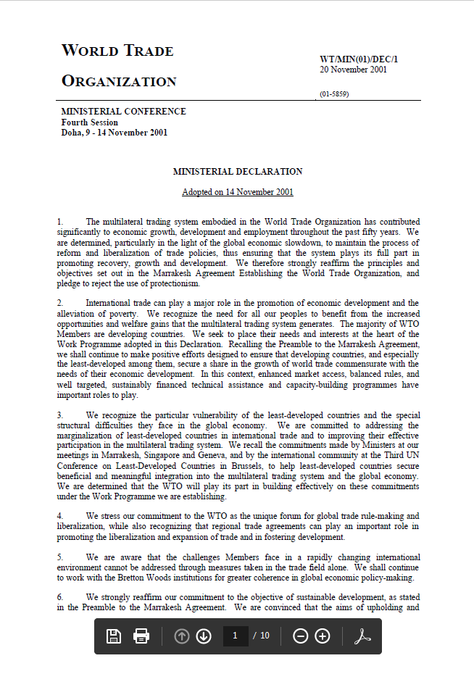
An Example of a Ministerial Declaration
A 10-page document with sections on NAMA, agriculture, services, etc.
The agricultural example in the declaration:
Building on the work carried out to date and without prejudging the outcome of the negotiations we commit ourselves to comprehensive negotiations aimed at: substantial improvements in market access; reductions of, with a view to phasing out, all forms of export subsidies; and substantial reductions in trade-distorting domestic support. We agree that special and differential treatment for developing countries shall be an integral part of all elements of the negotiations and shall be embodied in the Schedules of concessions and commitments and as appropriate in the rules and disciplines to be negotiated, so as to be operationally effective and to enable developing countries to effectively take account of their development needs, including food security and rural development. We take note of the non-trade concerns reflected in the negotiating proposals submitted by Members and confirm that non-trade concerns will be taken into account in the negotiations as provided for in the Agreement on Agriculture.
https://www.wto.org/english/thewto_e/minist_e/min01_e/mindecl_e.pdf
Notes:
Deep Dive: Public Procurement
Day Two Presentation

Slide 13
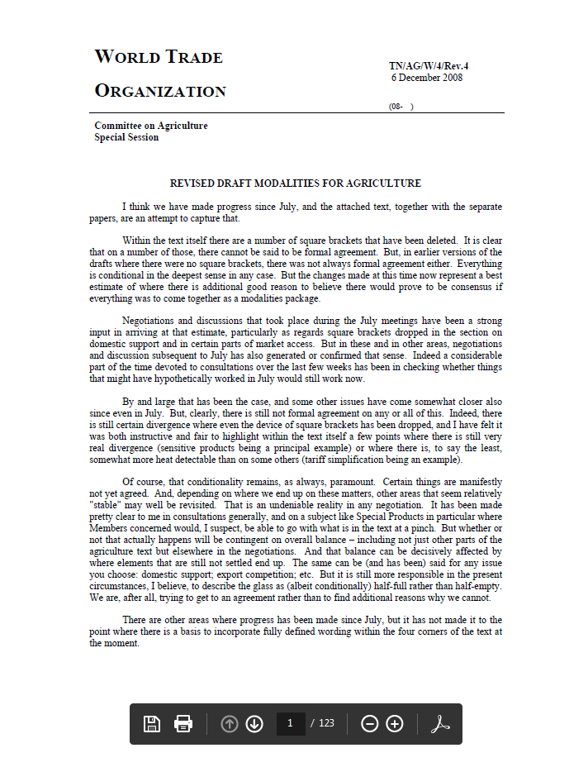
An Example of (Failed) Modalities:
The Proposed Doha Agricultural Deal of 2008
A 123-page document with detailed provisions on tiered tariff cuts, average cuts, the phase-in period, tariff quotas, treatment of sensitive products (for developed and developing) and special products (for developing only), and two types of safeguard mechanisms.
We of course have no example to show of a Doha Round result, but it would likely consist of numerous, lengthy agreements and declarations as well as separate goods, agricultural, and services schedules for each WTO member.
https://www.wto.org/english/tratop_e/agric_e/agchairtxt_feb08_e.doc
Notes:
Deep Dive: Public Procurement
Day Two Presentation

Slide 14
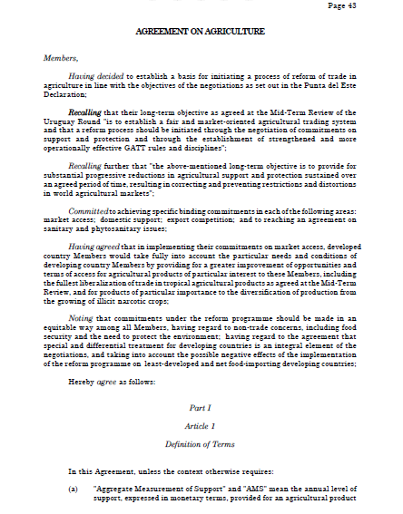
An Example of a Final Agreement:
The Uruguay Round Agreement on Agriculture
A 29-page document supplemented by members’ schedules of tariff commitments, subsidies commitments, etc.
Notes:
Deep Dive: Public Procurement
Day Two Presentation

Slide 15
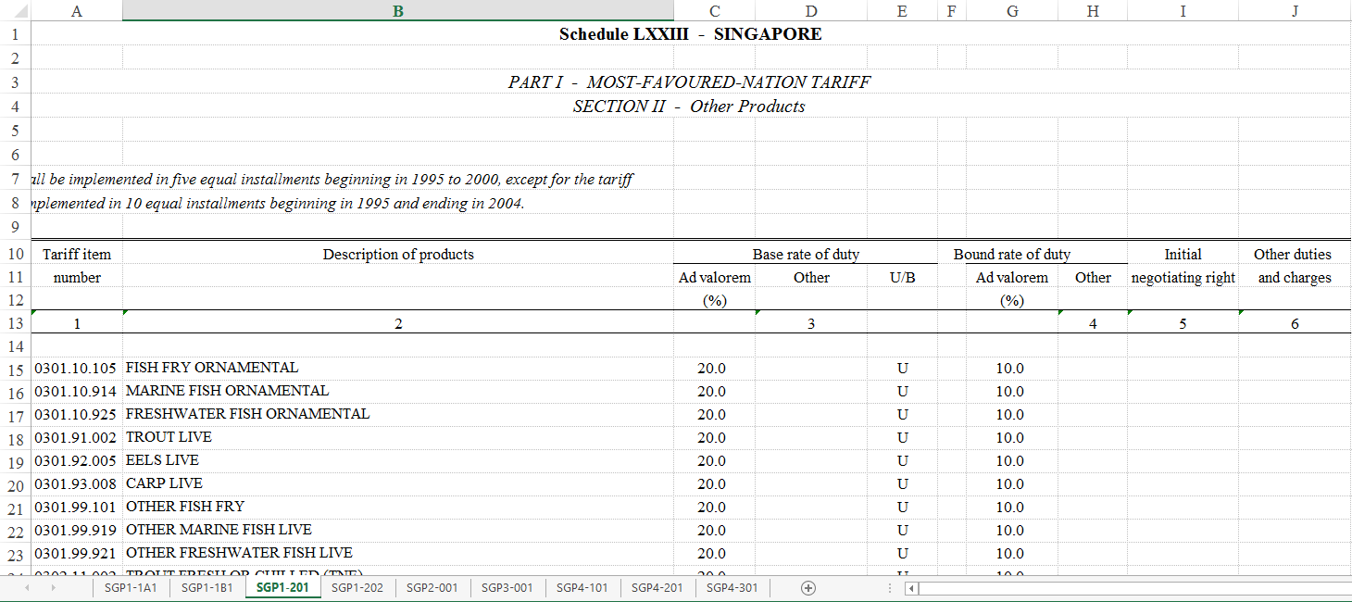
The Uruguay Round Agreements Were Complemented by National Schedules
This example from Singapore has separate worksheets on agricultural and non-agricultural goods, commitments on domestic agricultural support, etc.
Note that original versions at https://goods-schedules.wto.org/members are often only in scanned form, making the Excel versions preferable when available.
Notes:
Deep Dive: Public Procurement
Day Two Presentation

Slide 16
Point 3:
The Role of the Chairman
and the Evolution of Texts
Notes:
Deep Dive: Public Procurement
Day Two Presentation

Slide 17
The Role of the Chair in Multilateral Negotiations
One of the most important differences between multilateral negotiations and
smaller configurations (bilateral, regional, etc.) comes in the important role of
the chairman in WTO negotiations. A chair is expected not merely to facilitate
debate but to build consensus, and to take an active role in developing texts.
A chairman should act on behalf of the system, balancing impartiality toward members with the responsibility to break deadlocks and achieve consensus. The first task is to gather information on members’ positions, determining the option by conducting consultations that sound out members on the intensity of their views and their willingness to consider compromises. The most common device is a one-on-one meeting called a “confessional.”
Another key role can be the preparation of a “chairman’s text” or “chairman’s mark,” which is the proposed text for a final deal. Such a proposal aims to put together a total package that should be at least minimally acceptable to all. Preparing such a proposal is not always necessary, and indeed should be done only if there is a deadlock that needs to be broken.
Notes:
Deep Dive: Public Procurement
Day Two Presentation

Slide 18
The Mark-Up of Negotiating Texts:
Square Brackets
The purpose of [square brackets] is to designate sections of a text that remain under negotiation. They can take various forms, for example:
The first bracketed section consist of one word that might or might not get adopted.
This second choice is between two proposed alternatives.
The third and fourth choices indicate places where numbers will be inserted, but no specific figures are currently suggested.
We commit ourselves to [comprehensive] negotiations aimed at: substantial improvements in market access; reductions of, with a view to phasing out, all forms of export subsidies; and [elimination of] [substantial reductions in] trade-distorting domestic support. Average applied tariffs will be reduced by […] percent over a period of […] years.
The text inside brackets might also indicate which country or group sponsored the language in question. It might for example look like this:
  We commit ourselves to [Australia: comprehensive] [India: significant] negotiations aimed at …
Note that the bold used here is solely to highlight the text at issue.
Notes:
Deep Dive: Public Procurement
Day Two Presentation

Slide 19
The Mark-Up of Negotiating Texts:
Underlines
The purpose of underline is to designate sections of a text that have now been approved or added. For example:
The removal of the brackets and the use of underline here shows that the word in question was indeed adopted. Note that this may sometimes be indicated solely by removing the brackets, without underlines.
The underline here indicates that the parties agreed to newly introduced text (i.e., it was not previously in brackets).
We commit ourselves to comprehensive negotiations aimed at: substantial improvements in market access; reductions of, with a view to phasing out, all forms of export subsidies; and [elimination of] [substantial reductions in]
trade-distorting domestic support. Average applied tariffs will be reduced by […] percent over a period to be agreed at a later date.
Notes:
Deep Dive: Public Procurement
Day Two Presentation

Slide 20
The Mark-Up of Negotiating Texts:
Strike-Throughs
The purpose of strike-throughs is to designate sections of a text that have now been removed or rejected. For example:
The removal of the brackets and the use of strike-through here shows that the word in question was rejected. Note that this may sometimes be indicated solely by removing the brackets, without a strike-through.
The strike-through here indicates that the parties agreed to delete text that had not previously been contested (i.e., it was not in brackets).
We commit ourselves to comprehensive negotiations aimed at: substantial improvements in market access; reductions of, with a view to phasing out, all forms of export subsidies; and [elimination of] [substantial reductions in]
trade-distorting domestic support. Average applied tariffs will be reduced by […] percent over a period of […] years.
Notes:
Deep Dive: Public Procurement
Day Two Presentation

Slide 21
Review of This Session’s Vocabulary
Brackets
Chairman’s Text
Launch
Ministerial
Ministerial Declaration
Modalities
Plurilateral Agreements
Single Undertaking
Notes:
Deep Dive: Public Procurement
Day Two Presentation

Slide 22
Notes:
Deep Dive: Public Procurement
Day Two Presentation

