Slide 1

A Short History of the Trading System
Notes:
Deep Dive: Public Procurement
Day Two Presentation

Slide 2

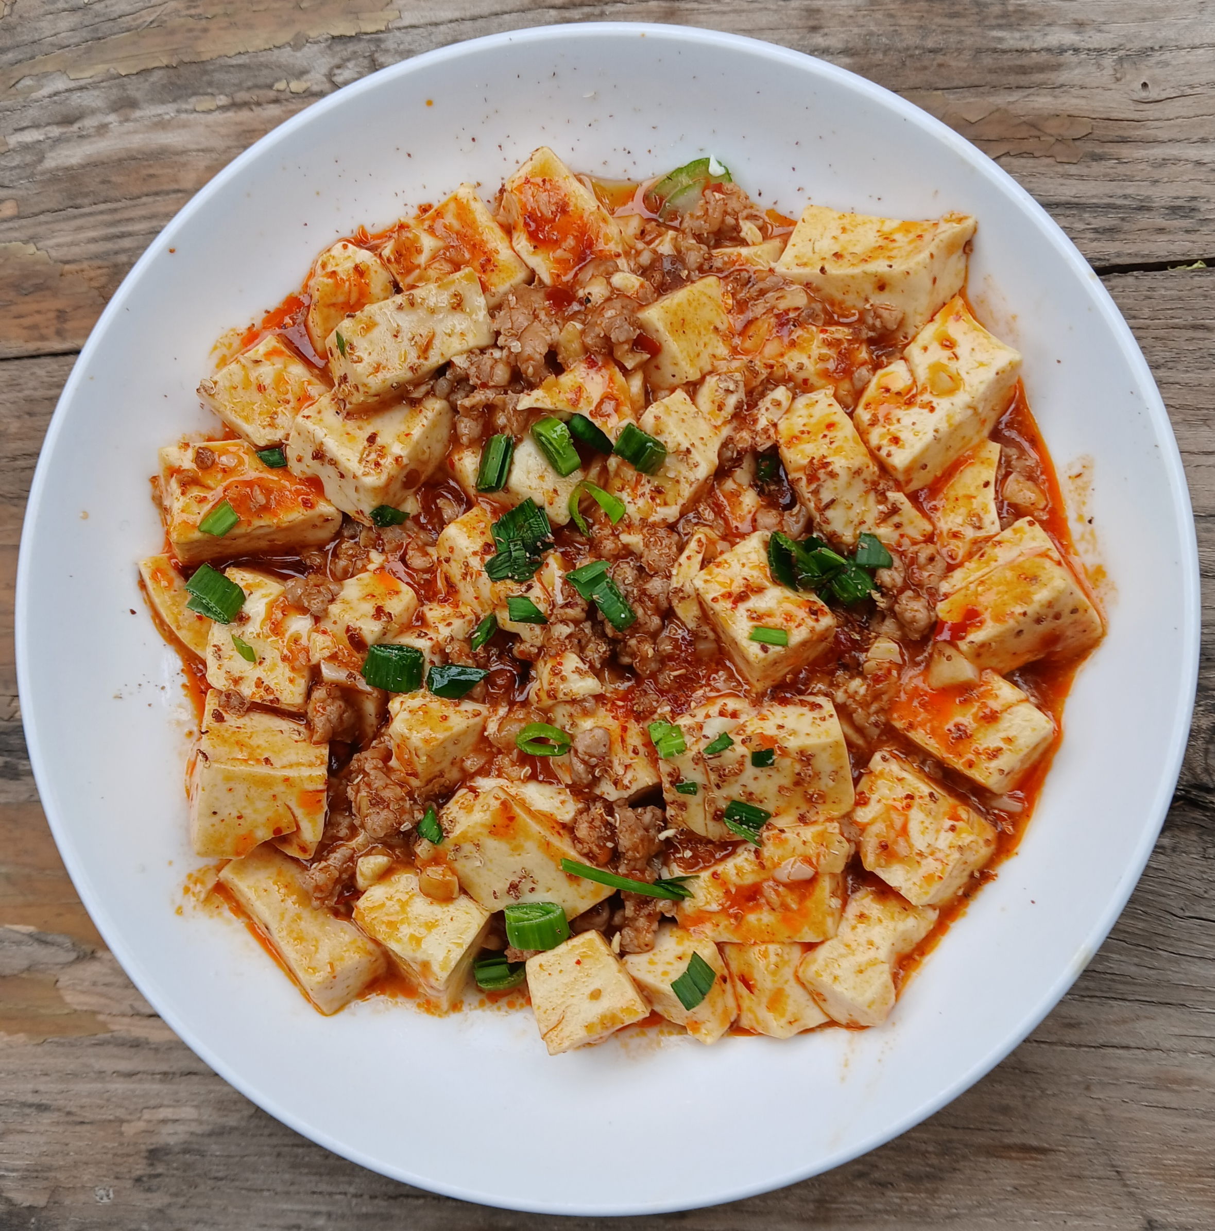
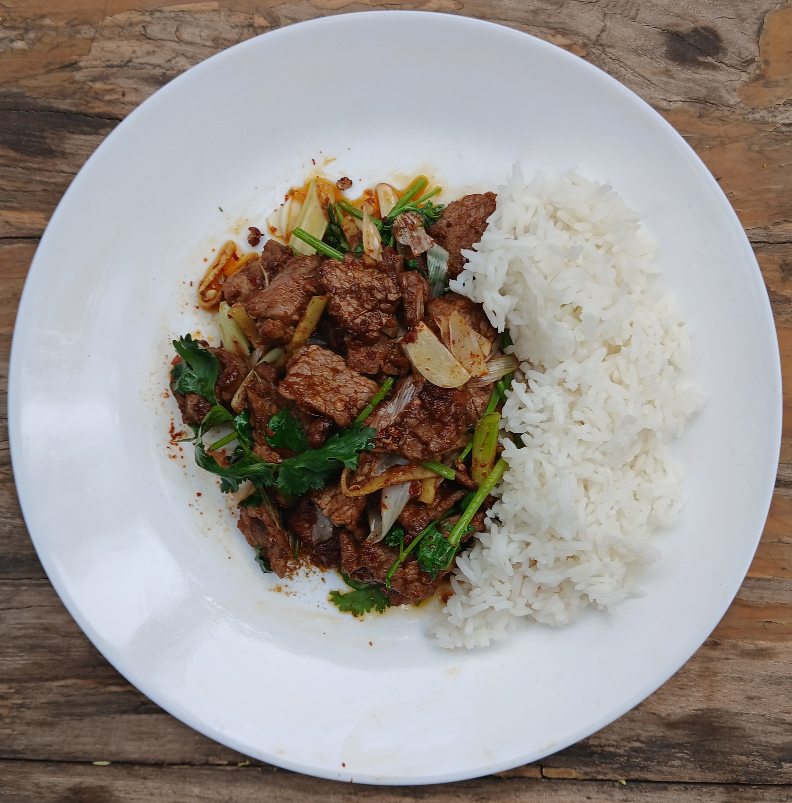
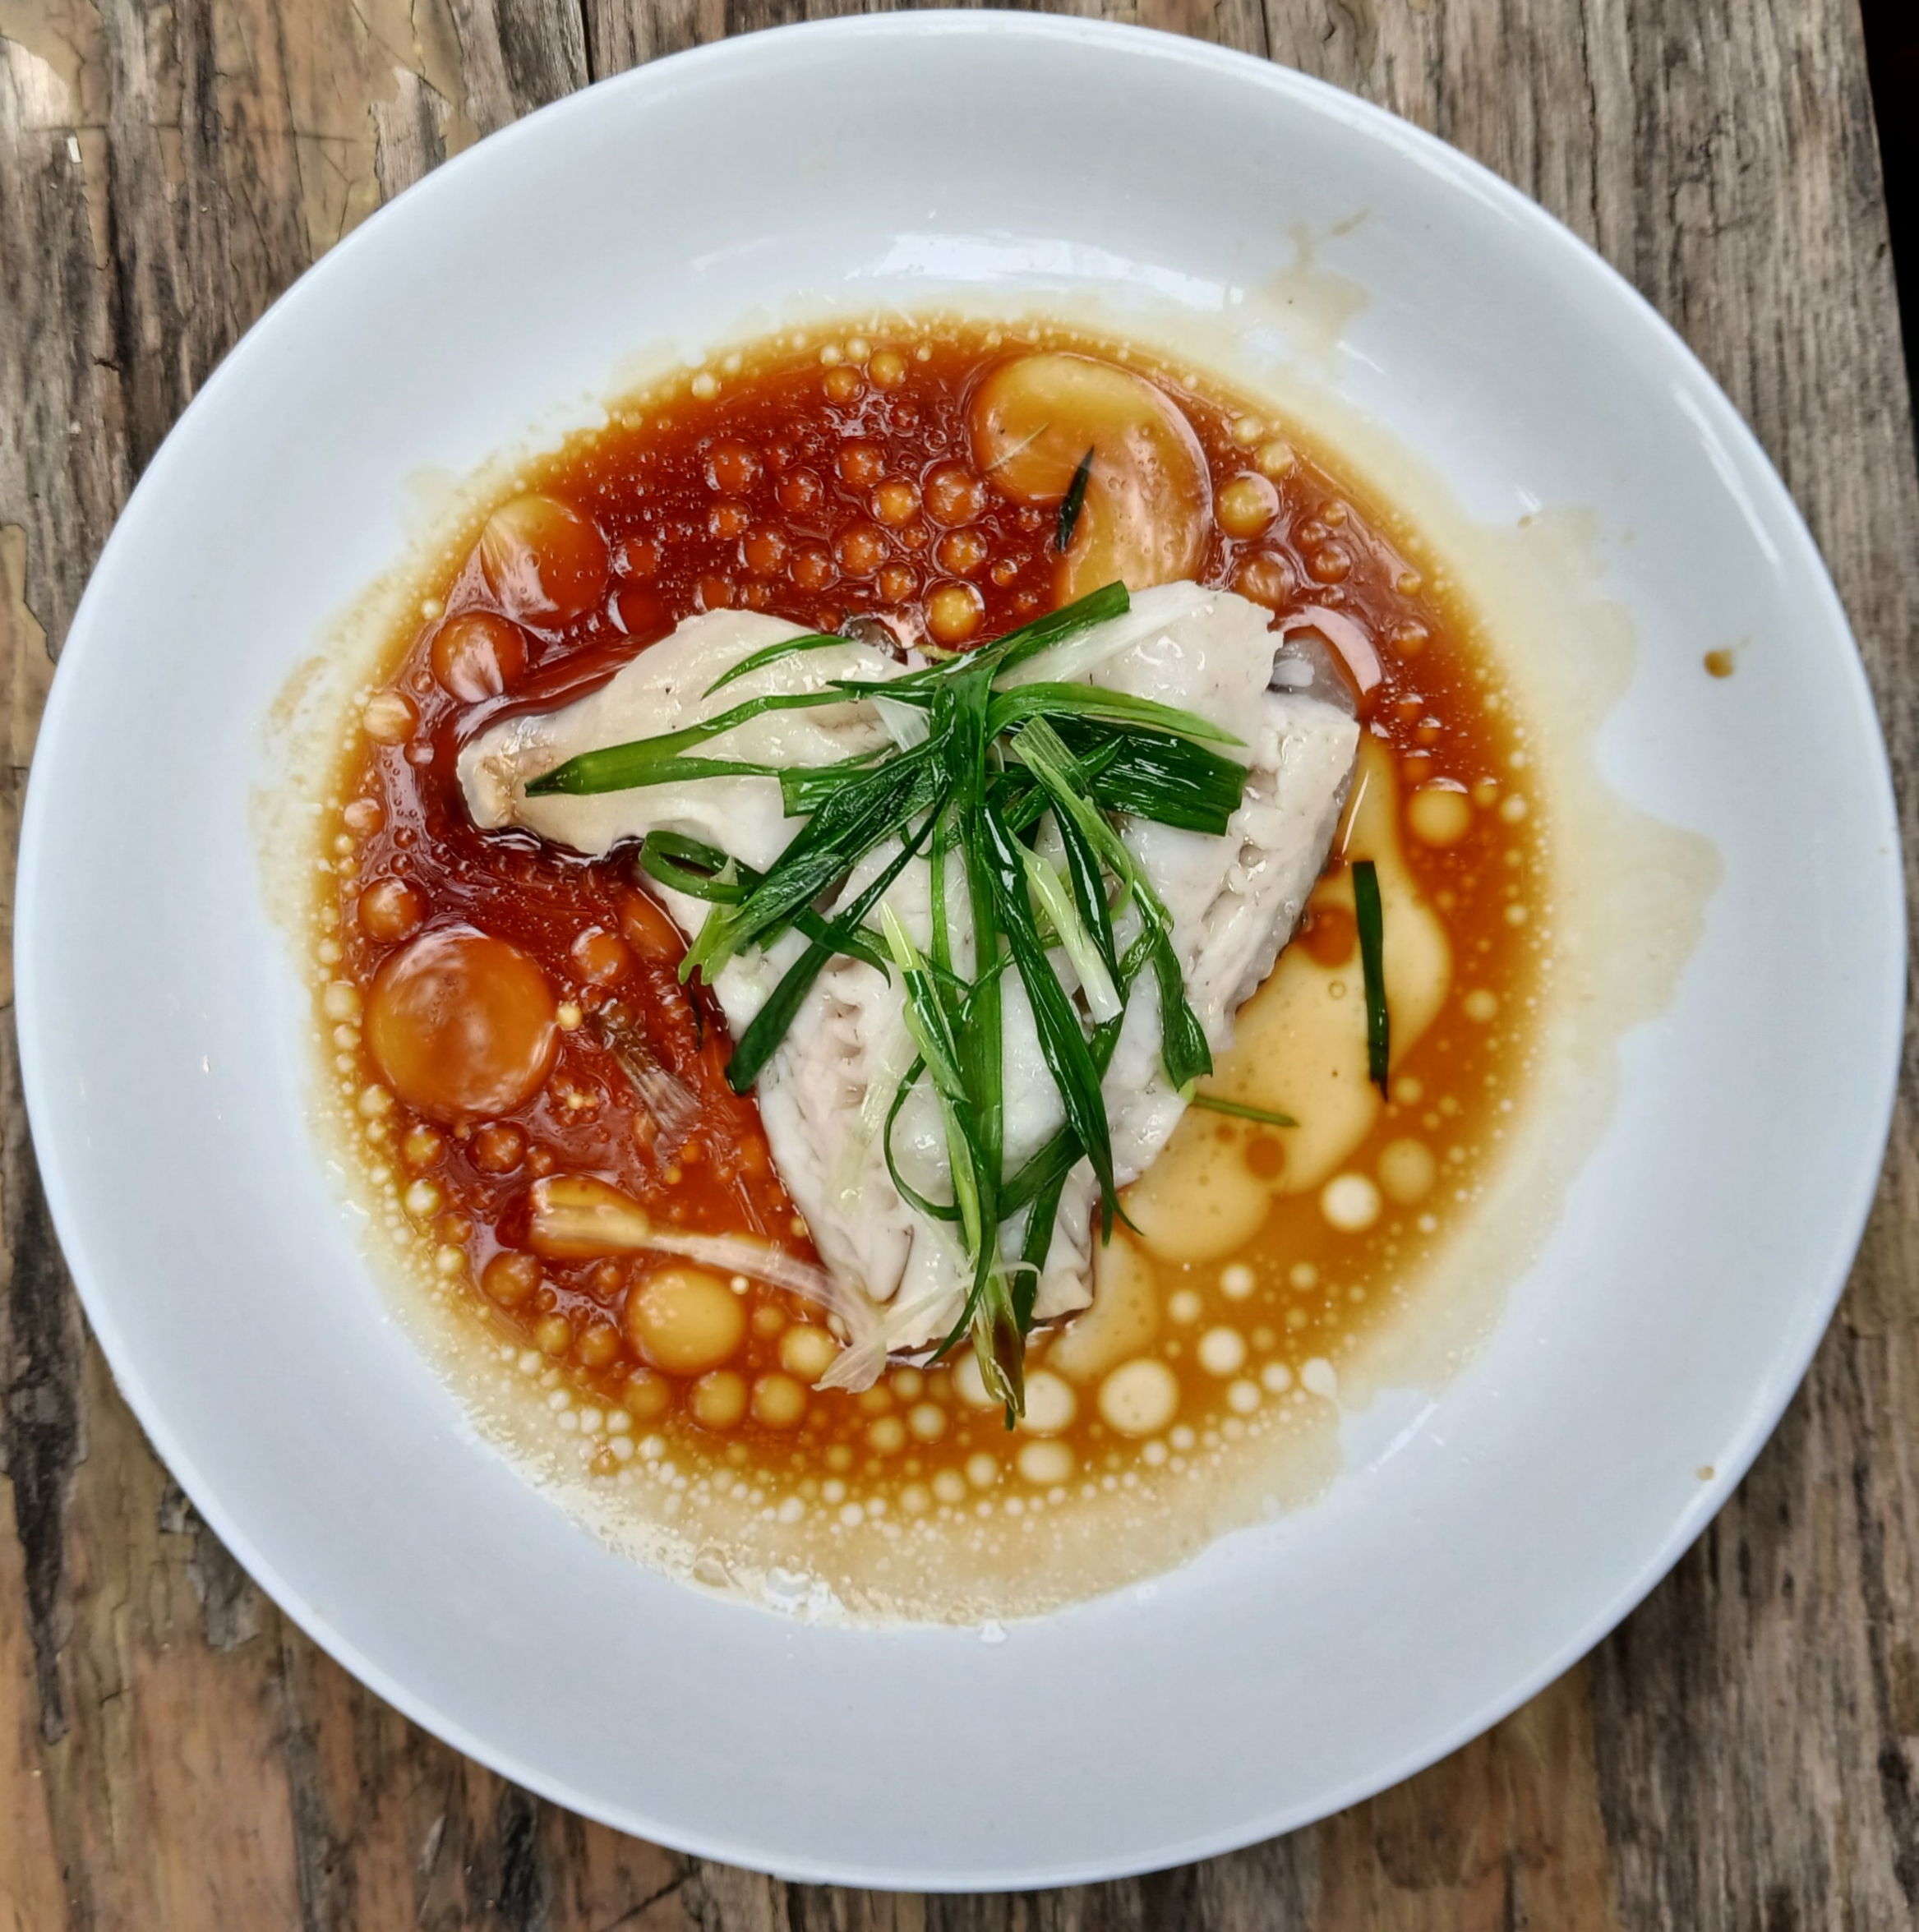
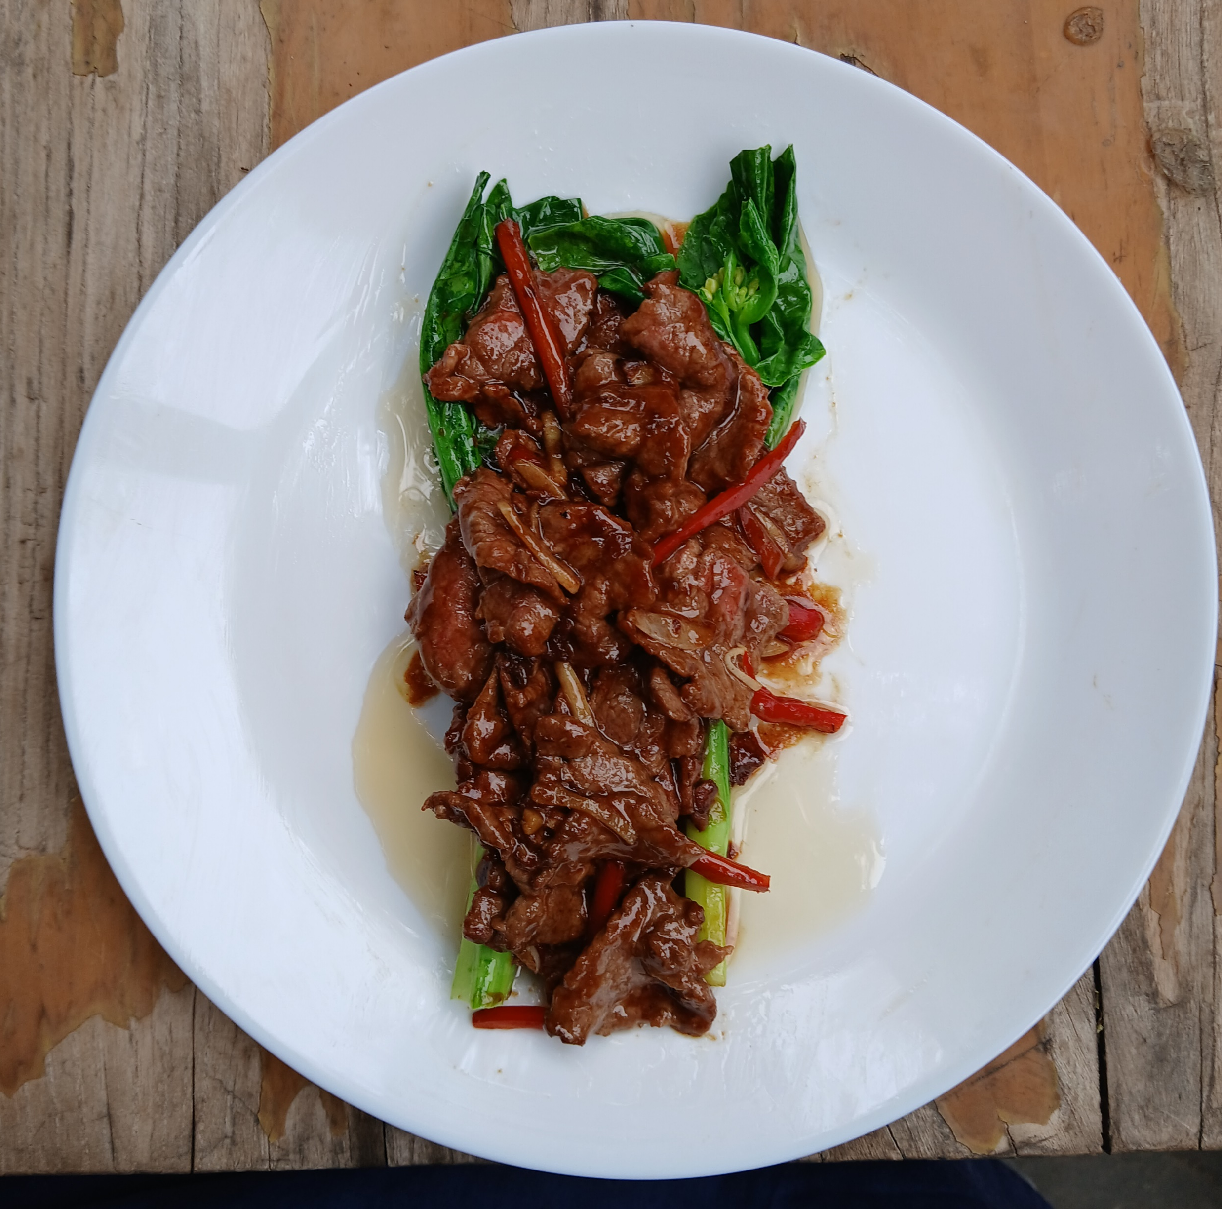



Slide 3
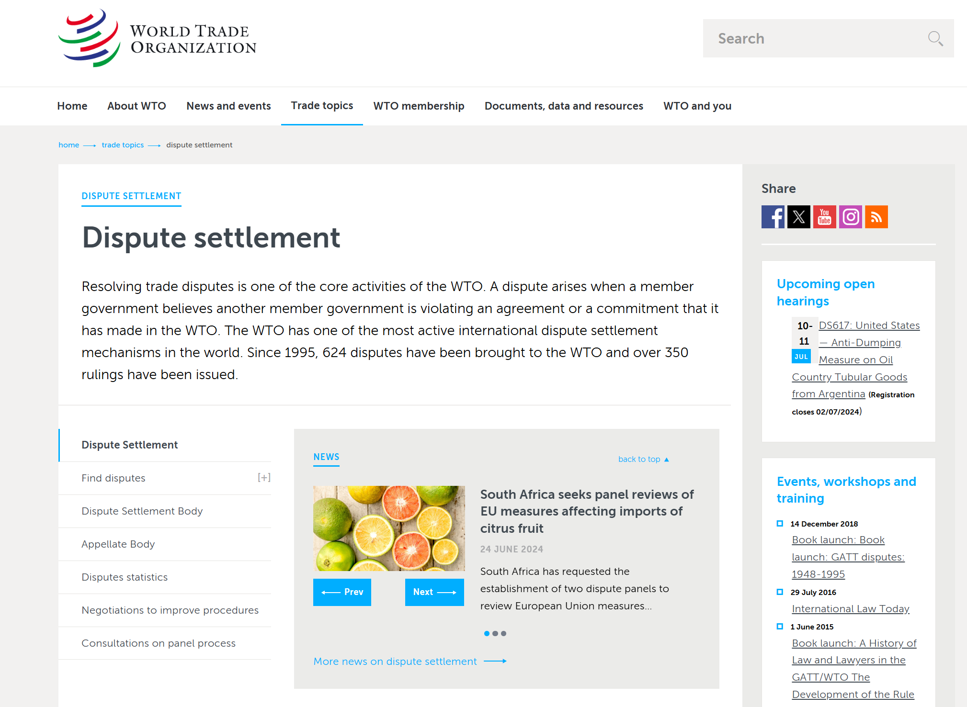

Slide 4
The Principal Phases in the History of the International Trading System
16th to 18th centuries: Mercantilism and the first colonial wave
Late 19th to early 20th century: Generally free trade under British leadership, and the second colonial wave
Between the two world wars: Protectionism and militarism
The Cold War: The “Three Worlds,” with autarky in the East, decolonization in the South, and generally free trade in the West under American leadership (almost entirely in the GATT)
Post-Cold War: The incorporation of nearly all the East and South into the WTO, but a drift back into discrimination and protection
Notes:
Deep Dive: Public Procurement
Day Two Presentation

Slide 5
Topic 1:
Historical Evolution of the International Trading System and its Leadership
Notes:
Deep Dive: Public Procurement
Day Two Presentation

Slide 6
Public Goods
Public goods may be distinguished from ordinary (private) goods insofar as they are:
Non-rival in consumption, and
Are non-excludable.
Examples include roads, national defense, etc.
Public goods tend to under-provided due to the free-rider problem, unless some institution such as government steps in to provide them.
Notes:
Deep Dive: Public Procurement
Day Two Presentation

Slide 7
The Theory of Hegemonic Stability
An open global market is a public good (a special category of goods that are non-excludable and non-rivalrous).
Public goods tend to be underprovided (markets are typically closed in anarchy).
A hegemon has the motive (efficiency) and the means (power) to provide this good.
Historical openness and closure correspond to what the theory predicts.
Notes:
Deep Dive: Public Procurement
Day Two Presentation

Slide 8
Prior to the 19th Century:
Mercantilism and the First Colonial Wave
FR₁
Power = Wealth
A simple syllogism:
Because both power and wealth are finite, and they are interchangeable —
My power depends on my wealth
My wealth comes at your expense
Therefore: My power requires your poverty
UK₁
UK₂
Also Spain, Portugal, the Netherlands, etc.
United Kingdom
France
FR₂
FR₃
UK₃
Trade was seen as another form of zero-sum conflict, and both trade and colonies were often a cause of war.
Notes:
Deep Dive: Public Procurement
Day Two Presentation

Slide 9
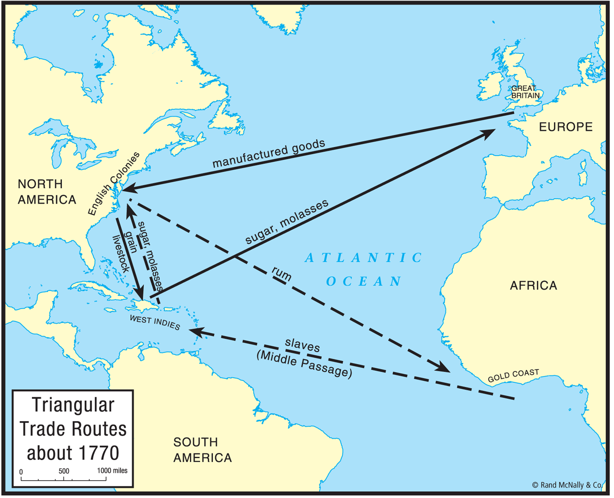
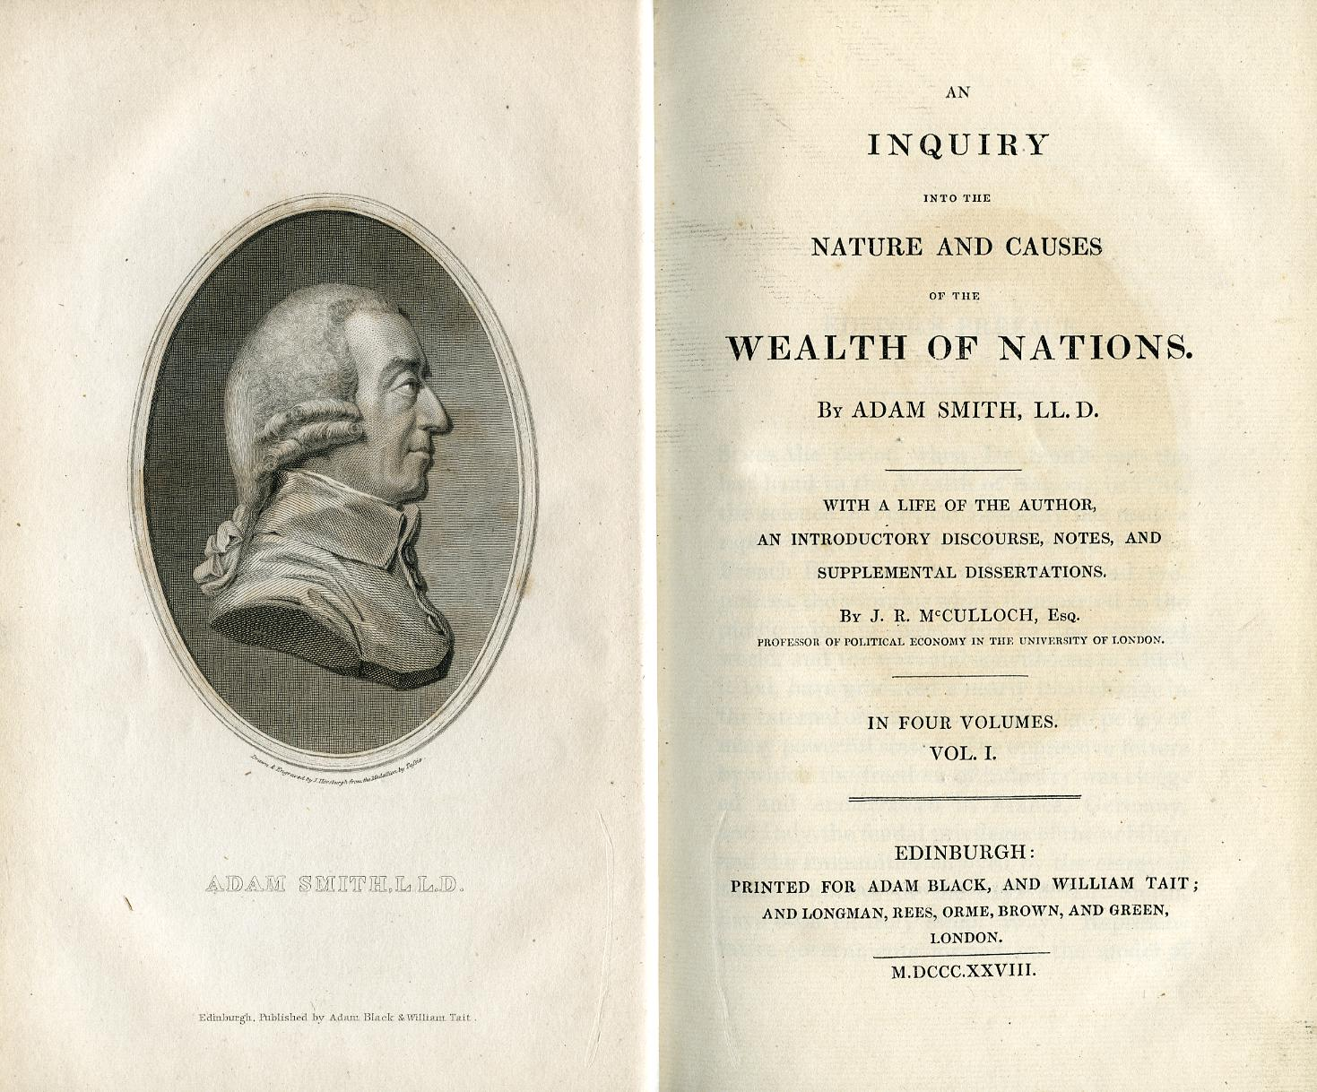
In Smith’s World View:
Wealth = A country’s productivity.
The gains from trade are positive-sum because trade allows all countries to become more productive.
He believed in free trade, and was also opposed to colonialism.
Smith’s pro-trade argument became popular long before his anti-colonial argument was accepted
Notes:
Deep Dive: Public Procurement
Day Two Presentation

Slide 10
British Leadership, Late 19th Century:
Bilateral Treaties with MFN Clauses
A
B
D
China
United Kingdom
E
These developments also coincide with a renewed scramble for colonies (especially in Africa) in the second colonial wave.
The first major steps in transforming theory into practice were the repeal of the Corn Laws (1846) and negotiation of the Cobden-Chevalier Treaty with France (1860).
United States
C
Notes:
Deep Dive: Public Procurement
Day Two Presentation

Slide 11
System Falls Apart after World War I and the Start of the Great Depression in 1929
A
B
D
China
United Kingdom
Countries stop negotiating market-opening treaties, and violate the existing treaties by erecting high tariff barriers. Some also negotiate “clearing agreements” that depend more on the state than the market to determine outcomes.
E
United States
C
Notes:
Deep Dive: Public Procurement
Day Two Presentation

Slide 12
U.S. Leadership, 1934-1946:
Reciprocal Trade Agreements with MFN
The United States made important legal reforms in 1923 and 1934 that made the negotiation of this network possible.
A
B
The major difference between these agreements and today’s FTAs is in the MFN clauses.
China
D
United States
United Kingdom
E
Note that the ITO never came into effect because the U.S. Congress would not approve the Havana Charter of this organization.
This is followed by extension of MFN treatment to all U.S. partners in 1942, and negotiation of the GATT (and the ITO) in 1947.
F
C
Notes:
Deep Dive: Public Procurement
Day Two Presentation

Slide 13
1934-1939: Trade Agreements as a Prelude to War
Countries Reaching Clearing Agreements with Germany in Underline;
German Commercial Treaty Partners and/or Military Alliances in BOLD CAPITALS
 | Allied and Related States
 | Combatants | Occupied by Axis | Declaration of War Only | Neutrals | Axis Powers
Trade Agreement Partners of the United States by 1943 | Major: Other: Canada Brazil U.K. Mexico | Belgium Czechoslovakia France Luxembourg Netherlands | Argentina Honduras Colombia Iran Costa Rica Nicaragua Cuba Peru Ecuador Turkey El Salvador Uruguay Guatemala Venezuela Haiti | Iceland Sweden Switzerland | FINLAND
All Other States | Major: Other: China Australia SOVIET UNION New Zealand South Africa | Denmark Lithuania Estonia Norway Ethiopia Philippines Greece Poland Latvia YUGOSLAVIA | Bahrain Morocco Bolivia Nepal Chile Oman Domin. R. Panama Egypt Paraguay Iraq Saudi Arabia Kuwait Syria Lebanon Tunisia Liberia | Afghanistan Ireland Portugal Spain Tibet Yemen | Major: Other: Germany AUSTRIA ITALY BULGARIA JAPAN CROATIA HUNGARY ROMANIA SLOVAK REP. Thailand
Notes:
Deep Dive: Public Procurement
Day Two Presentation

Slide 14
U.S. Leadership, 1947-c.1970:
The Early GATT Period
Charles De Gaulle blocked British membership in the EEC in 1963, but the British eventually joined in 1973 and completed the transformation of the G-2 from a Washington-London to a Washington-Brussels partnership.
China
A
B
D
United States
C
UK
E
EEC
F
Notes:
Deep Dive: Public Procurement
Day Two Presentation

Slide 15
U.S. Leadership, c.1970-1994:
The Late GATT/Early FTA Period
Throughout the GATT period, reaching a transatlantic consensus was both necessary and sufficient to conclude a round.
That was equally true for the Kennedy (1962-1967), Tokyo (1972-1979), and Uruguay (1986-1994) rounds.
When USTR Mickey Kantor, EU Trade Commission Leon Brittan, and GATT DG Peter Sutherland (Irish) solved the Uruguay Round in 1993 it was the final act in North Atlantic leadership.
The demise of the G-2’s power was not fully apparent until the epic fail at Cancún in 2003. Transatlantic agreement is no longer sufficient to solve a round, and it may not even be necessary.
E
China
A
B
United States
C
EU
F
D
Notes:
Deep Dive: Public Procurement
Day Two Presentation

Slide 16
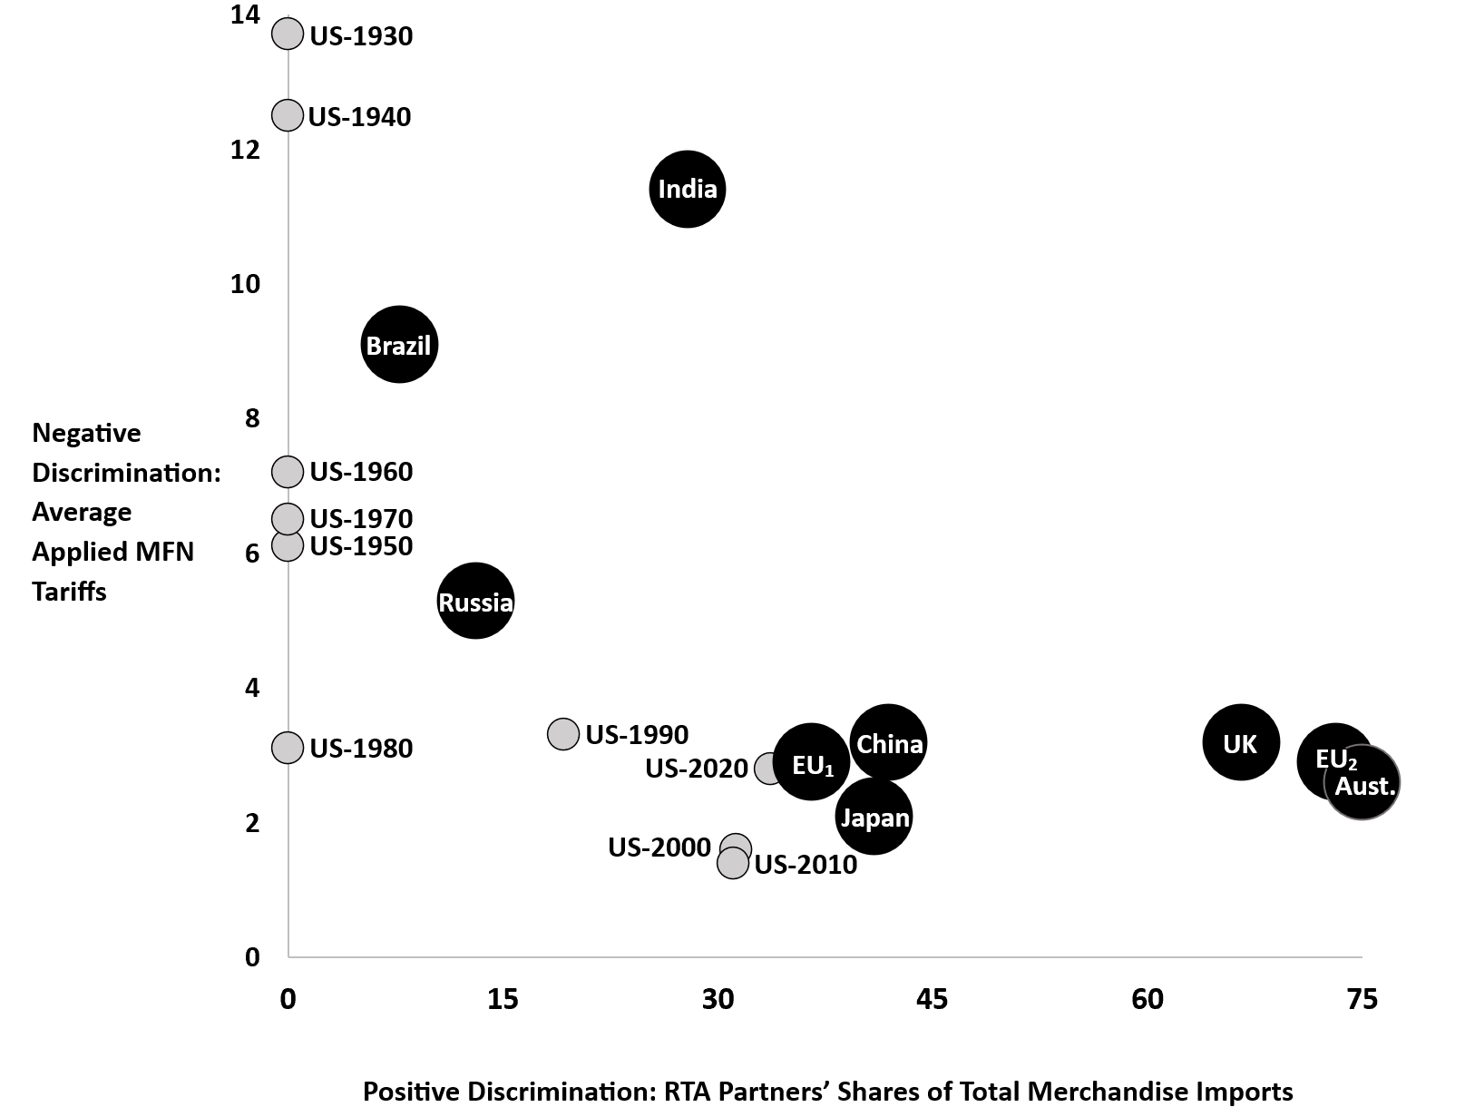
Rising Discrimination, 1930s to 2020

Slide 17
The Rising Number of Total RTAs
Notes:
Deep Dive: Public Procurement
Day Two Presentation

Slide 18
The Rising Number of Total RTAs
These raw numbers tell only part of the story, because
They do not tell us how big any given pair (or group) is, nor
Whether any given agreement is meant as a complement or a substitute for multilateralism.
Notes:
Deep Dive: Public Procurement
Day Two Presentation

Slide 19
U.S. Leadership after 2003:
Can FTAs Revive Multilateralism?
This might actually have worked, if the U.S.-E.U. (TTIP) and U.S.-Japan (TPP) negotiations started in the Obama administration set new precedents for trade agreements in an environment of competitive liberalization – but then came Brexit and Trump.
B
A
E
C
United States
China
Japan
We are now left wondering whether the renegotiated NAFTA (USMCA) might form the new template for mercantilist FTAs by making these networks exclusive.
EU
D
F
Notes:
Deep Dive: Public Procurement
Day Two Presentation

Slide 20
Trade Agreements Have Become a Part of the Rivalry between the United States and China
 |  | United States
 |  | Agreement in Effect | Negotiations Suspended | Agreement Not Approved (TPP) | Negotiations Launched But Failed | No Plans
China | Agreement in Effect | Australia Nicaragua Chile Peru Costa Rica Singapore Korea | Japan | Brunei Malaysia New Zealand Vietnam | Ecuador Qatar Kuwait | Cambodia Mauritius Georgia Myanmar Hong Kong Pakistan Iceland Philippines Indonesia Taiwan Laos Thailand Macau Saudi Arabia Maldives Switzerland
 | Under Active Negotiation | Bahrain Oman Israel Panama |  |  | United Arab Emirates | Moldova Palestine Norway Sri Lanka
 | Negotiations under Study | Colombia |  |  |  | Bangladesh Nepal Fiji Papua New G. Mongolia
 | Failed or Not Launched | Canada Mexico |  |  |  | India
 | No Plans | Domin. Rep. Honduras El Salvador Jordan Guatemala Morocco | European Union Kenya United Kingdom |  | Botswana Namibia Eswatini South Africa Lesotho | [All other countries that are not actual or potential FTA partners]
Notes:
Deep Dive: Public Procurement
Day Two Presentation

Slide 21
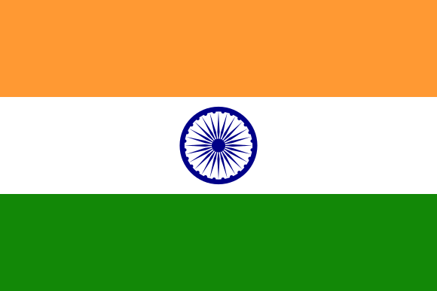
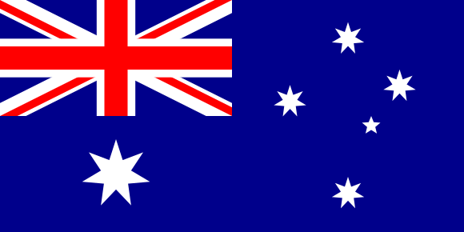
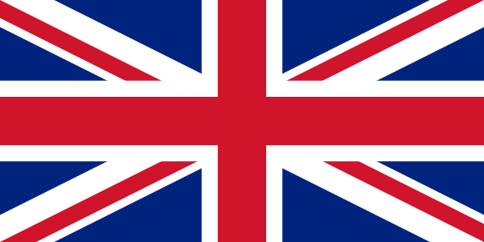
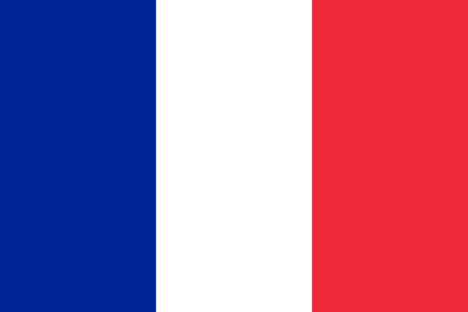
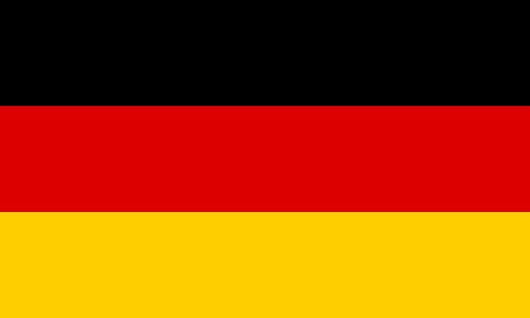
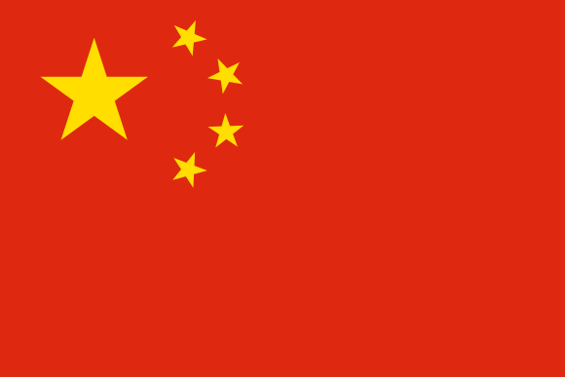
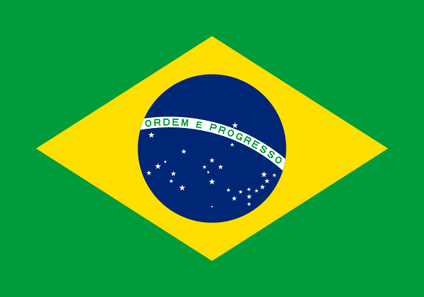
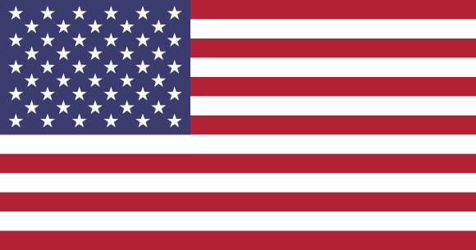
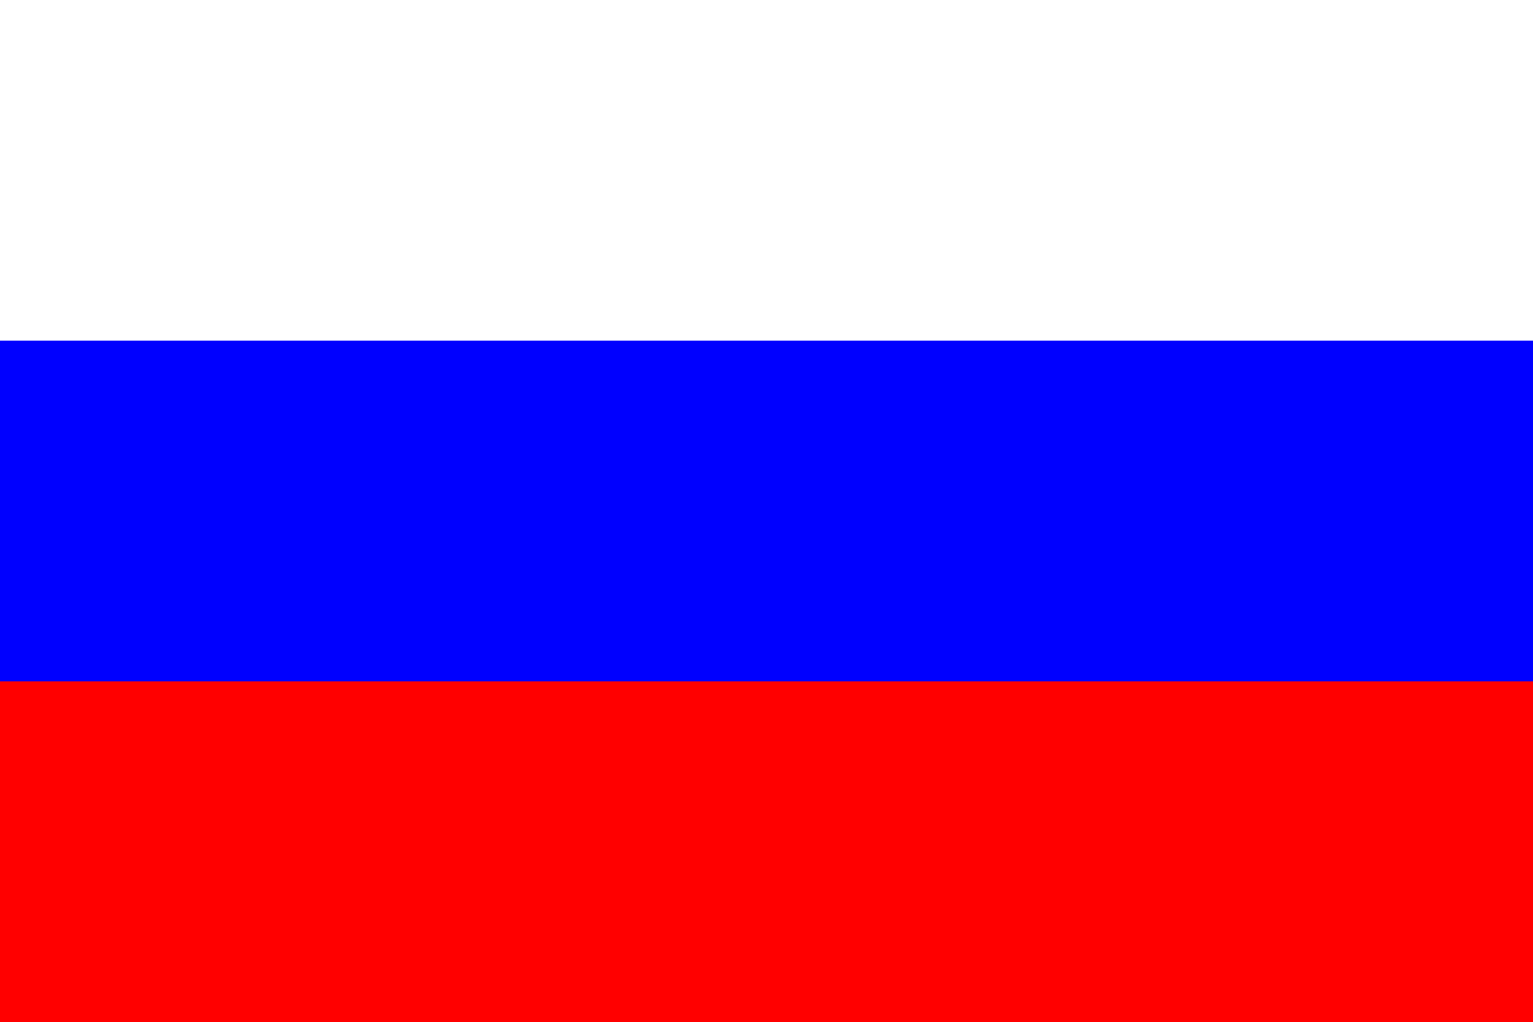
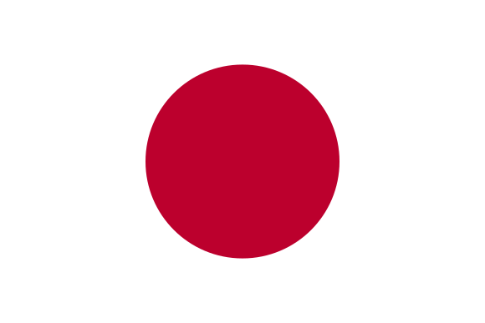
The Ten Great Powers

Slide 22
RTAs among the Ten Great Powers
Common Market
Free Trade Agreement
Talks Failed, Stalled, or Incomplete

Slide 23
Russia’s Missing RTAs with Great Powers
No RTA
Talks Failed, Stalled, or Incomplete

Slide 24
China’s Missing RTAs with Great Powers
No RTA
Talks Failed, Stalled, or Incomplete

Slide 25
America’s Missing RTAs with Great Powers
No RTA
Talks Failed, Stalled, or Incomplete

Slide 26
The European Union’s Missing RTAs
No RTA
Talks Failed, Stalled, or Incomplete

Slide 27
Different Patterns of Great-Power RTA Negotiations
The Most Enthusiastic RTA Negotiators
The One with the Most Stalled or Failed Talks
Traditionally Skeptical, Getting More Active
The Fewest RTAs with Other Great Powers

Slide 28
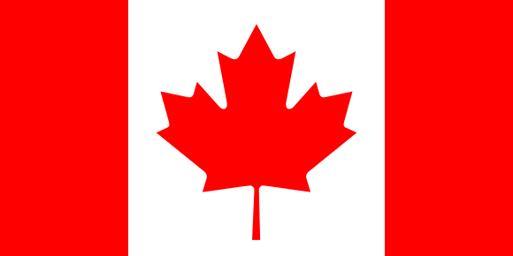

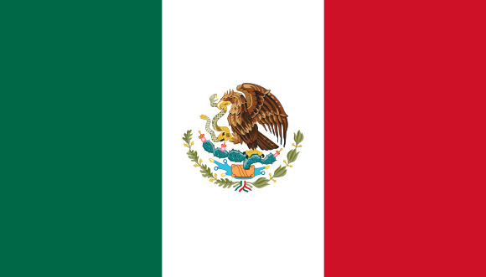
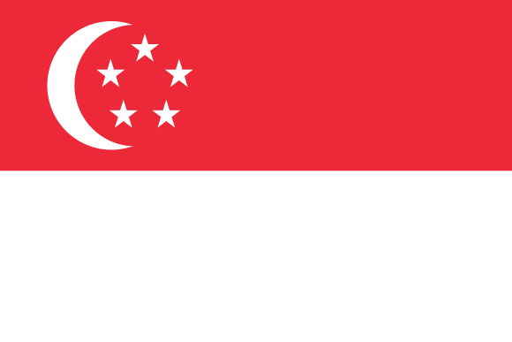
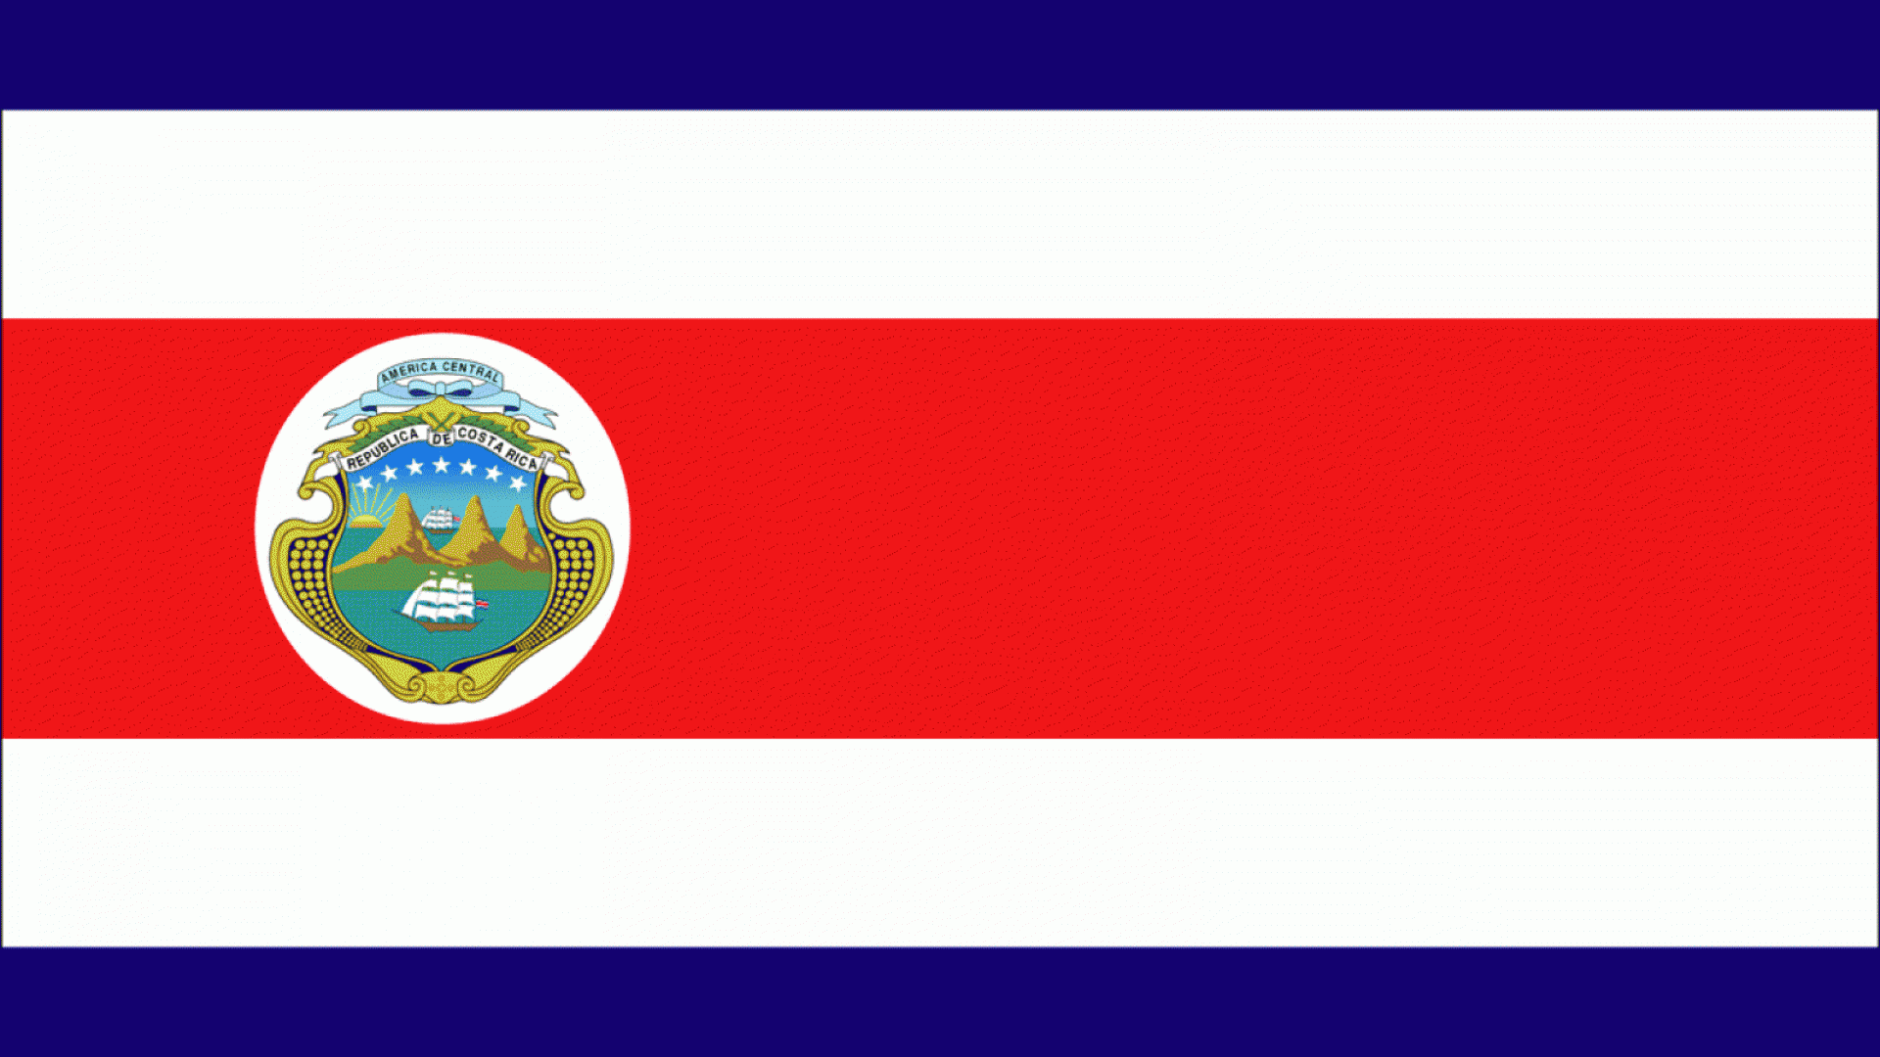
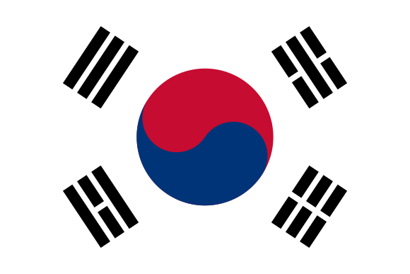
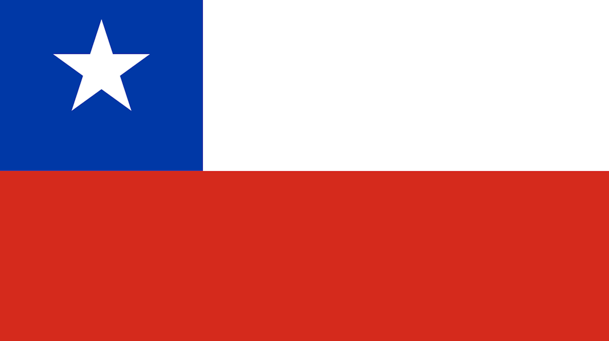
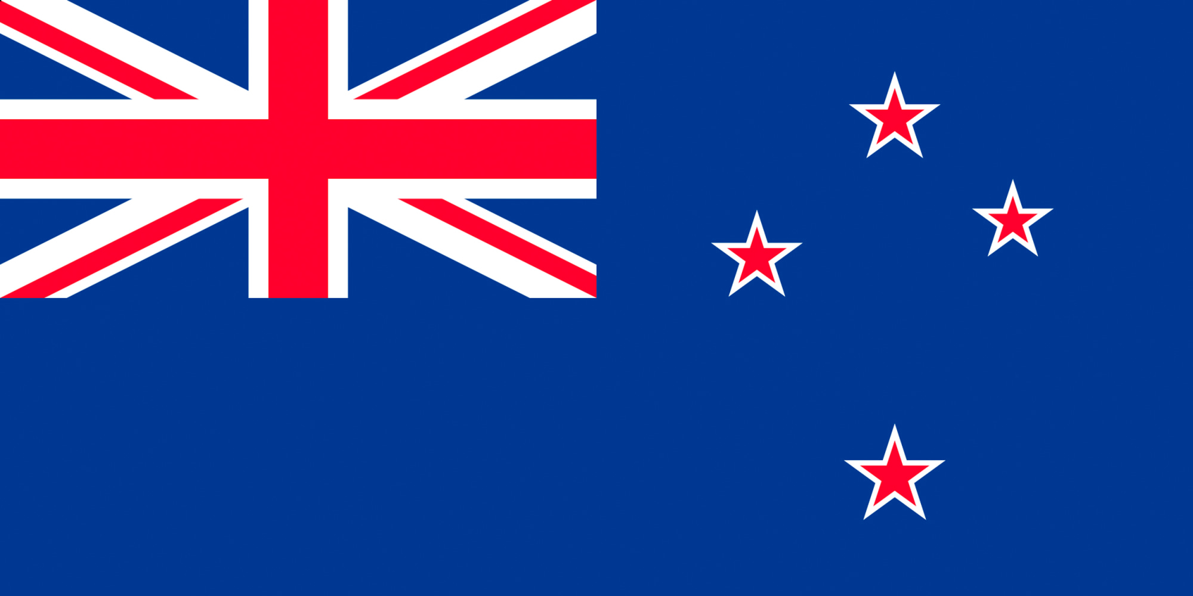
RTAs of the More Active Middle Powers
Canada: 15
Switzerland: 35
Mexico: 23
Singapore: 28
Costa Rica: 15
Republic of Korea: 23
New Zealand: 15
Chile: 31

Slide 29
Topic 33:
Which Countries Have the
Most Influence in the WTO?
Notes:
Deep Dive: Public Procurement
Day Two Presentation

Slide 30
The Unwritten Norms of WTO Leadership
All countries are equal, but some are more equal than others
Eight countries (formerly seven) have disproportionate appointments to the top positions
Certain roles are off-limits to E.U., U.S., or Chinese diplomats
Some positions are traded off sequentially by (a) developing and developed and (b) developing regions
Whoever chairs the Dispute Settlement Body one year will chair the General Council the next year
Notes:
Deep Dive: Public Procurement
Day Two Presentation

Slide 31
The Eight Large Economies

Slide 32
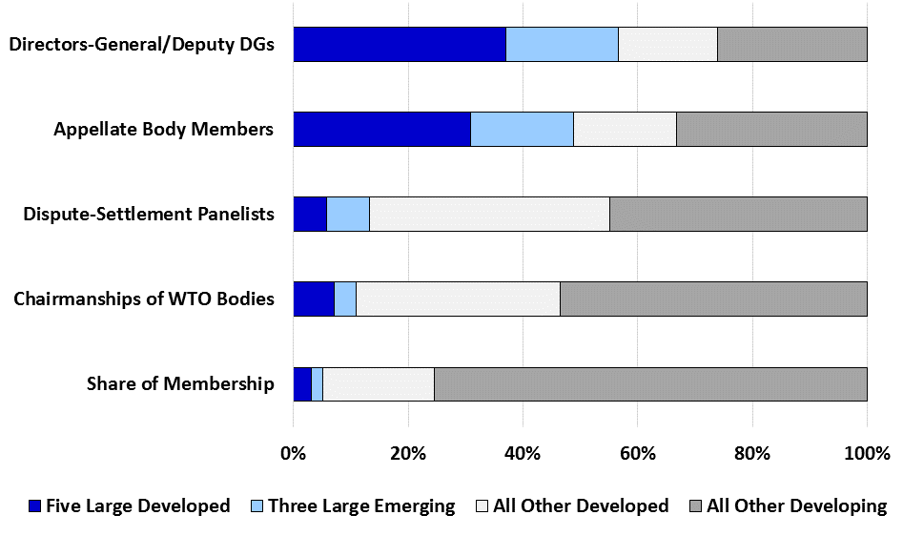
The WTO Roles in which the
Big Eight Are Over-Represented

Slide 33
Which of the Ten Great Powers Were Influential in the GATT Era?

Slide 34
Some Could Not Be Influential Until They Acceded

Slide 35
GATT Was Initially a G-2 Arrangement of the Anglo-Americans …

Slide 36
… to Which India Became Informally the Principal Representative of Developing Country Influence …

Slide 37
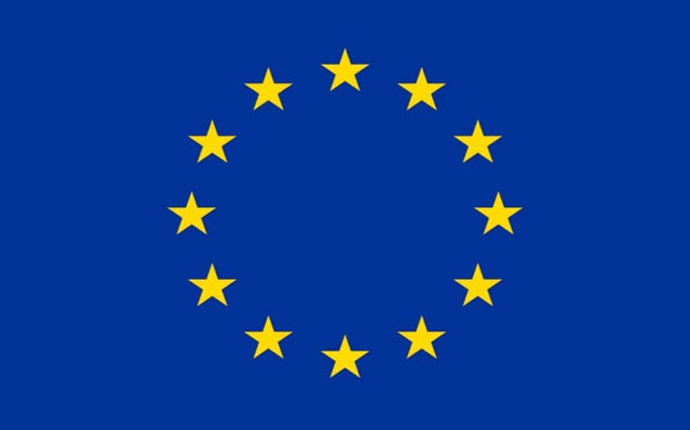
… With the U.K. Position in the G-2 Being Taken over by the European Union (Under Various names) …

Slide 38
… Being a Key Part of the Quad …

Slide 39

… Which Were the Largest Countries Usually Represented in the Green Room.

Slide 40
Depending on the Issues, the Countries in the Green Room Might Align North vs. South …
Intellectual Property Rights and Investment

Slide 41
… Or Could Choose Different Alignments with Varying Degrees of Ambition.
Most Protective on Agricultural Subsidies
Most Ambitious on Agricultural Subsidies

Slide 42
What Are the Main Differences between the GATT and WTO Leadership Styles?

Slide 43
First, the Green Room Is Gone.
Countries Prefer Issue-Based Coalitions.

Slide 44
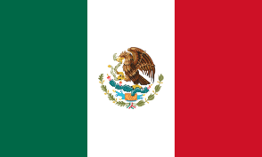
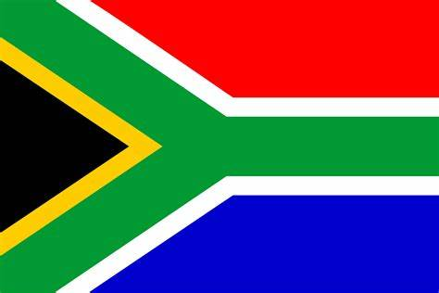
Second, those Coalitions Are More Often North-South.

Slide 45
Third, Accessions Have Expanded the Leadership Group to Eight Large Economies

Slide 46
Third, Accessions Have Expanded the Leadership Group to Eight Large Economies

Slide 47
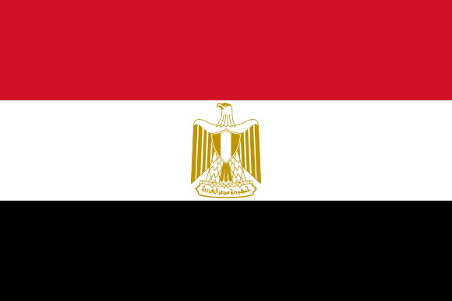
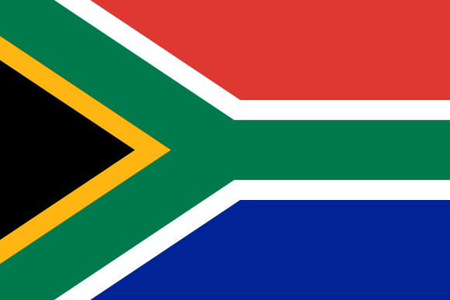
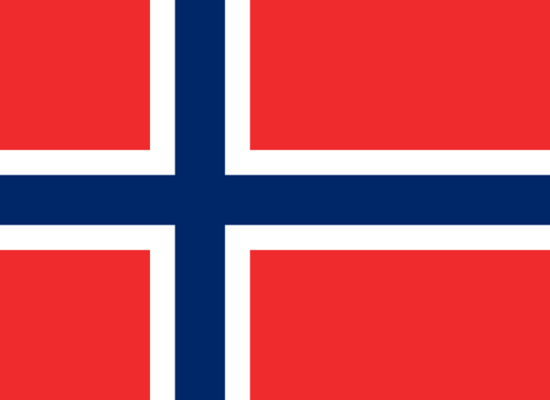
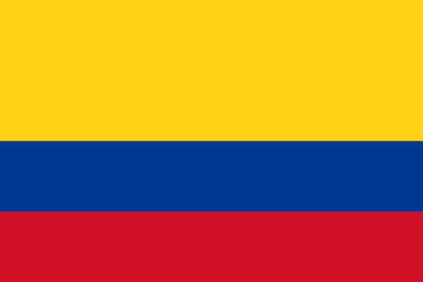

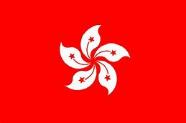
The WTO Is an Institution in Which the
Middle Powers Play an Important Role
(Though Decidedly Less Influential than the Big Eight)

Slide 48
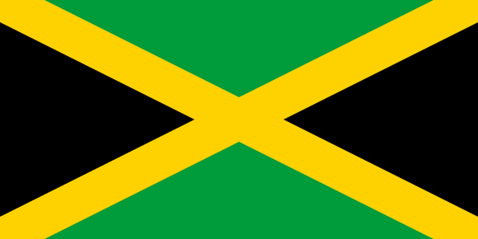
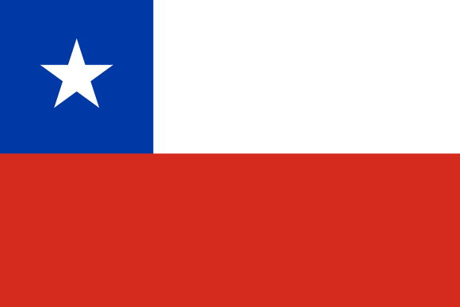

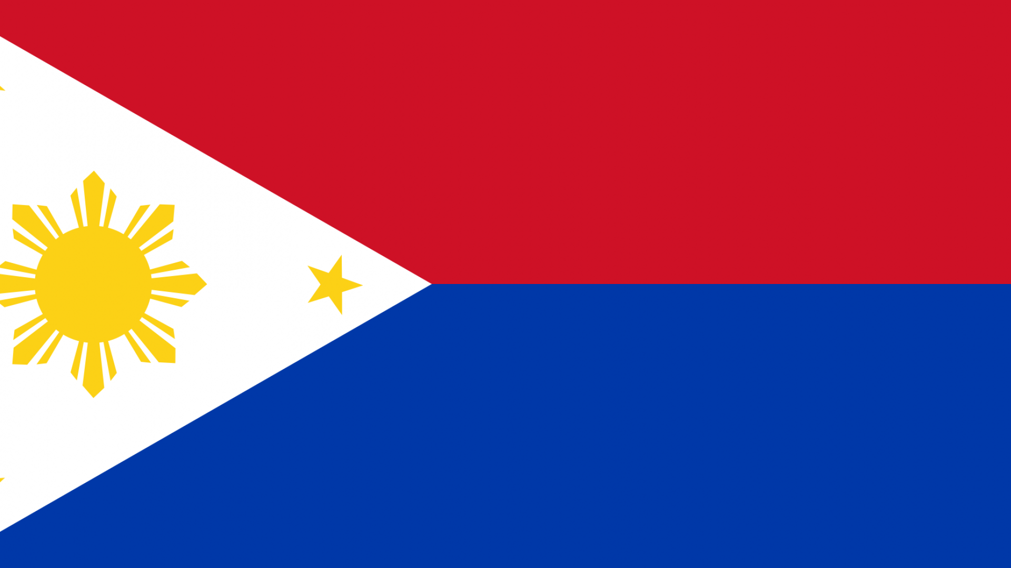

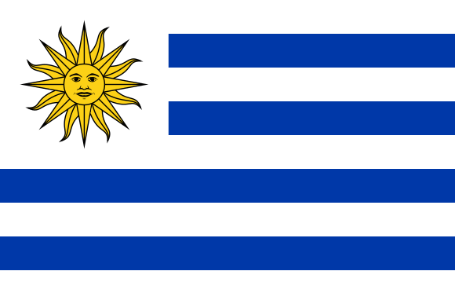
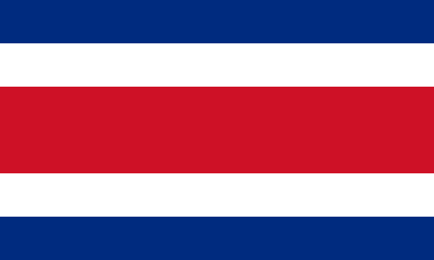
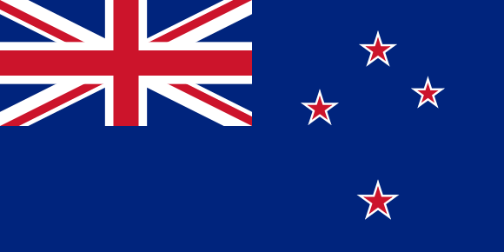
It Is Also a Place Where Several Smaller Countries Are Often Said to “Punch Above Their Weight”

Slide 49
Topic 4:
Coalitions in the WTO
Notes:
Deep Dive: Public Procurement
Day Two Presentation

Slide 50
Decision-Making in the
GATT versus the WTO
Both are based on consensus decision-making, but that works out differently when:
The GATT had an incomplete membership operating in a system of code reciprocity and the green room, but
The WTO is nearly universal, is built around a single undertaking, and operates largely through coalition diplomacy.
Notes:
Deep Dive: Public Procurement
Day Two Presentation

Slide 51
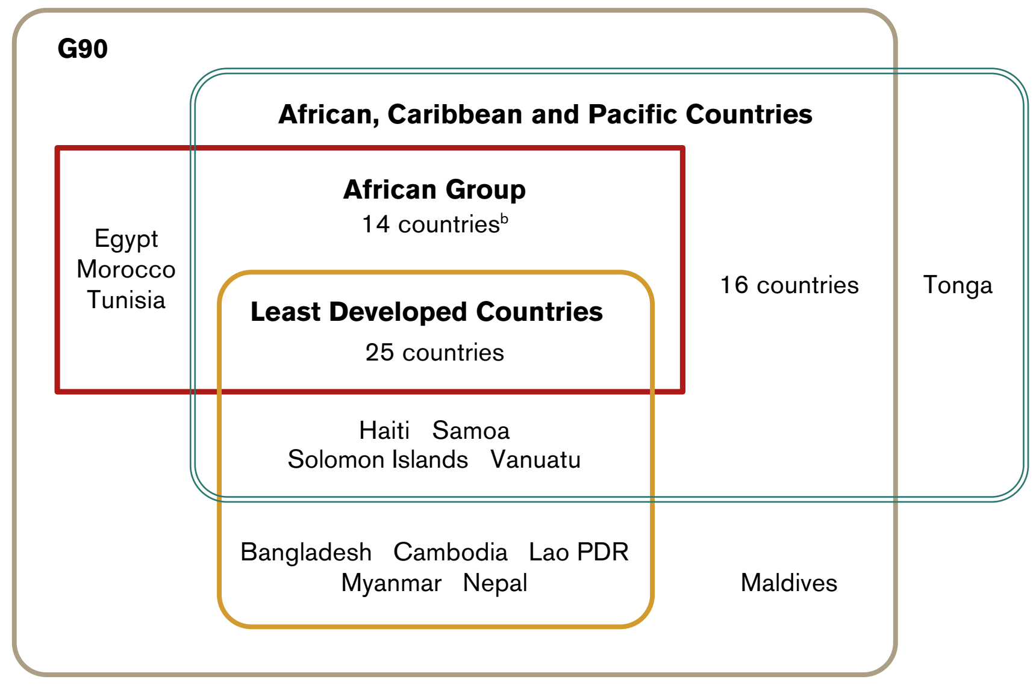
Major Developing Country Coalitions in the WTO
Notes:
Deep Dive: Public Procurement
Day Two Presentation

Slide 52
Notes:
Deep Dive: Public Procurement
Day Two Presentation

