Slide 1
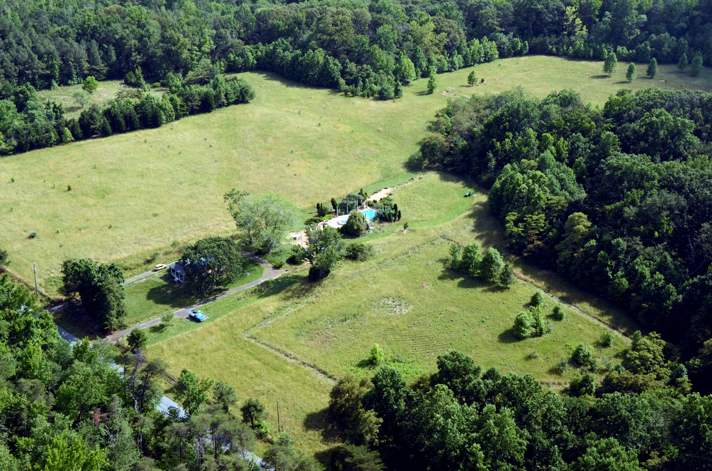
Trade in Agriculture
Craig VanGrasstek

Slide 2
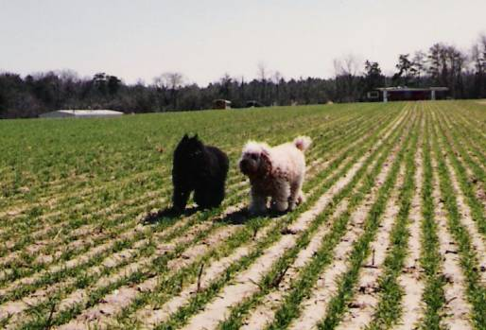
A Few Questions to Frame Our Discussion
How many of you —
Grew up on and/or currently live on a farm?

Slide 3
A Few Questions to Frame Our Discussion
How many of you —
Grew up on and/or currently live on a farm?
Have at least one parent who did that?

Slide 4
A Few Questions to Frame Our Discussion
How many of you —
Grew up on and/or currently live on a farm?
Have at least one parent who did that?
Have at least one grand-parent who did that?

Slide 5
A Few Questions to Frame Our Discussion
Can we conclude from these data that the agricultural sector is less important in U.S. trade policy than it is in either China or the world as a whole?
How many of you —
Grew up on and/or currently live on a farm?
Have at least one parent who did that?
Have at least one grand-parent who did that?
Share of Employment in Agriculture, 1992-2022
China
Theory suggests that as farmers become a smaller group, it is easier for them to organize in support of their demands.
World
United States
Source: https://data.worldbank.org/indicator/SL.AGR.EMPL.ZS

Slide 6
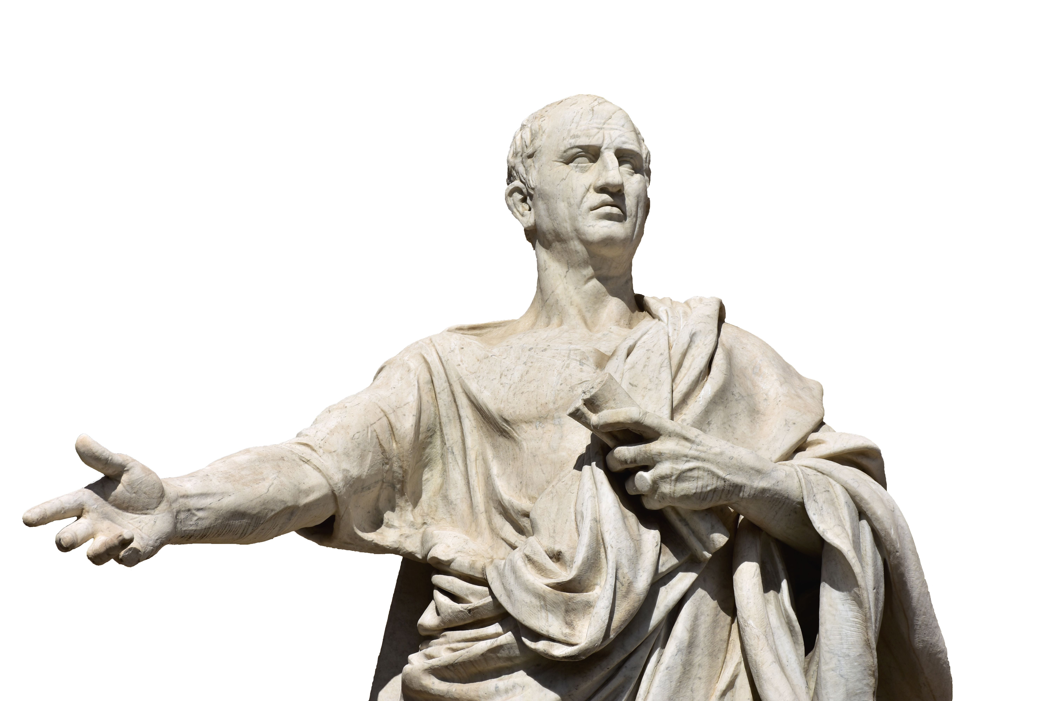

A Few Questions to Frame Our Discussion
How many of you —
Grew up on and/or currently live on a farm?
Have at least one parent who did that?
Have at least one grand-parent who did that?

Slide 7
A Few Questions to Frame Our Discussion
How many of you —
Grew up on and/or currently live on a farm?
Have at least one parent who did that?
Have at least one grand-parent who did that?
Cicero, 106-43 BCE
Confucius (Kongzi), 551-479 BCE

Slide 8
A Few Questions to Frame Our Discussion
Give me your best estimates of these numbers:
Agricultural raw materials (grains, meat, cotton, tobacco, etc.) …
… as a share of global trade in goods? ____%
… as a share of Chinese exports? ____%
… as a share of U.S. exports? ____%
… as a share of Australian exports? ____%
… as a share of Brazilian exports? ____?
Agricultural products as a share of
… disputes taken to the WTO Dispute Settlement Body? ____?
… the difficulties in concluding trade agreements? ____?

Slide 9
A Few Questions to Frame Our Discussion
Give me your best estimates of these numbers:
Agricultural raw materials (grains, meat, cotton, tobacco, etc.) …
… as a share of global trade in goods? 1.1%
… as a share of Chinese exports? 0.4%
… as a share of U.S. exports? 1.7%
… as a share of Australian exports? 1.8%
… as a share of Brazilian exports? 4.2%
Agricultural products as a share of
… disputes taken to the WTO Dispute Settlement Body? 36.7%
… the difficulties in concluding trade agreements? Incalculable.
Agricultural liberalization was the origin of the modern trading system (see the British repeal of the Corn Laws in 1846). But it has been more troublesome since then.
Developments attributable to agricultural frictions:
Enactment of the Hawley-Smoot Tariff Act of 1930
Poor Kennedy Round GATT results (1962-1967)
Declining trust in GATT dispute-settlement system
Failed WTO Cancun Ministerial Conference (2003)
Failed WTO “mini-ministerial” (2008)
Agricultural issues almost always have a disproportionately high weight in negotiations over FTAs.

Slide 10
The Economic Transition and Its
Impact on Countries’ Interests

Slide 11
The Economic Transition:
Shares of Global Employment
Services
Agriculture
Source: Calculated from World Bank data at https://data.worldbank.org/indicator/SL.AGR.EMPL.ZS and https://data.worldbank.org/indicator/SL.SRV.EMPL.ZS.

Slide 12
Shares of Employment in
High-Income Countries
Services
Agriculture
Source: Calculated from World Bank data at https://data.worldbank.org/indicator/SL.AGR.EMPL.ZS and https://data.worldbank.org/indicator/SL.SRV.EMPL.ZS.

Slide 13
Shares of Employment in
Least-Developed Countries
Agriculture
Services
Source: Calculated from World Bank data at https://data.worldbank.org/indicator/SL.AGR.EMPL.ZS and https://data.worldbank.org/indicator/SL.SRV.EMPL.ZS.

Slide 14
Agricultural Share of National Exports
Brazil
United States
World
China
Source: Calculated from World Bank data. Based on raw agricultural materials.

Slide 15
The Higher and Sustained
Levels of Agricultural Protection

Slide 16
We (Mostly) Protect Agriculture More
Most countries have significantly higher average applied MFN tariffs on agricultural than on non-agricultural products.
Source: Calculated from WTO, World Tariff Profiles 2022.

Slide 17
Other Unique Aspects of Agricultural Tariffs
By comparison with non-agricultural products, tariffs tend to be not only high but also:
Either unbound in a country’s WTO schedule, or bound at a very high level with lots of water
Subject to tariff-rate quotas
Denominated as specific tariffs or (less often) compound tariffs
Agricultural products are also defined, for WTO purposes, in a somewhat surprising way.

Slide 18
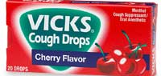
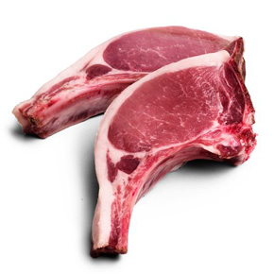
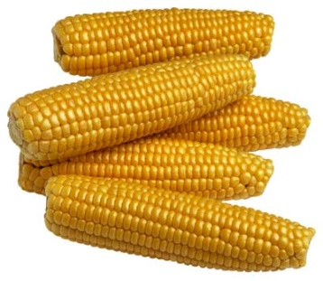
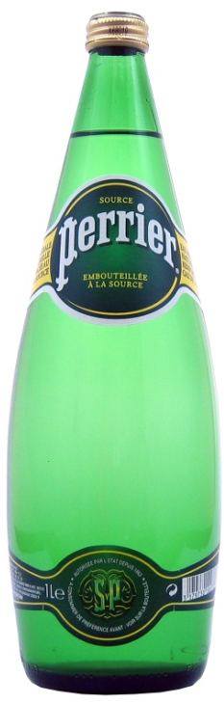
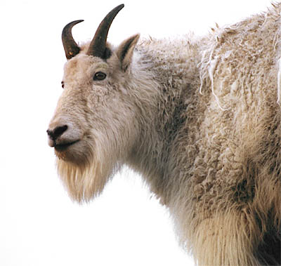

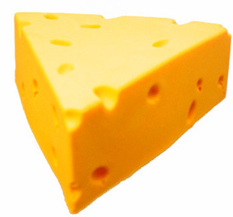
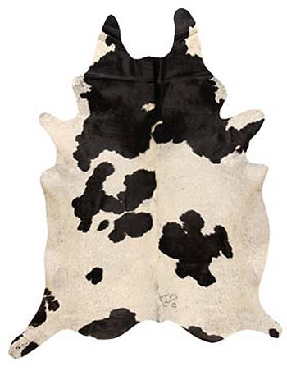
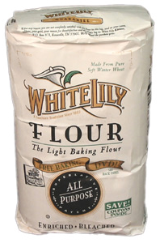
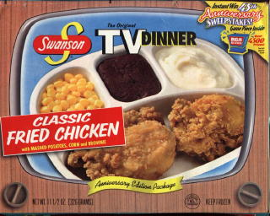
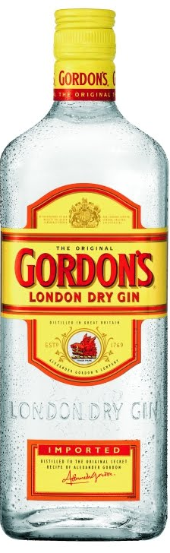

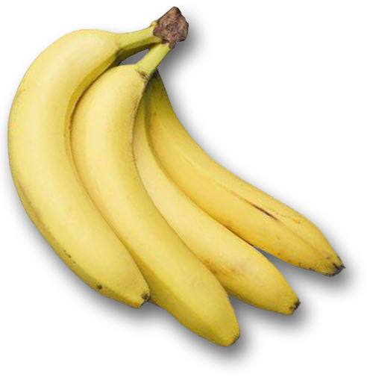

Which of These Are “Agricultural Products”?
All of these products fall within the WTO definition in Annex 1 of the Agreement on Agriculture.

Slide 19
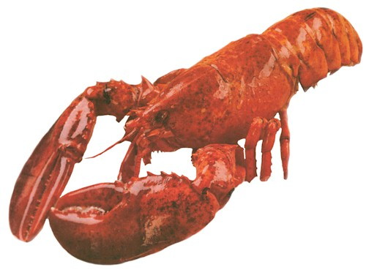
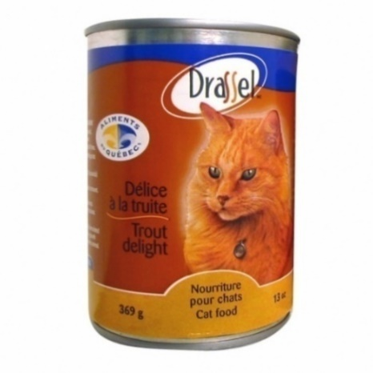
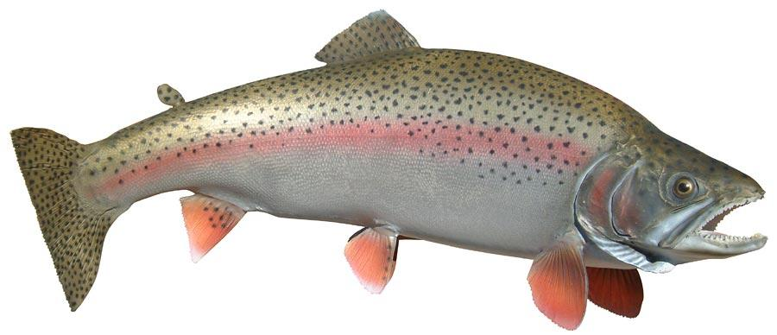
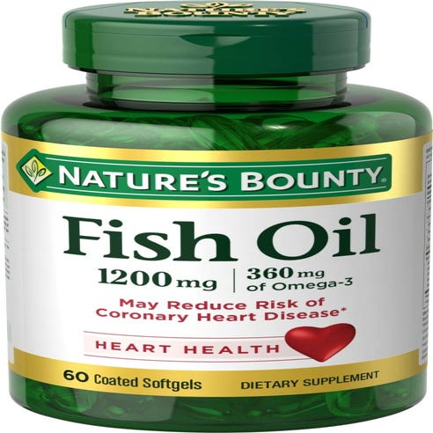
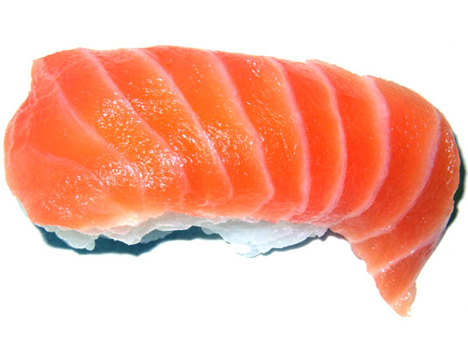
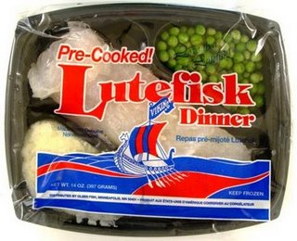
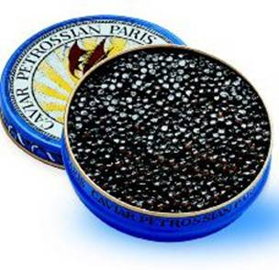

Note However that None of These Are

Slide 20
WTO Definition (Annex 1)
 | HS Chapters 1 to 24 less fish and fish products, plus
 |  | 2905.43 | (mannitol)
 |  | 2905.44 | (sorbitol)
 |  | 33.01 | (essential oils)
 |  | 35.01 to 35.05 | (albuminoidal substances, modified starches, glues)
 |  | 3809.10 | (finishing agents)
 |  | 3823.60 | (sorbitol n.e.p.)
 |  | 41.01 to 41.03 | (hides and skins)
 |  | 43.01 | (raw furskins)
 |  | 50.01 to 50.03 | (raw silk and silk waste)
 |  | 51.01 to 51.03 | (wool and animal hair)
 |  | 52.01 to 52.03 | (raw cotton, waste and cotton carded or combed)
 |  | 53.01 | (raw flax)
 |  | 53.02 | (raw hemp)

Slide 21
Chapters 1-24 of the Harmonized System
1 Live animals
2 Meat and edible meat offal
3 Fish and crustaceans, molluscs and other aquatic invertebrates
4 Dairy produce; birds eggs; natural honey; edible products of animal origin
5 Products of animal origin, not elsewhere specified or included
6 Live trees and other plants; bulbs, roots and the like; cut flowers and ornamental foliage
7 Edible vegetables and certain roots and tubers
8 Edible fruit and nuts; peel of citrus fruit or melons
9 Coffee, tea, maté and spices
10 Cereals
11 Products of the milling industry; malt; starches; inulin; wheat gluten
12 Oil seeds & fruits; misc. grains, seeds & fruits; industrial or medicinal plants; straw & fodder
13 Lac; gums, resins and other vegetable saps and extracts
14 Vegetable plaiting materials; vegetable products not elsewhere specified or included
15 Animal or vegetable fats and oils
16 Preparations of meat, of fish or of crustaceans, molluscs or other aquatic invertebrates
17 Sugars and sugar confectionery
18 Cocoa and cocoa preparations
19 Preparations of cereals, flour, starch or milk; bakers' wares
20 Preparations of vegetables, fruit, nuts or other parts of plants
21 Miscellaneous edible preparations
22 Beverages, spirits and vinegar
23 Residues and waste from the food industries; prepared animal feed
24 Tobacco and manufactured tobacco substitutes

Slide 22
Why We Should Not Expect Much
Progress in the Foreseeable Future

Slide 23
Necessary but not Sufficient Condition
One could argue that reaching transatlantic agricultural concurrence was both a necessary and a sufficient condition for ending the Kennedy (1962-1967), Tokyo (1974-1979), and Uruguay (1986-1994) rounds. At Cancún (2003), however, we learned that it remains necessary but far from sufficient. Both pro-trade and protectionist developing countries were unhappy with the U.S.-E.U. terms.
Since then, the larger coalitions dealing with agricultural trade
have been problematic.
Since the establishment of the EU’s Common Agricultural Policy (CAP), the single greatest determinant of the success of a GATT or WTO round has been the degree of cooperation or conflict in US-EU agricultural negotiations.

Slide 24
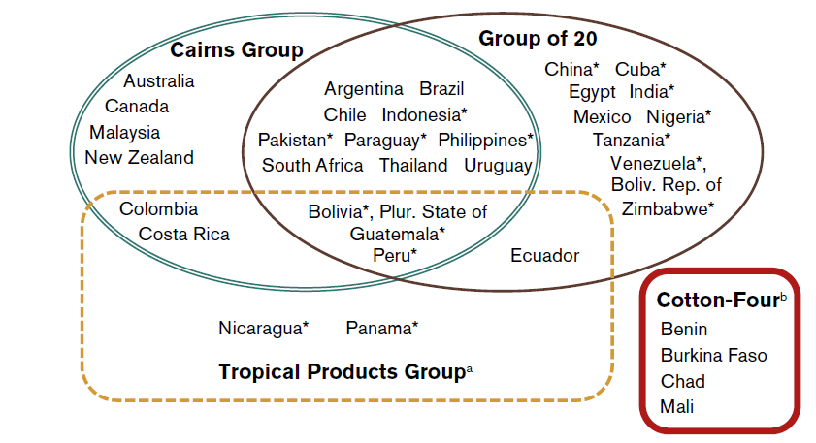
Offensive Coalitions in the Doha Round
These countries constitute 35 of the 164 members of the WTO (and just a few of the smaller developed members).

Slide 25
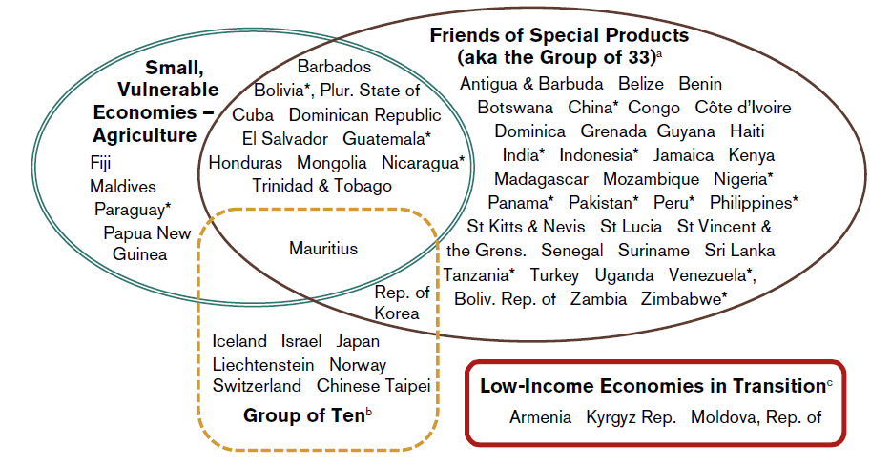
Defensive Coalitions in the Doha Round
These countries constitute 60 of the 164 members of the WTO — and include 15 of the 35 countries that are also in the offensive coalitions.

Slide 26
Limited Uruguay Round Accomplishments
Agricultural tariffs remain very high
Quotas were largely transformed to TRQs
The domestic support agreement provides a framework by which truly liberalizing commitments might be made in the future

Slide 27
The Doha Round’s Proposed Tariff Cuts
 | Developed | Developing
Average cut for all products | Tiered reductions from 50% for those 0-20% to 70% for those ≥75% | Tiered reductions from 33.3% for those 0-30% to 46.7% for those ≥130%
Min. average cut | 54% | 36%
Phase-in period | Six steps, five years | Eleven steps, ten years
Sensitive products (deviations ⅓-⅔) | Up to 4% of tariff lines | Up to 5.3% of tariff lines
Tariff quotas | New access opportunities as % of domestic consumption | ⅔ of what the developed countries must do
Special agricultural safeguard | 1% of tariff lines, eliminated in 7 years | 2.5% of lines; for SVEs reduced to 5% over 12 years
Special products | [None] | Up to 12% of lines may be self-selected, of which 5% will not be cut; overall cut of 11%
How ambitious can the final results be if:
We are cutting on the basis of bound rates,
The formula is tiered-linear rather than Swiss,
Industrialized countries can isolate some sensitive products,
Developing countries can do the same for both sensitive and special products, and
Developing countries may have recourse to special safeguards?

Slide 28
The Doha Round’s Proposed Subsidy Cuts
 | Developed | Developing
Overall Trade-Distorting Domestic Support | Final bound AMS from UR plus 10% of agricultural production plus average notified blue box payments; further adjustment for developing
Formula for OTDS | A tiered reduction formula ranging from a 40% cut for those with OTDS of ≤$10 bn. to 80% when OTDS ≥$60 bn., with S&D and RAM provisions
Phase-in period | Six steps, five years | Nine steps, eight years
Formula for AMS | A tiered reduction formula ranging from a 45% cut for those with OTDS of ≤$15 bn. to 70% when OTDS ≥$40 bn., with S&D and RAM provisions
Phase-in period | Six steps, five years | Nine steps, eight years
Product-Specific | Limits are to be scheduled in monetary terms.

Slide 29
Problems with Agriculture in FTAs
Until recently, it was often taken off the table altogether (especially by the EU, but also in developing country partial scope of agreements)
This is the area where the United States has, in its FTAs, back-slided into special restrictions (as will discuss in the session on special treatment)
Discriminatory agreements cannot definitively address
production subsidies
Remember always that an FTA is not just a smaller version of a WTO deal. There are important qualitative differences in which some issues are easier to deal with in an FTA (e.g., labor rights) and others are harder (e.g., agricultural subsidies).

Slide 30
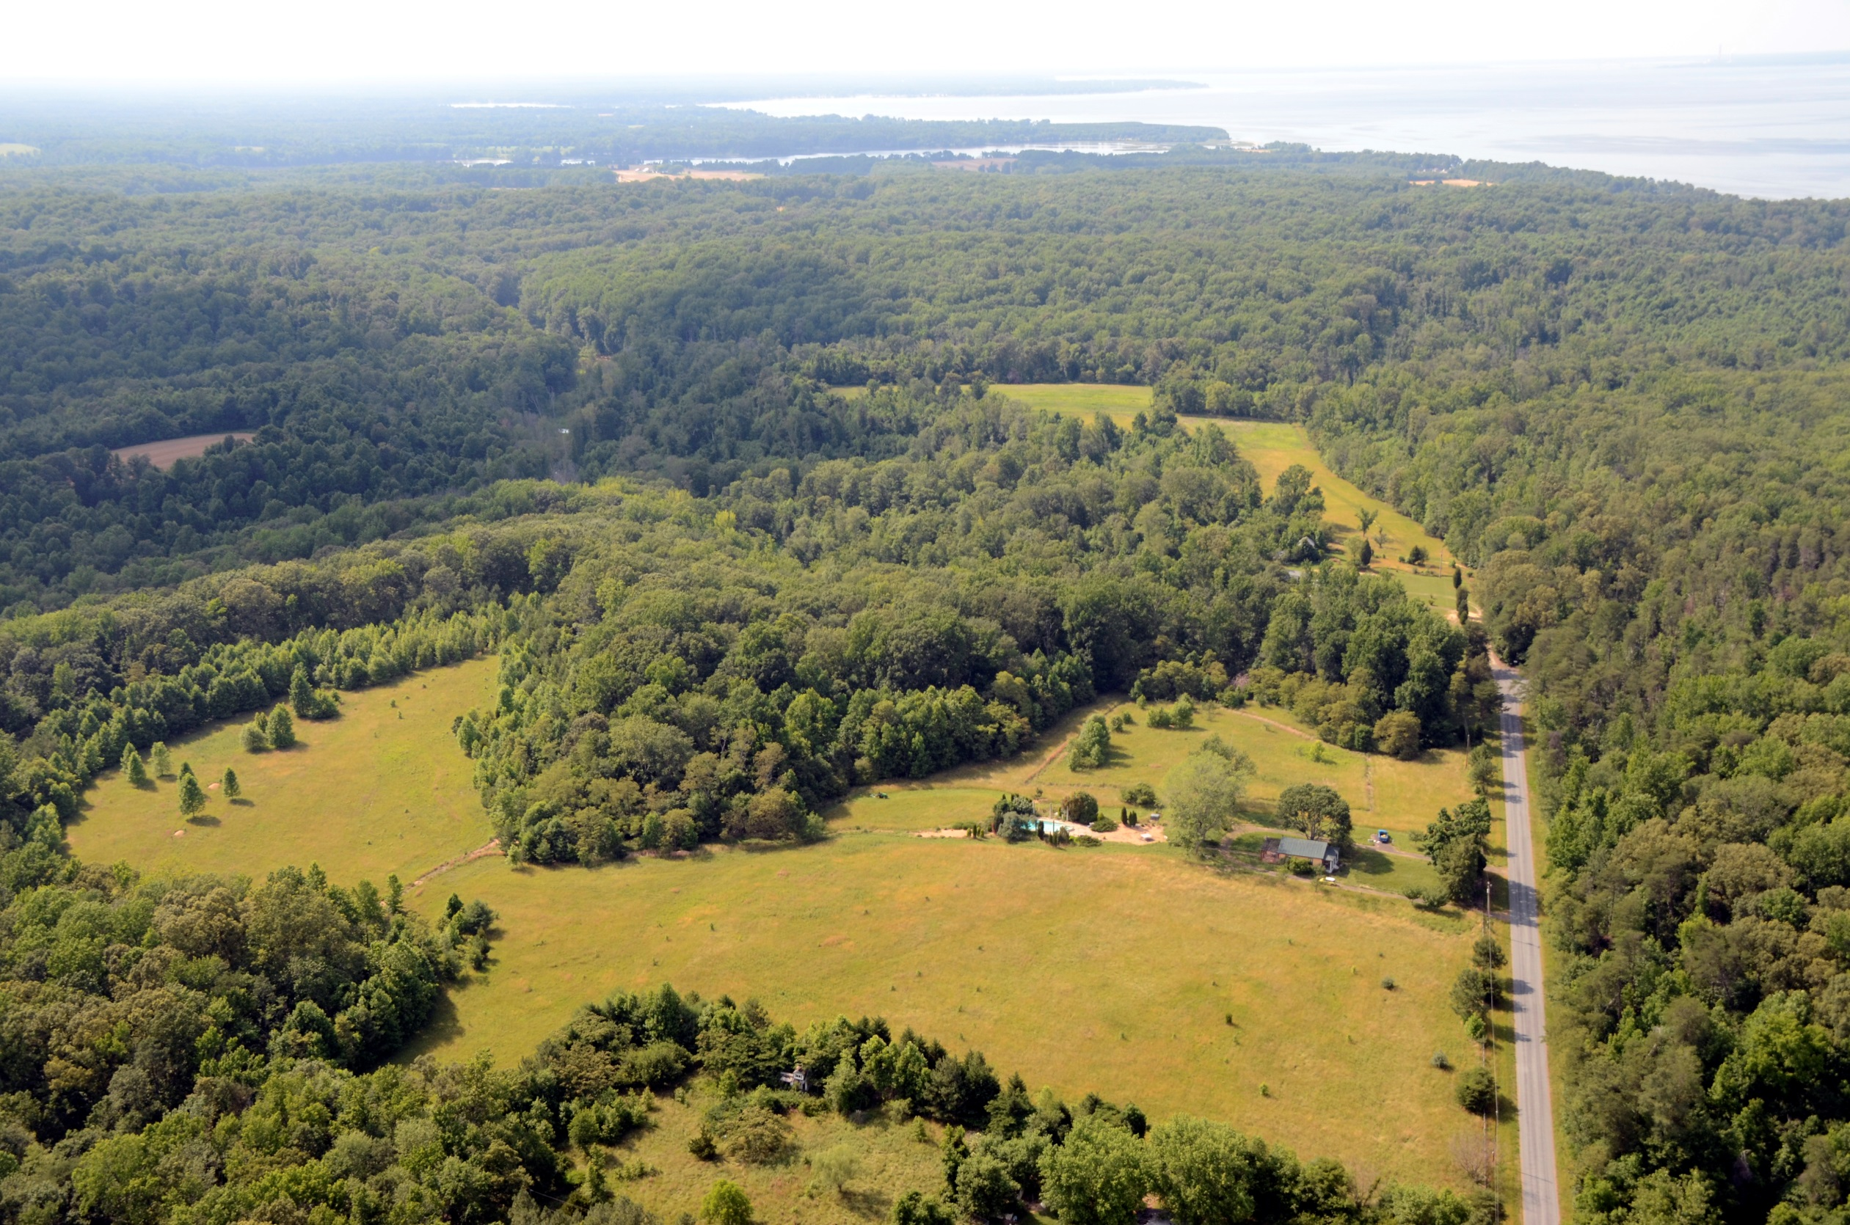
Do we have time left for questions?

