Slide 1
Tariff and Trade Data

Slide 2
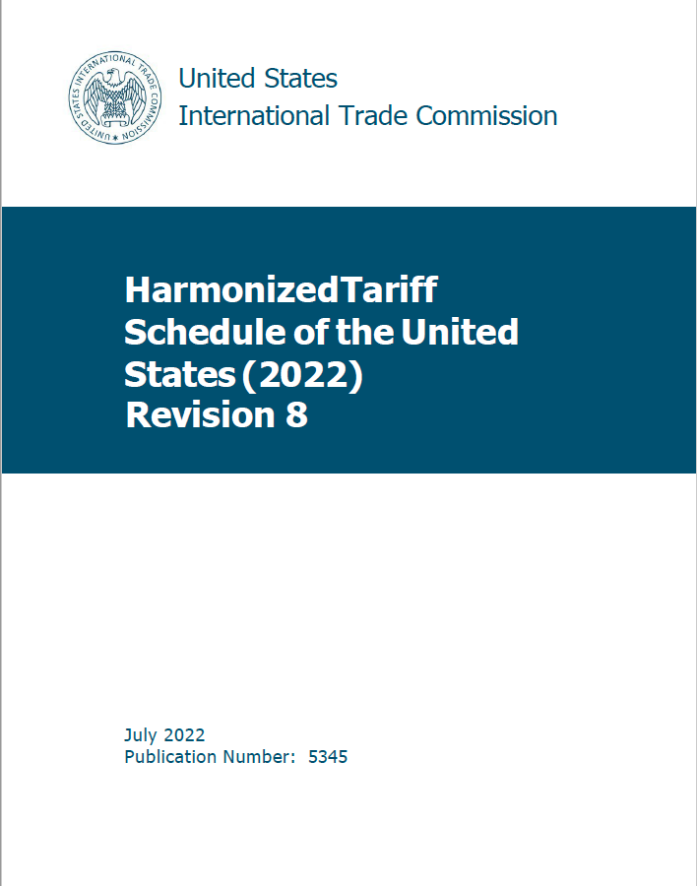
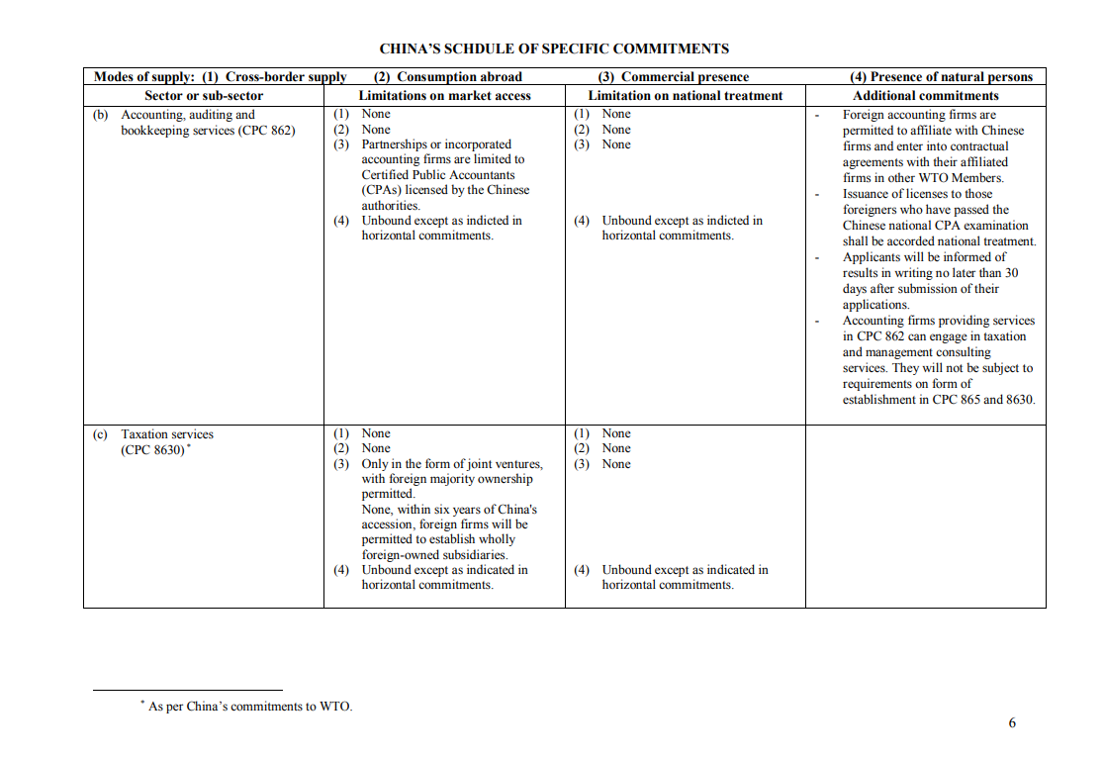
Topic 1: Understanding Tariff and Services Schedules

Slide 3
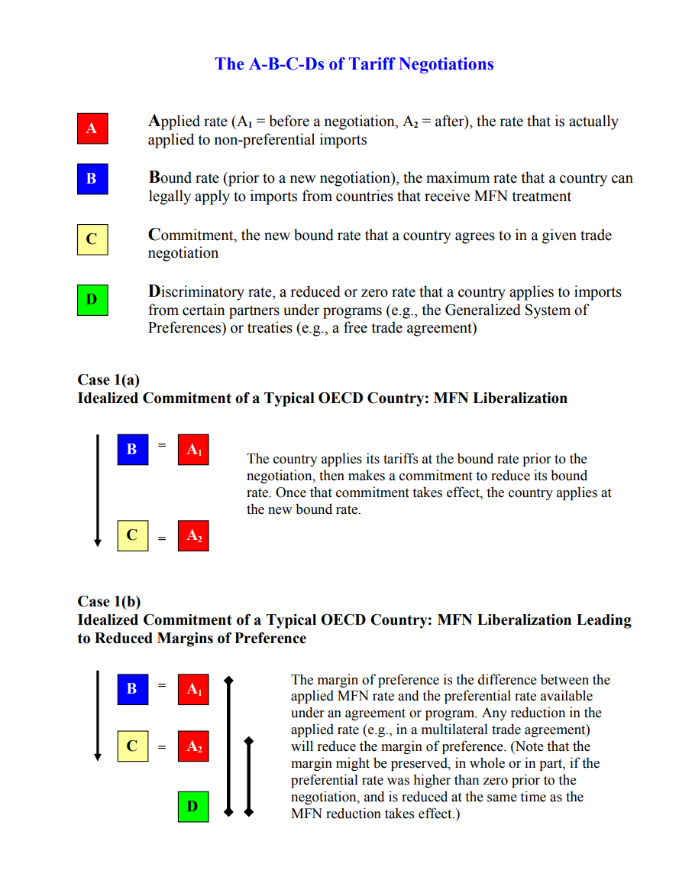
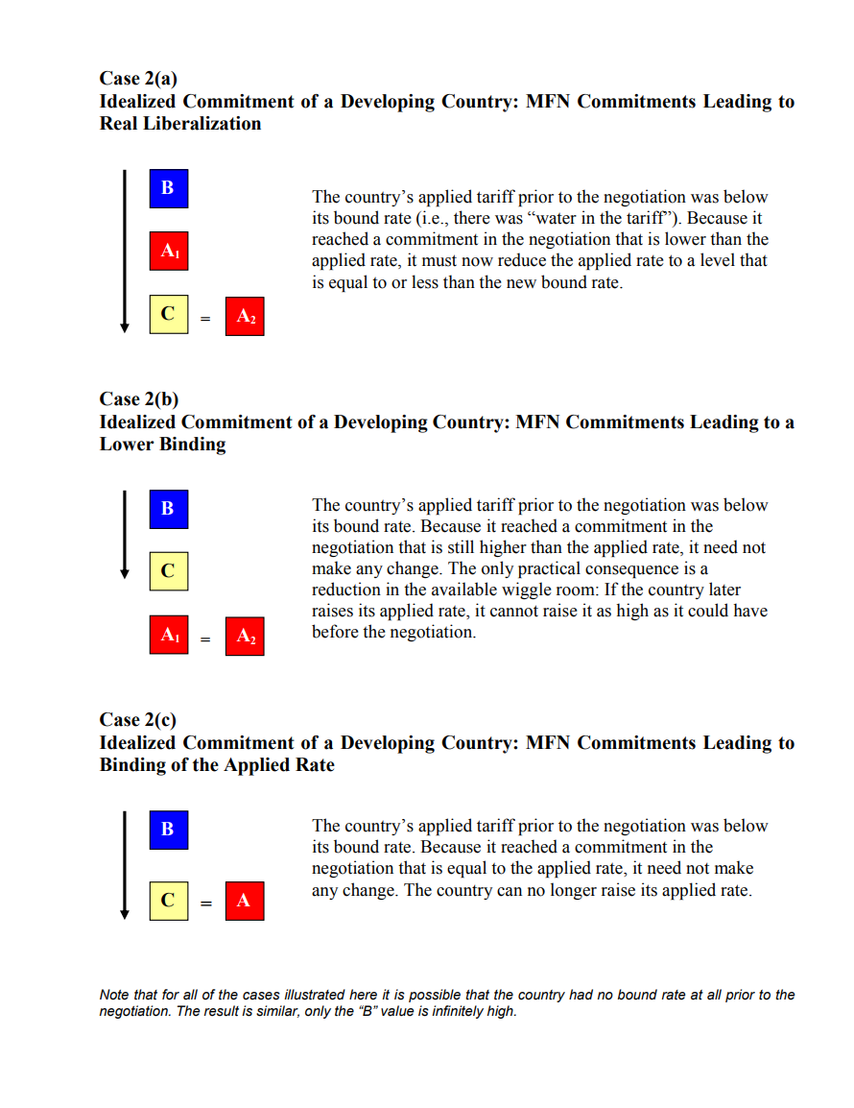
The Three Most Important Terms for this Subject
Applied Rate: The tariff rate that a country actually applies to imports.
Bound Rate: The rate that a country has bound itself to in a trade agreement.
Water: The difference between an applied tariff rate and a bound tariff rate. For example, if the bound rate is 5% and the applied rate is 3% there are two points of water.

Slide 4
Various Commitments Are Scheduled
  Tariffs
  Other duties and charges
  Services commitments in positive-list agreements such as GATS
  Exceptions (e.g., laws that are “grand-fathered”)
  Export subsidies

Slide 5
Various Commitments Are Scheduled
  Tariffs
  Other duties and charges
  Services commitments in positive-list agreements such as GATS
  Exceptions (e.g., laws that are “grand-fathered”)
  Export subsidies
We will concentrate on trade in goods, but will also cover services if time permits.
Also if time permits, we will cover today where to find trade data. If we run out of time, we will cover that in the next session.

Slide 6

The Best Source for Aggregated Data — But Not Individual Rates
https://www.wto.org/english/res_e/statis_e/tariff_profiles_list_e.htm

Slide 7
Not all countries bind all tariffs
Developed and RAMs generally bind 100% tariff lines.

Slide 8
Some bindings have lots of water
Averages for all products, 2022
We will take a deeper look at the statistics later today.

Slide 9
Goods Schedules:
The Harmonized System of Tariff Nomenclature

Slide 10
The Harmonized System
The same principles apply to reading all WTO member countries’ tariff schedules.
They all employ a common (i.e., harmonized) nomenclature, at least to the six-digit level, but each has its own rates.
However, be aware that there are differences in the format and degree of information in the schedules. Also note that the HS changes over time.

Slide 11
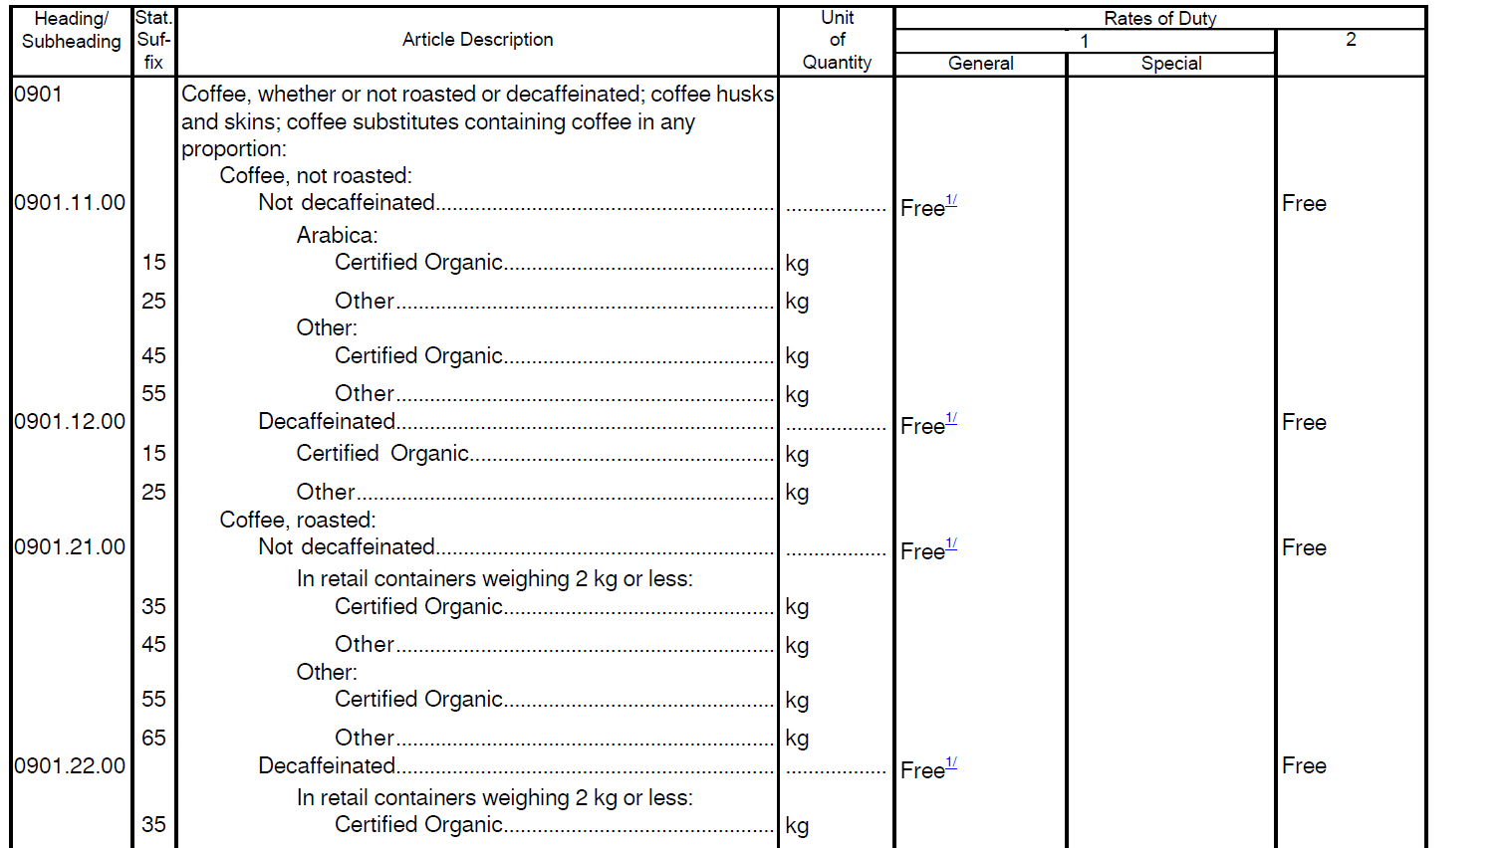
United States

Slide 12
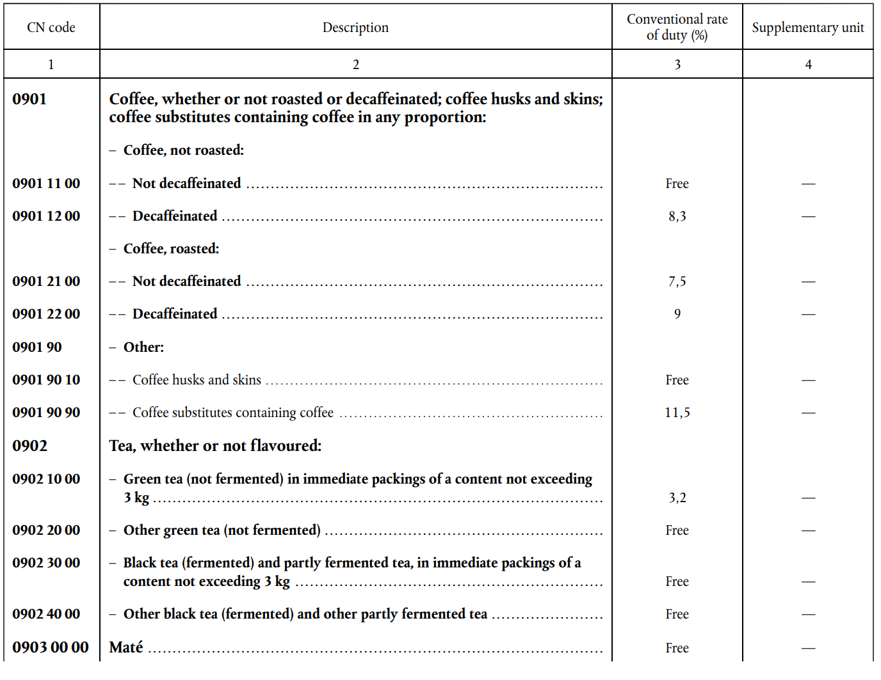
European Union

Slide 13
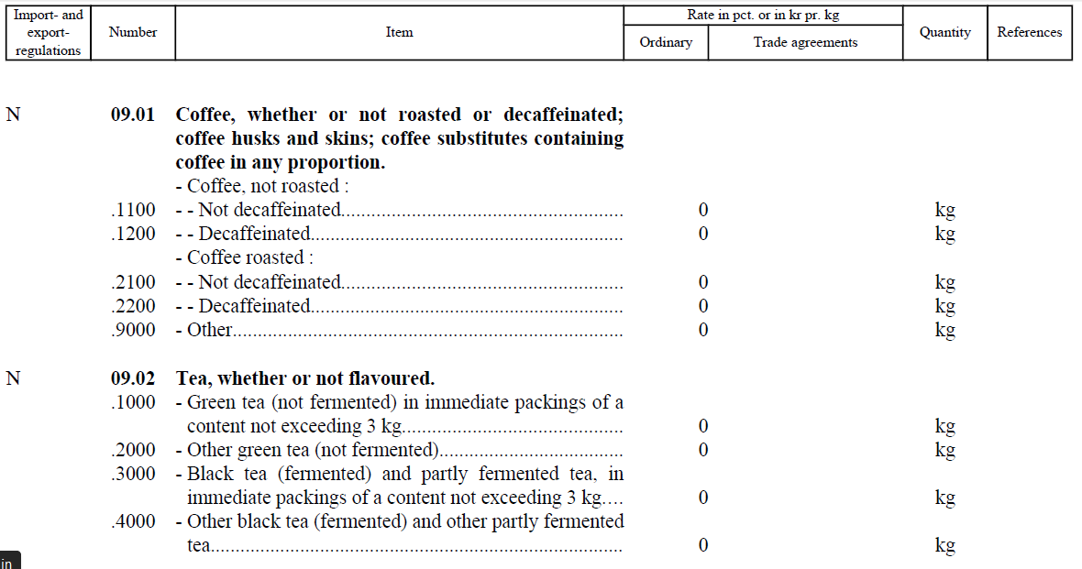
Norway

Slide 14
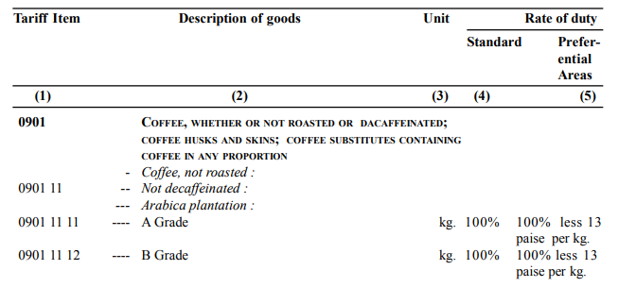
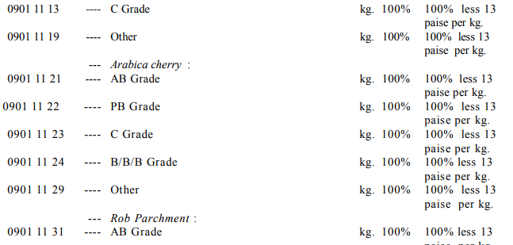
India

Slide 15
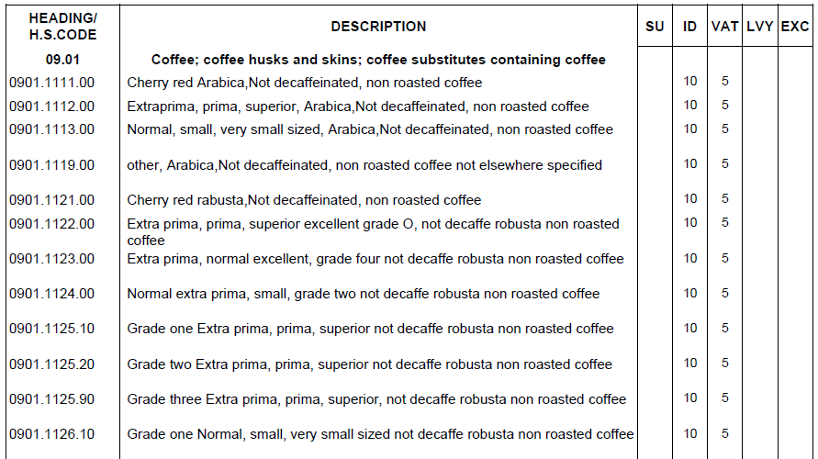
Nigeria

Slide 16
Applied and Preferential Rates in the U.S. Schedule

Slide 17
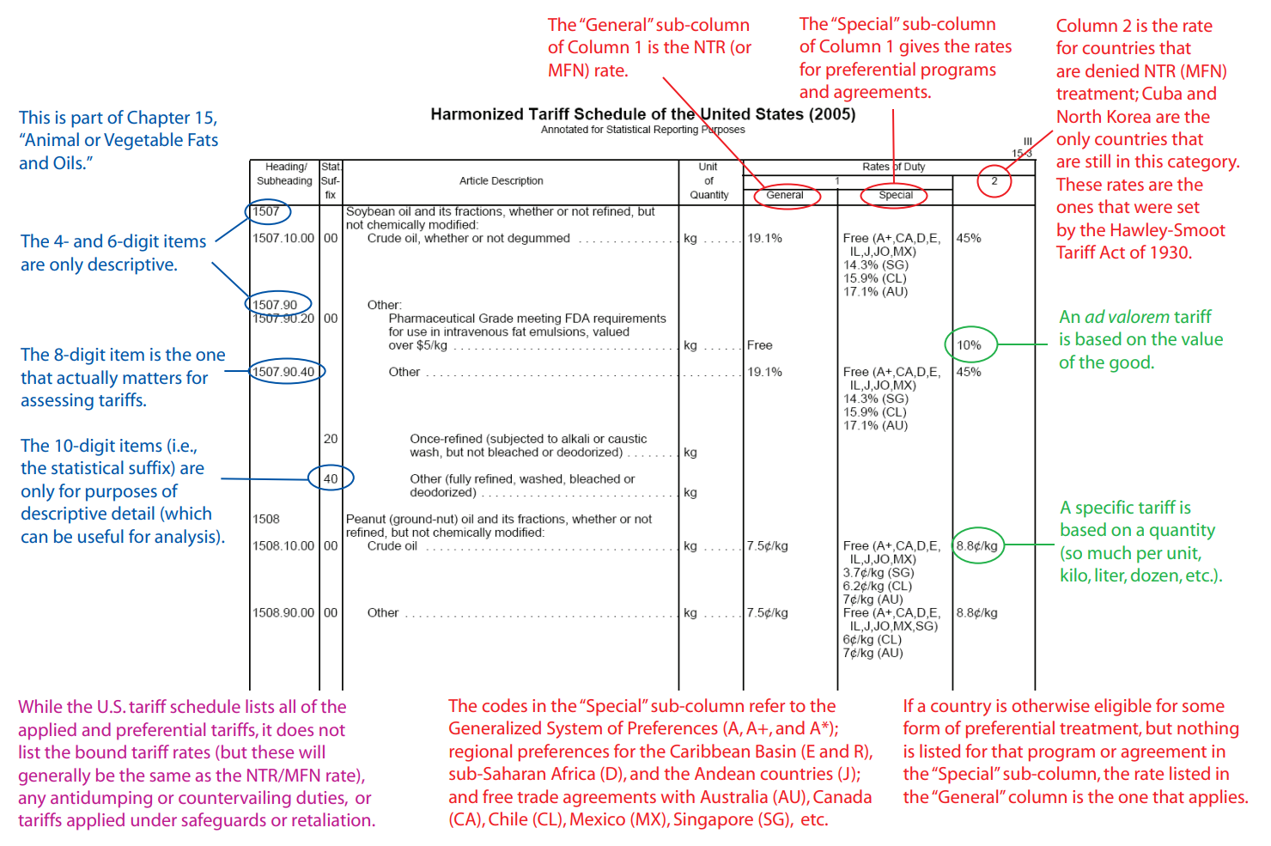
How to read the U.S. schedule

Slide 18
A small issue of terminology
MFN = Most Favored Nation
NTR = Normal Trade Relations
The two terms mean the same thing, but in the United States we use NTR because by 1998 members of Congress had grown tired of explaining to constituents that approving MFN to China did not mean making that the most favored nation.

Slide 19
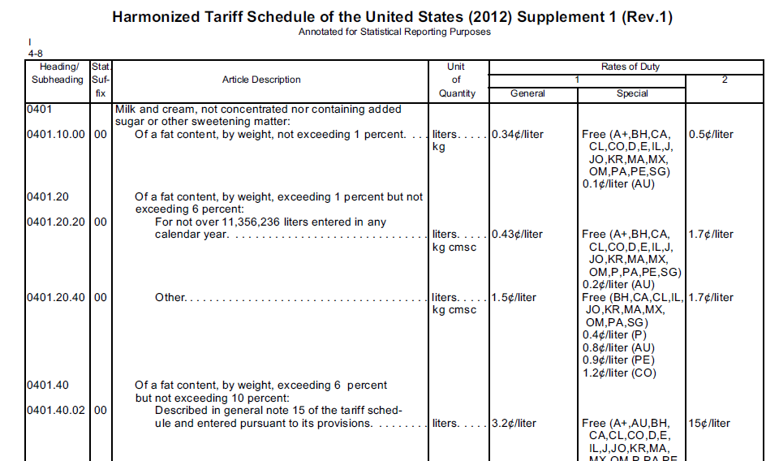
For the United States, denial of MFN (NTR) means Hawley-Smoot (1930) tariffs

Slide 20
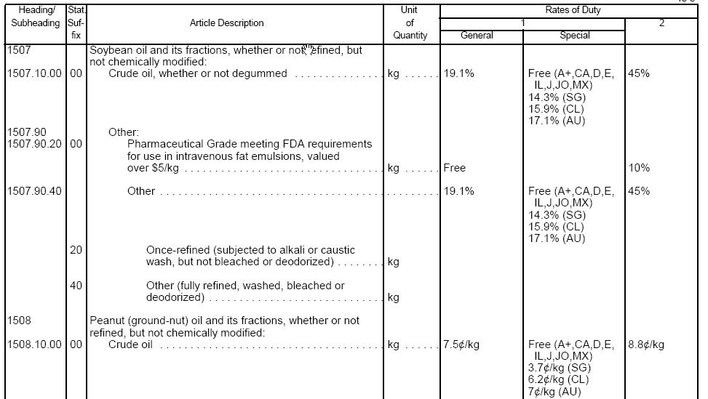
The digits
The nomenclature is divided into a series of two-digit bunches. The first two digits indicate the chapter, while the four-, six-, eight-, and ten-digit levels are progressively more specific. All countries’ schedules are identical to the six-digit level. In the United States, tariffs are determined at the eight-digit level.

Slide 21
Units of Quantity
Data are collected on the volume of imports, which might be in kilograms, tons, liters, dozens, etc.
The HS system is metric.
These figures are not only of statistical importance, but are also used to assess any tariffs that are specific or compound (rather than ad valorem).

Slide 22
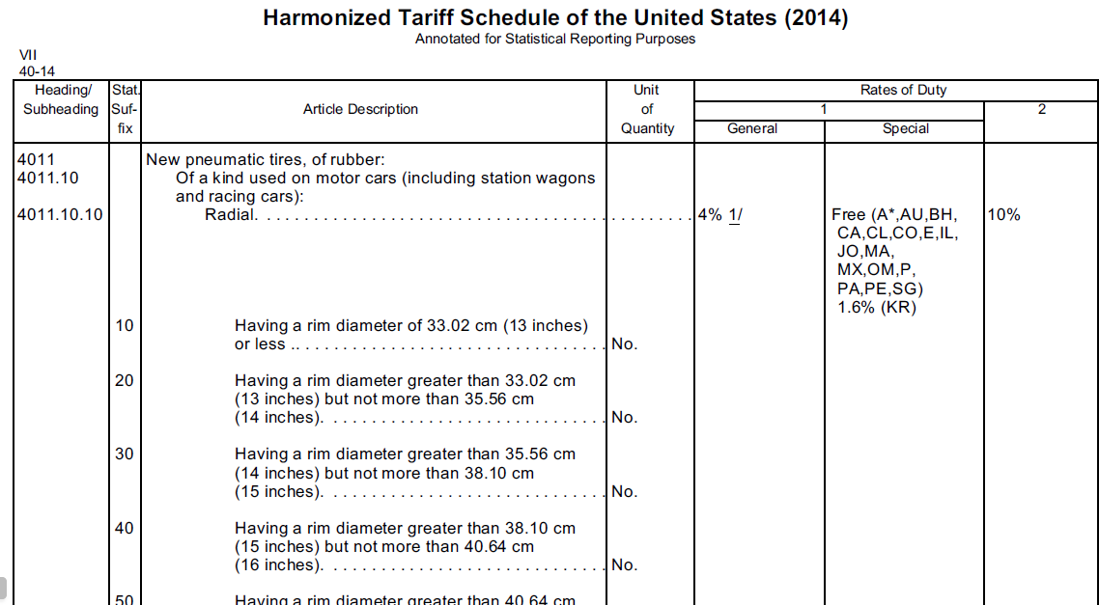
An example of an ad valorem tariff:
Item 4011.10.10: Radial tires

Slide 23
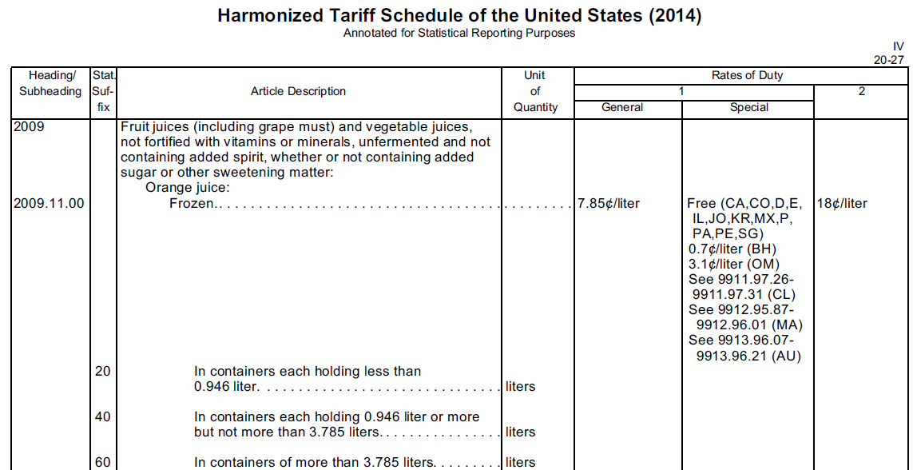
An example of a specific tariff:
Item 2009.11.00: FCOJ

Slide 24
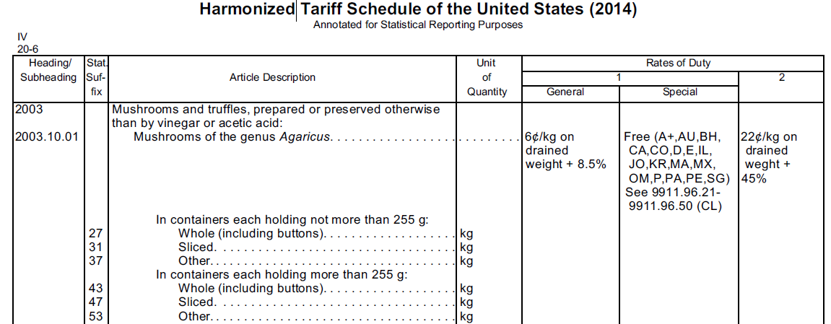
An example of a compound tariff:
Item 2003.10.01: Prepared mushrooms
As in the case of specific tariffs, the specific portion of the compound tariff might be assessed per unit, kilogram, liter, ton, dozen, etc.

Slide 25
Column 1/Special:
Preferential Treatment
Members of free trade agreements or beneficiaries of preferential trade programs can receive the duty-free or reduced-duty treatment in the “special” subcolumn.

Slide 26
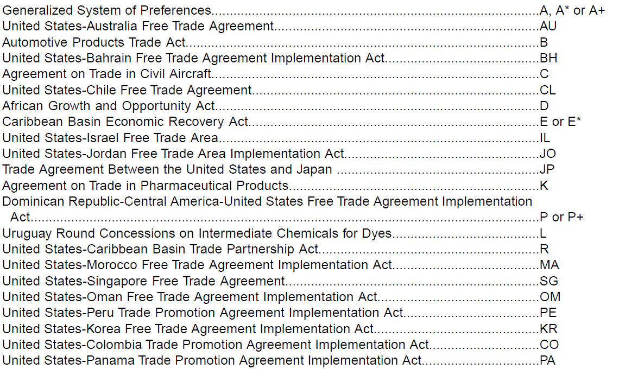
Code Letters for Preferential Programs and Agreements

Slide 27
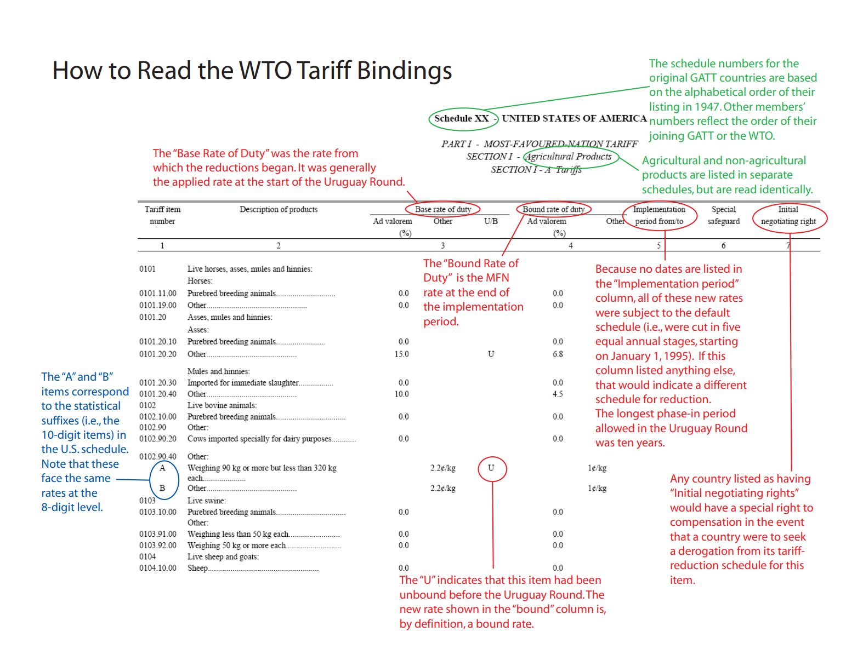

Slide 28
How to Find Applied and Bound Rates

Slide 29
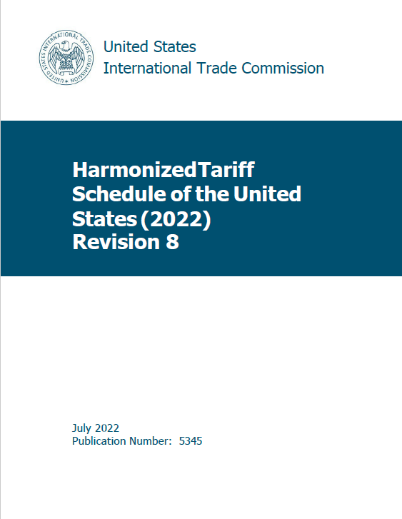
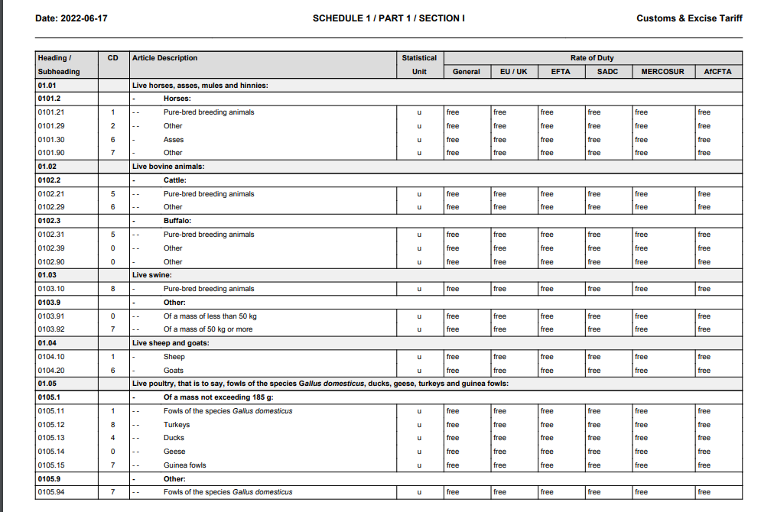
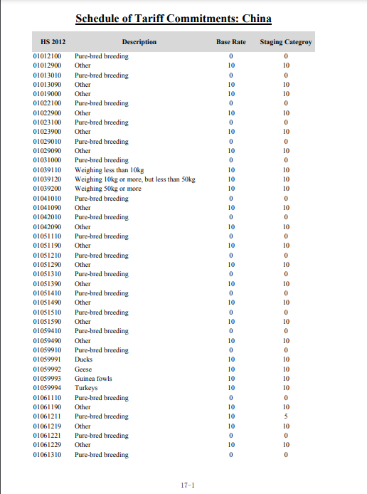
For applied, the first option is to go old school and get the printed schedule (or its PDF).

Slide 30
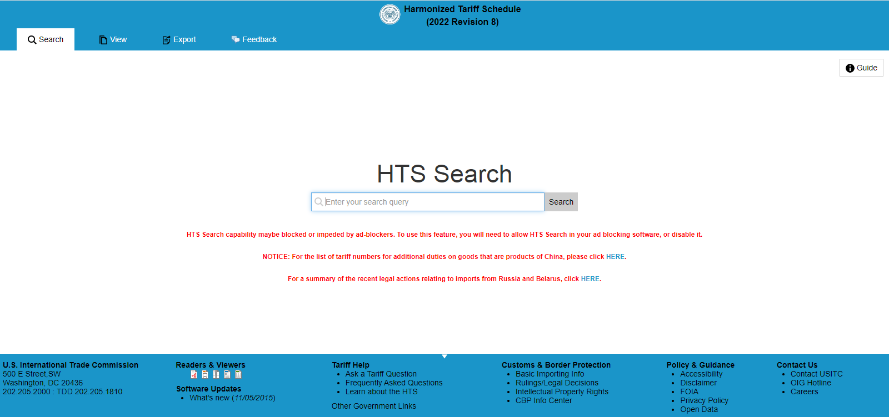
Some countries have online tariff facilities

Slide 31
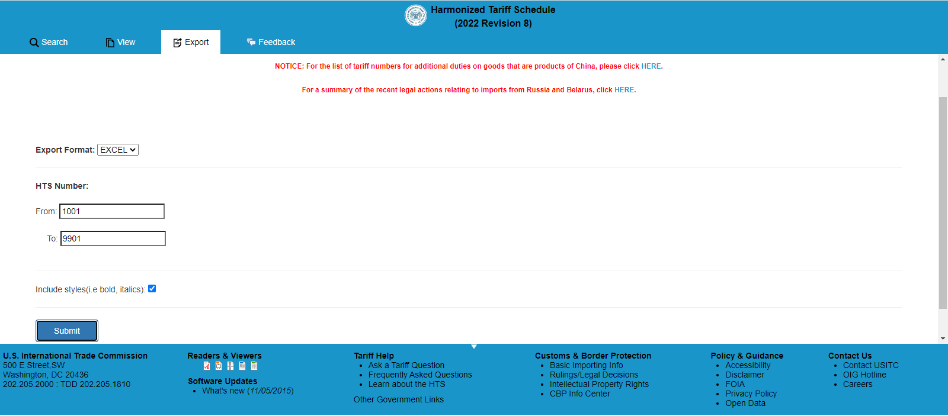
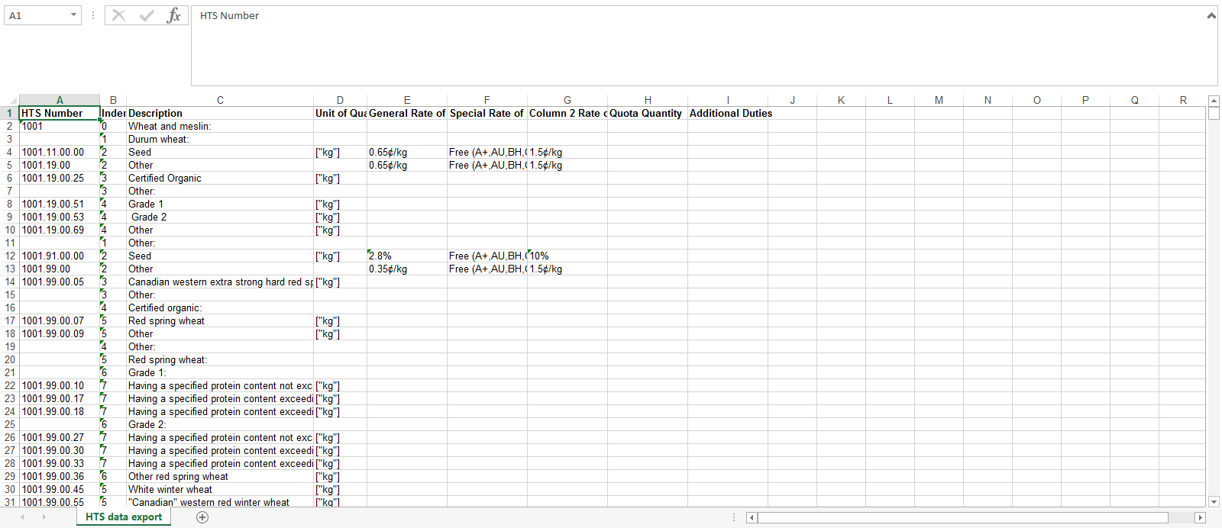
The USITC also makes it available in Excel
https://www.usitc.gov/sites/default/files/tariff_affairs/documents/tariff_data/tariff_database_v8.xlsx

Slide 32
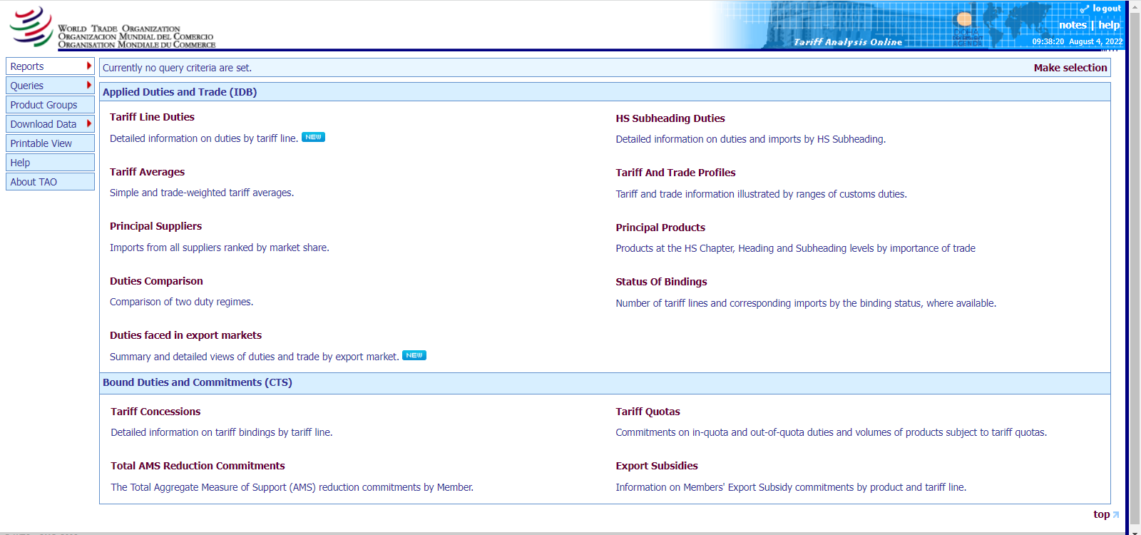
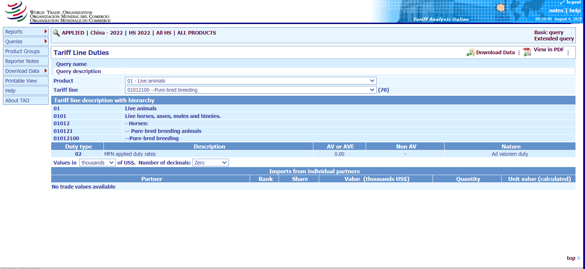
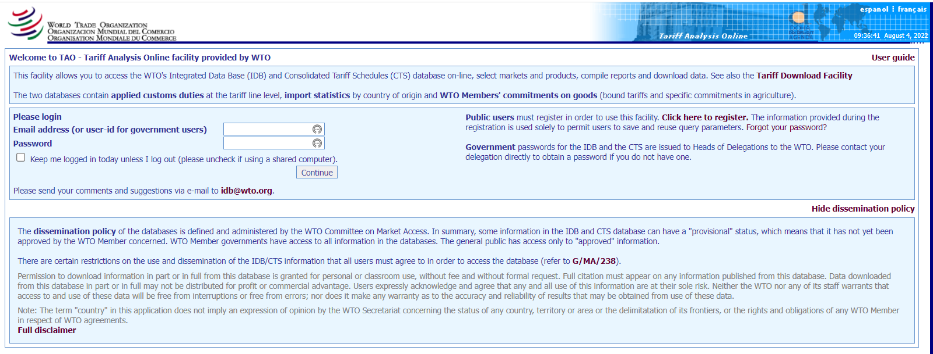
The WTO Tariff Analysis Online facility

Slide 33
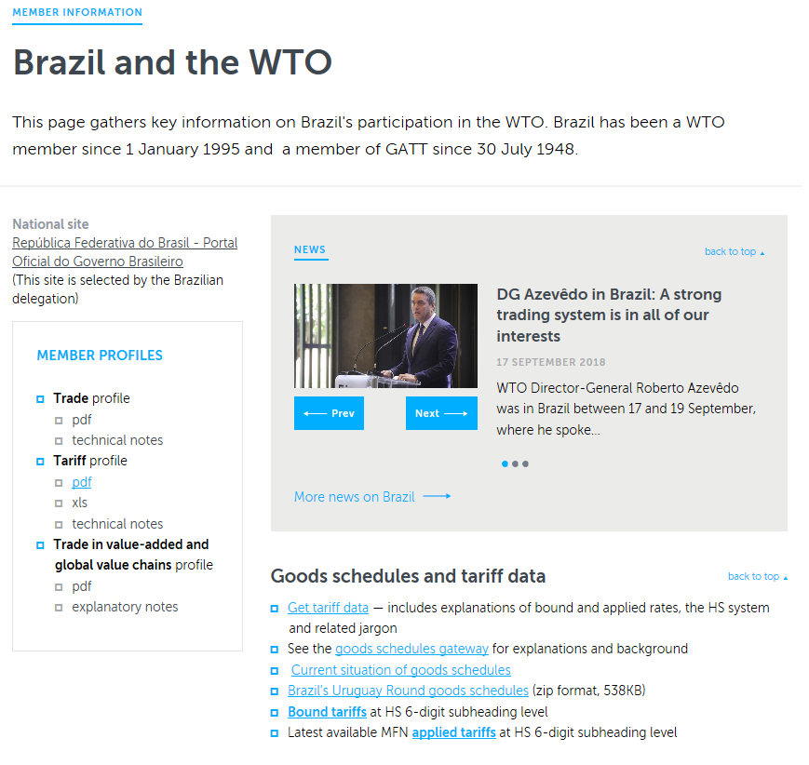
Or go to the WTO member page
https://www.wto.org/english/thewto_e/countries_e/brazil_e.htm

Slide 34
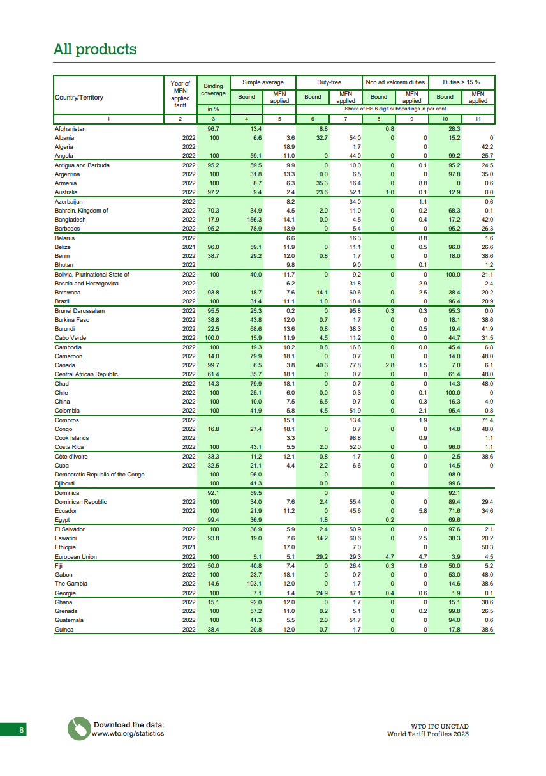
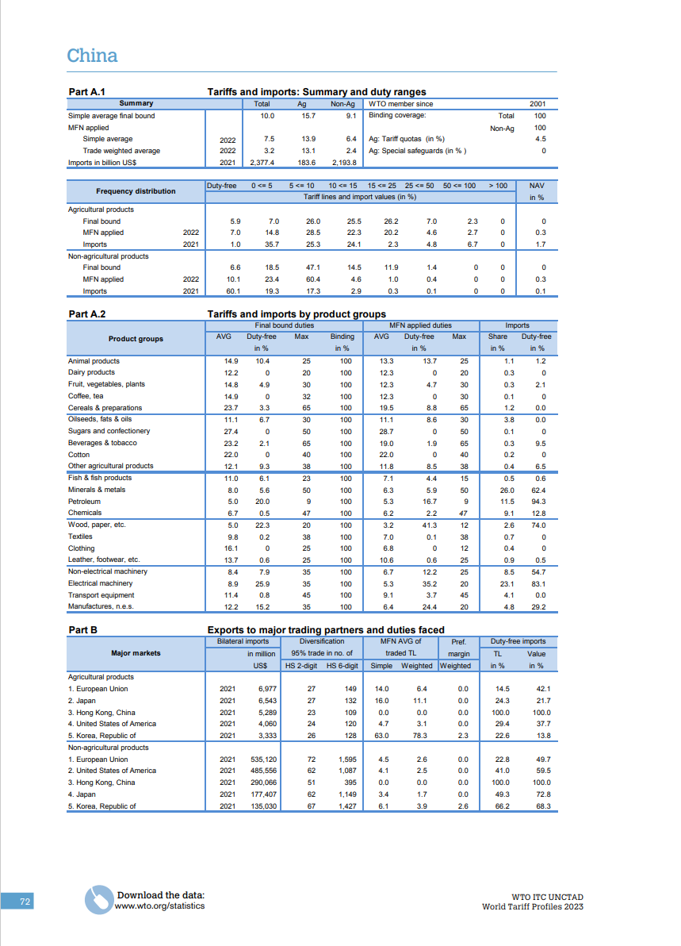
World Tariff Profiles: https://www.wto.org/english/res_e/publications_e/world_tariff_profiles20_e.htm
The data provide lots of useful detail, and can also be downloaded in Excel format. Note however that these data are at a high level of abstraction and are thus more suited to “big picture” than tactical analysis.

Slide 35
Dealing with Ad Valorem Equivalents (AVEs)

Slide 36
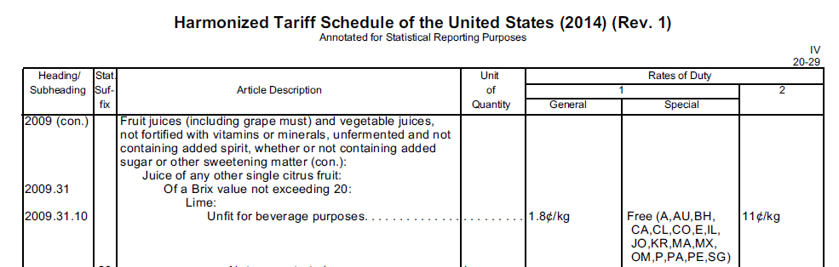
A Core Skill: Calculate an Ad Valorem Equivalent
Which of these two items is subject to the higher rate?

Slide 37
The problem with specific tariffs
The relative significance of a specific tariff is difficult to understand on its own.
For purposes of comparison, one can calculate an ad valorem equivalent (AVE) tariff based on average prices.

Slide 38
Why AVEs are worth calculating
Analysts will often be called upon to identify which products are subject to relatively high tariffs.
Moreover, this is a necessary step whenever formula cuts are used to reduce or phase down a tariff.

Slide 39
A simple way to calculate AVEs
  Tariff rate
  Unit price
  As long as they share the same unit, you can use any price (the most recent, an average, a hypothetical one, etc.) when calculating an AVE.
  (Note that in a negotiation, the choice of method may be critical and can be the subject of extensive bargaining.)

Slide 40
Suppose that the average price of Brazilian FCOJ is 29.4¢ per liter
  The simple formula is the tariff rate divided by the price.

Slide 41
Suppose that the average price of Brazilian FCOJ is 29.4¢ per liter
  The simple formula is the tariff rate divided by the price.
  Tariff
  Price

Slide 42
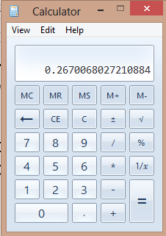
Suppose that the average price of Brazilian FCOJ is 29.4¢ per liter
  The simple formula is the tariff rate divided by the price.
  Tariff 7.85¢
  Price 29.4¢

Slide 43
Suppose that the average price of Brazilian FCOJ is 29.4¢ per liter
  The simple formula is the tariff rate divided by the price.
  Tariff 7.85¢
  Price 29.4¢
26.7%

Slide 44
Suppose that the average price of lime juice is $2.03/kilo
  The simple formula is the tariff rate divided by the price.
  Tariff
  Price

Slide 45
Suppose that the average price of lime juice is $2.03/kilo
  The simple formula is the tariff rate divided by the price.
  Tariff 1.8¢
  Price $2.03
0.9%
We can now definitively say that FCOJ is subject to a high tariff (26.7%) and lime juice is subject to a low tariff (0.9%). That makes it easier both to analyze trade and to negotiate a tariff agreement.

Slide 46
Understanding the Different Ways that Data Are Reported

Slide 47
Paired Trade Data Generally Do Not Match
We should generally expect A’s exports to B to be identical to B’s imports from A. However, they almost never match due to:
Different price components (CIF vs. FOB vs. FAS etc.)
Shipping schedules (e.g., December exports arrive in January)
Data-entry errors (declining now with automation)
Transshipment and entrepôt trade
Exchange rate fluctuations
Value attributions in complex supply chains
Fraud and corruption
Diverted shipments
Classification differences
A very important distinction:
In most countries, ad valorem tariffs are applied on the CIF value of the good.
In the United States and a few others, it is on the value of the good without insurance and freight.

Slide 48
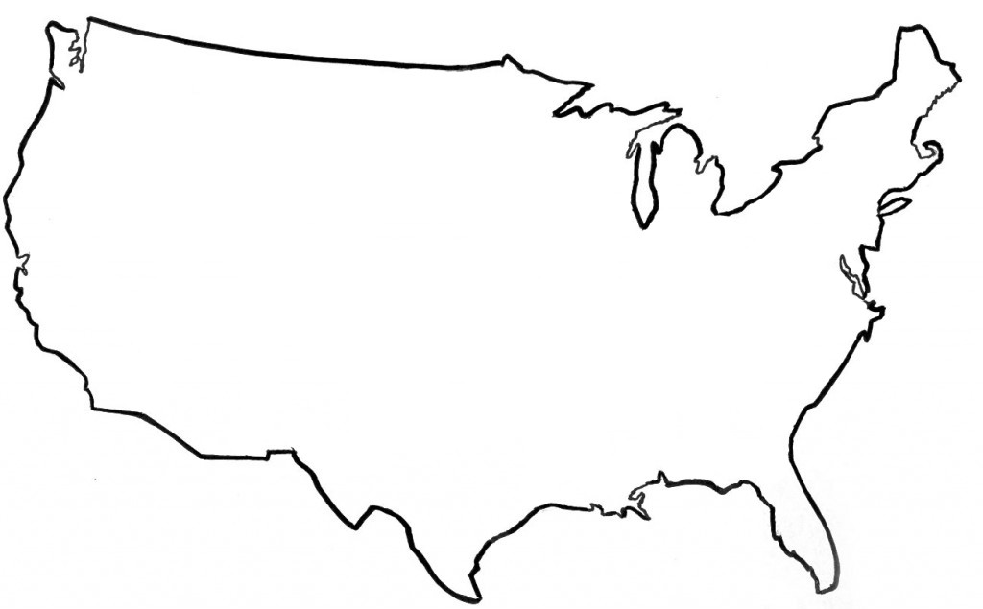
Total Exports = Domestic Exports + Reexports
When researching economies engaged in entrepôt trade (e.g., Panama, the Gambia, Lebanon, Hong Kong, etc.), be careful to distinguish exports and reexports. Note also the special case of the Netherlands in E.U. trade data.
Reexports
Miami
Domestic Exports

Slide 49
Most “General Imports” Are Ultimately for Consumption,
But Some Are Reexported and Some Are Transformed
Imports for
Consumption
Imports for
Consumption
(Gasoline)
General Imports
General Imports
(Crude Oil)
FTZ
Reexports
Miami

Slide 50
Services:
Scheduling in the GATS

Slide 51
Positive and negative lists
Positive List: Commitments are made only in those sectors where countries explicitly agree. In principle, it is the less comprehensive method.
This is the approach taken in GATS commitments and most FTAs.
Negative List: Countries are committed in all sectors unless they explicitly set restrictions or make exceptions.
This is the approach taken in most of the FTAs of the United States (and the rest of the Americas), where “modes” are not mentioned.

Slide 52

The classic example
Economists of a generation ago typically pointed
to haircuts as the quintessential “untraded” activity.

Slide 53




Mode 1
Mode 2
Mode 3
Mode 4

Slide 54
The four modes of supply
Cross-Border Supply: “Exports.” The provider and the consumer stay home; only the service moves.
Consumption Abroad: “Travel.” The consumer travels to another country to obtain the service.
Commercial Presence: “Investment.” The establishment of a branch, agency, or subsidiary.
Presence of Natural Persons: “Business travel.” Individuals temporarily enter another country to provide services.

Slide 55
Example: Education services
Mode 1: Distance learning. What we are doing now.
Mode 2: The traditional model, in which the (foreign) student travels to the school. This is what the Kennedy School usually does.
Mode 3: We establish a permanent training center in a foreign country.
Mode 4: Robert and I travel to a country and teach a customized, one-time-only course (which we have done in Brazil, Guatemala, Mongolia, Peru, etc.).

Slide 56
Variations and exceptions
Two types of commitments:
Limitations on market access
Limitations on national treatment
Each of which can be declared as “none,” “unbound,” or anything in-between, and may also be modified through horizontal commitments and a country’s exceptions.
There is no requirement to make a commitment in any given sector.

Slide 57
Limits on GATS commitments
Unlike goods, where a country’s commitments are reduced to a single number, services commitments are almost infinitely variable:
Four modes of supply times, multiplied by
Two areas of commitments,
Equals eight different areas to place limits on commitments,
Which may be of almost any type,
Countries may limit commitments in a horizontal fashion, and
MFN exceptions are also permitted.

Slide 58
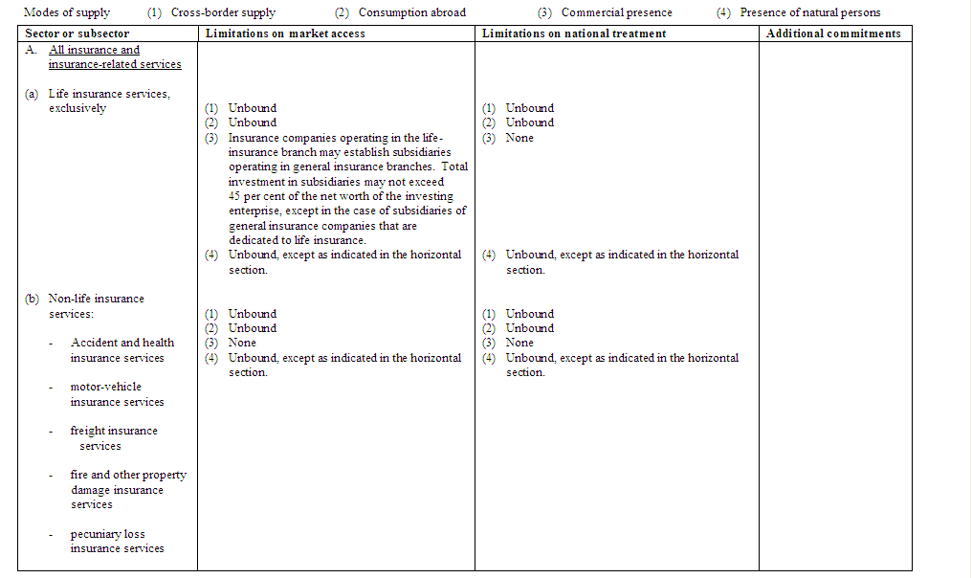
How to read a GATS schedule

Slide 59
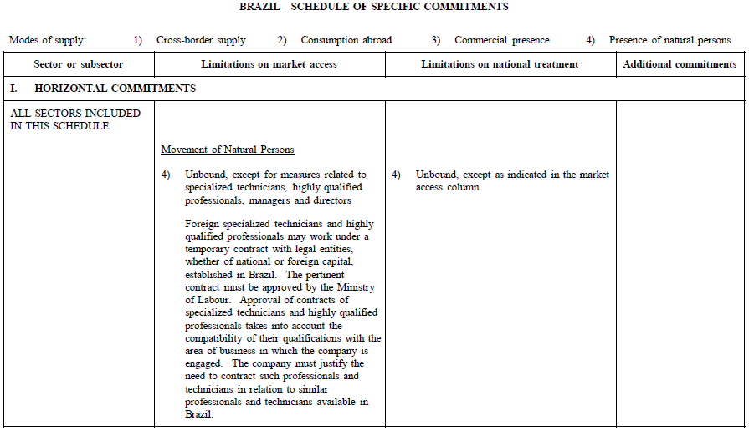
Horizontal commitments
Brazil’s horizontal commitments go on for five pages, dealing with issues in investment, commercial presence, and subsidies.

Slide 60
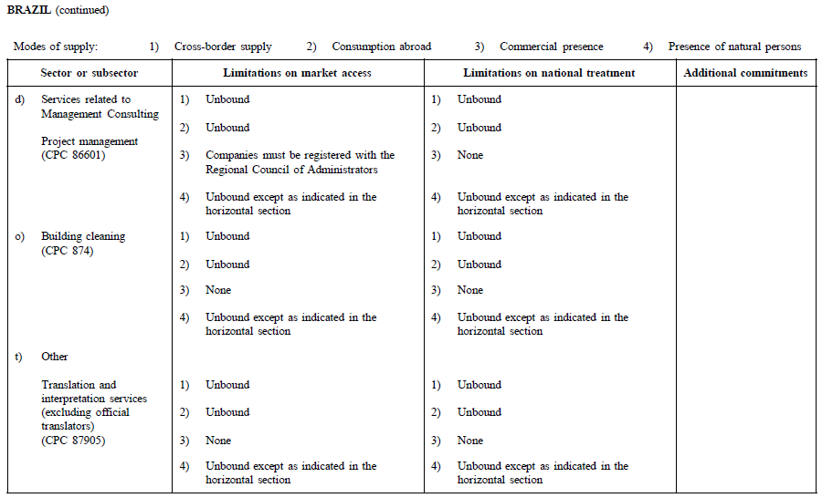
Sectoral commitments

Slide 61
Sectoral commitments
The first column identifies the sector or sub-sector. Note that there is no universally accepted harmonization of the nomenclature.

Slide 62
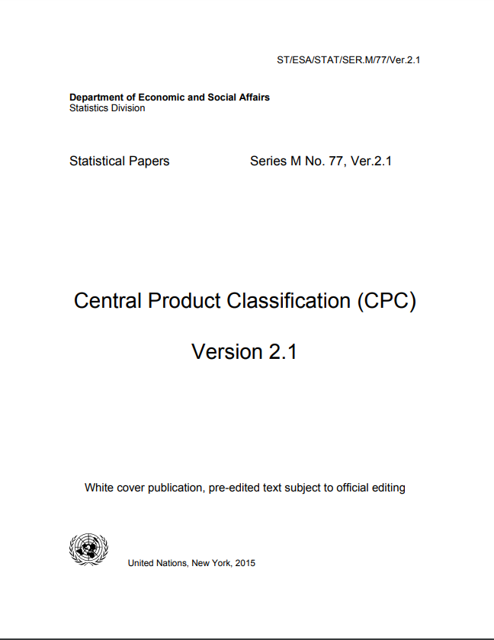
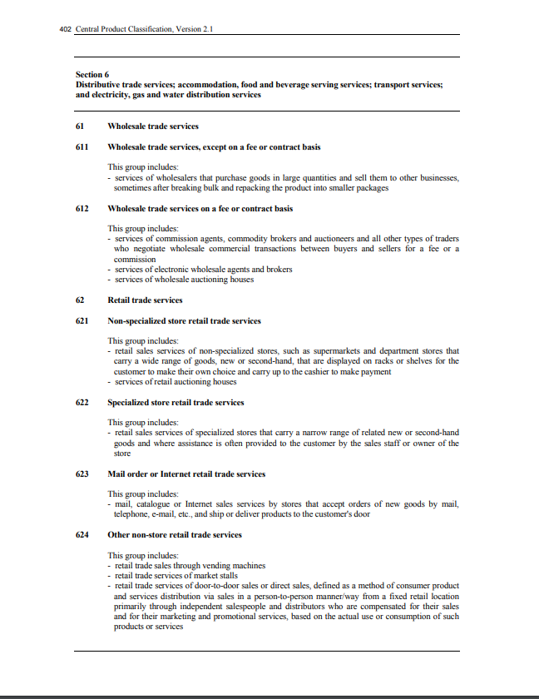
The CPC is at https://unstats.un.org/unsd/classifications/Econ/Download/In%20Text/CPCv2.1_complete(PDF)_English.pdf

Slide 63
Sectoral commitments
The second column specifies commitments, which range from “unbound” to “none,” and can be much more nuanced.
N

Slide 64
Sectoral commitments
The third column specifies any limitations on national treatment.

Slide 65
Sectoral commitments
The fourth column is usually left blank.

Slide 66
Where to Find Trade Data

Slide 67
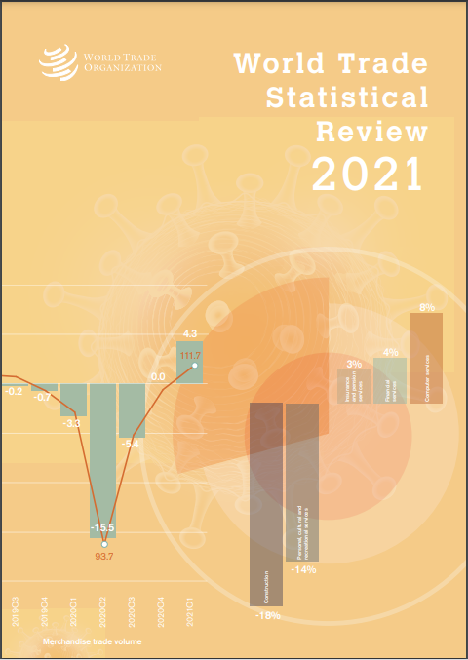
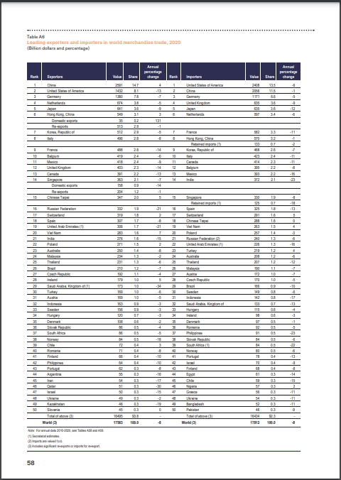
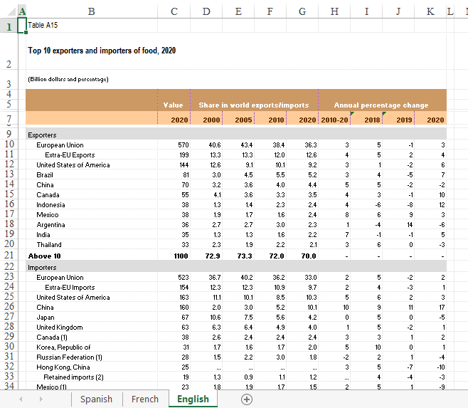
Try Not to Rely Solely on Pre-Digested Data
But if You Need to Do So, One Good Option Is …
At a minimum, you want to become a better-informed consumer of statistical data (e.g., understand the different bases on which is might be reported or analyzed).
If you are more ambitious, you also want to cultivate your own ability to find, compile, analyze, and report data in varying ways.
https://www.wto.org/english/res_e/statis_e/wts2021_e/wts21_toc_e.htm

Slide 68
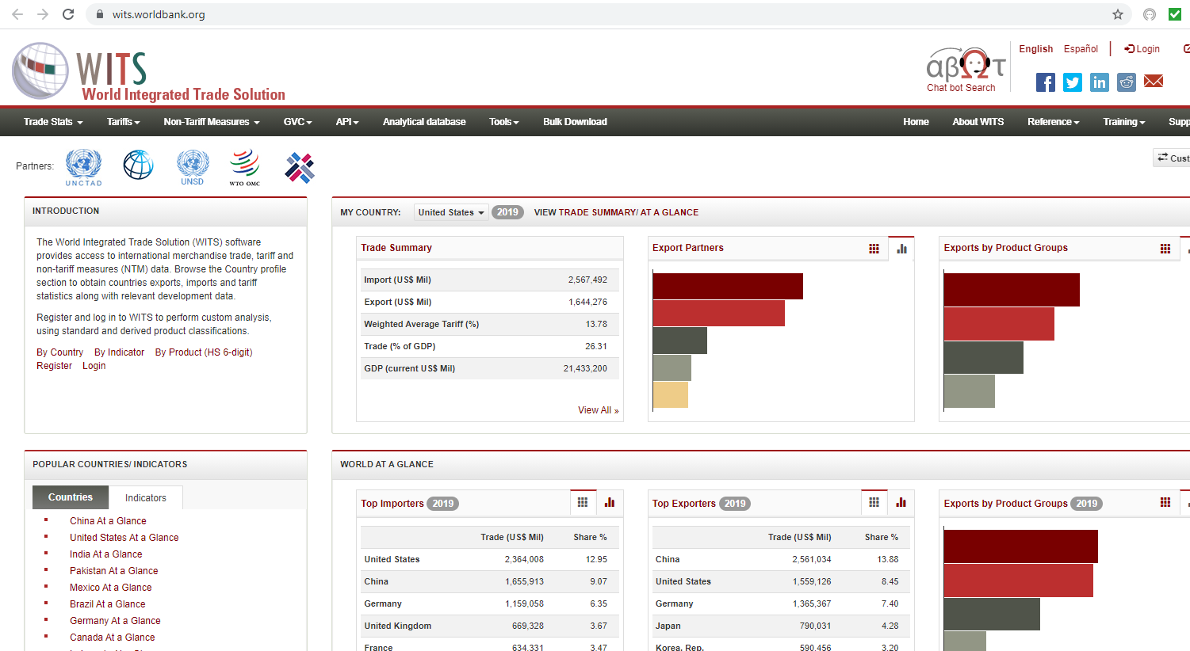
World Bank’s WITS: https://wits.worldbank.org/
If you are examining a single country or a bilateral relationship it will usually be better to use national sources, but this option is good if you are looking at a larger number of countries and/or the national sources have serious defects.

Slide 69
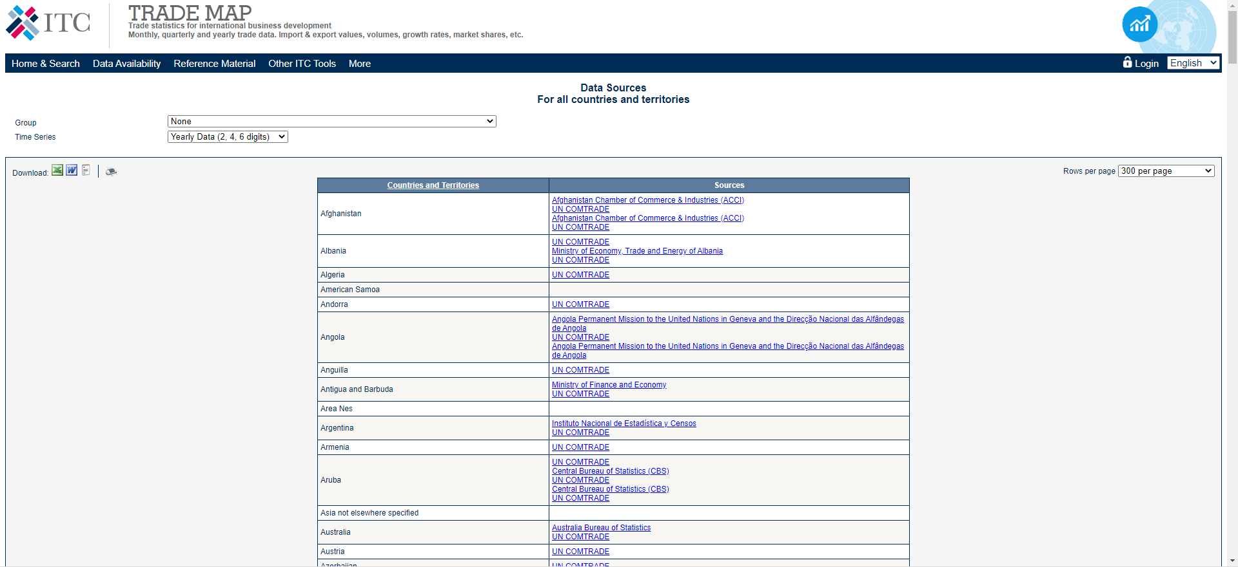
ITC’s Trade Map: https://www.trademap.org/stDataSources.aspx

Slide 70
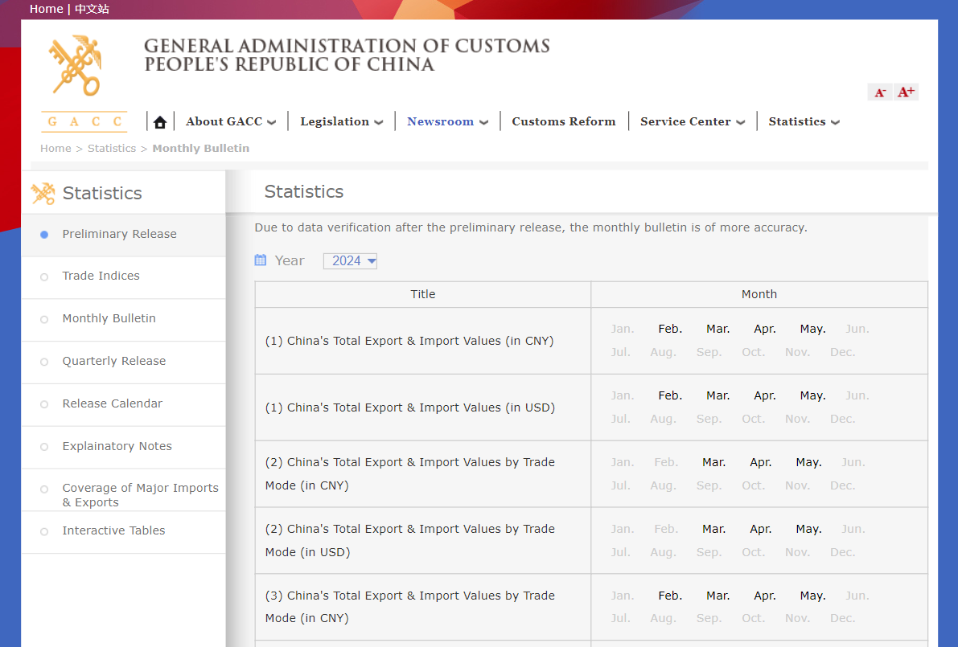
Trade Map (or Google) can lead you to (for example) the trade data posted by China …

Slide 71
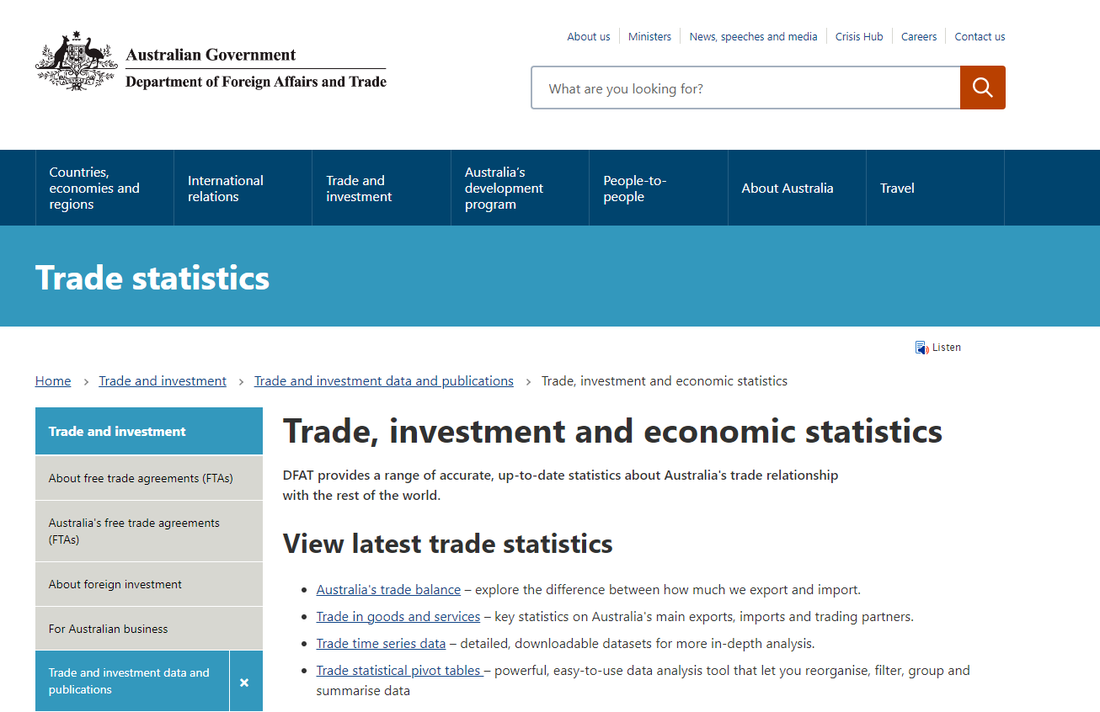
… or Australia …

Slide 72
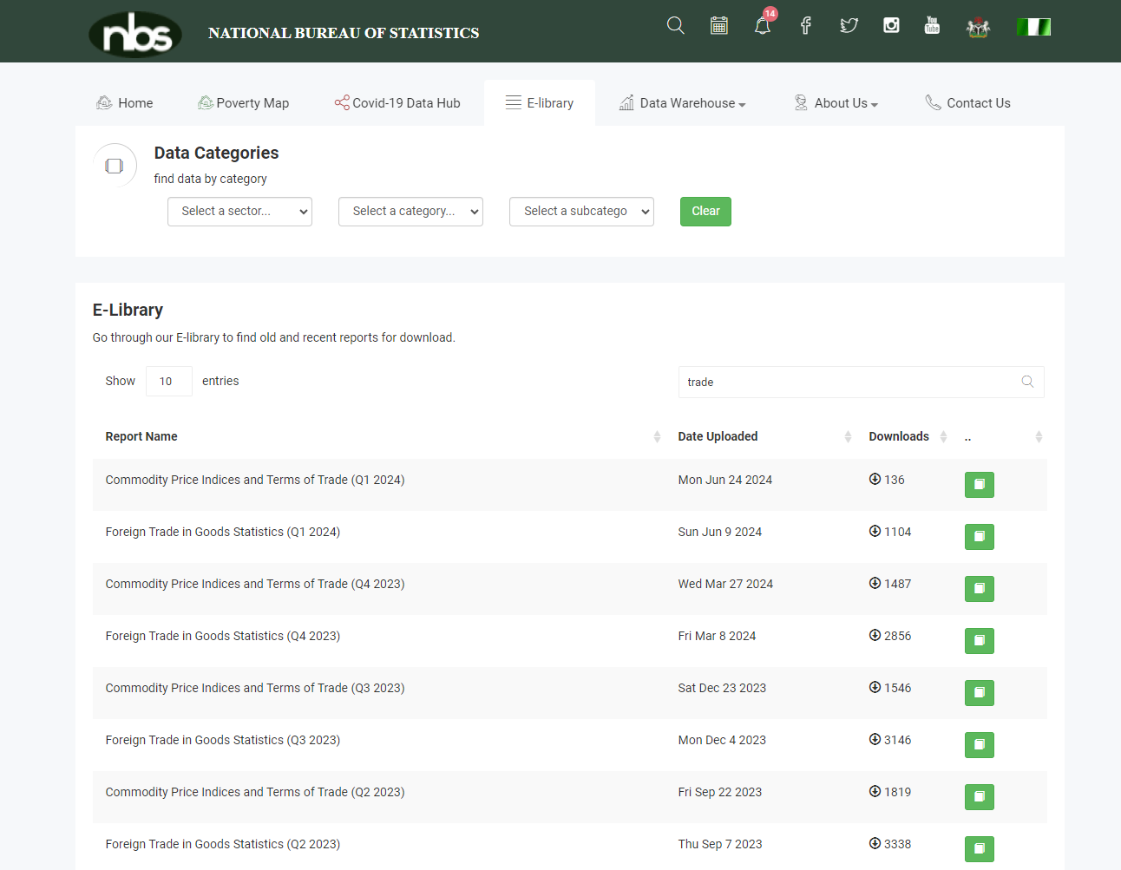
… or Nigeria (among so many others).

Slide 73
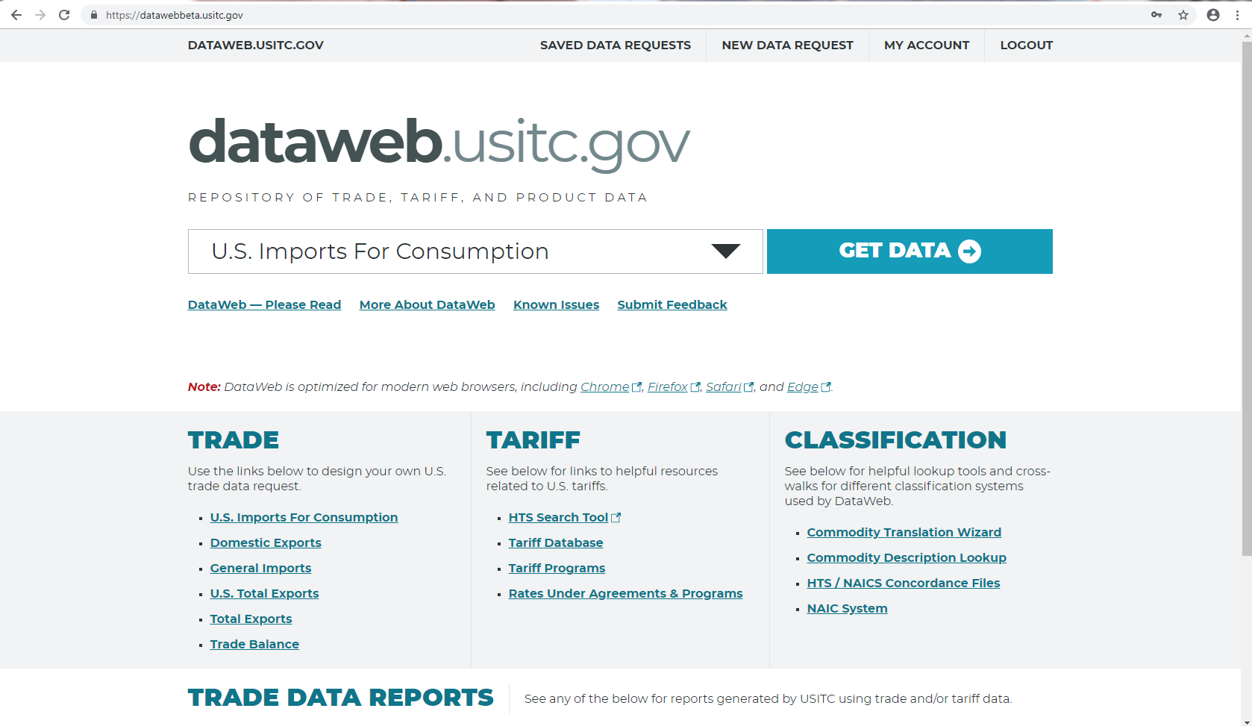
USITC’s DataWeb: dataweb.usitc.gov
Good sources like DataWeb offer many choices in how the data are presented, which creates great opportunities if you understand the distinctions but a trap if you do not.

