Slide 1
The prospects of WTO reform and China’s position
TU Xinquan
Dean and Professor, WTO Chair Holder
China Institute for WTO Studies
University of International Business and Economics
March 2024

Slide 2
Background of this round of discussions on WTO reform
The stagnation or death of the Doha Round strongly hurt the confidence in the negotiation function of the WTO for either developing or developed members
The dispute settlement function of the WTO hurt the self-interest and self-esteem of the United States
The intensifying geopolitical and geoeconomic competition between the US and China hurt the good faith as the basis of the WTO as well as the broader global governance
The expanding income gaps in the developed world hurt the social consensus on globalization

Slide 3
Why has Doha Round failed?
A premature launch lack of wide support in 2001 in either developed or developing countries
Changing power structure in the WTO as well as in the world economy: a multilateral system need a hegemony
Conflicting understandings on the development dimension of the Doha Round between developed and developing countries
A large number of Members makes it difficult or even impossible to reach consensus on all issues at the same time– Single Undertaking;
The high Level of Ambition; The issues – large number and complex;
Electoral cycles and domestic politics

Slide 4
The Changing US attitude toward WTO DSM
It was the US proposing to strengthen DSM during the Uruguay Round when it was so self-confident that DSM could be a useful tool for the US rather than for others
The early years of DSM met with US expectations because it launched more cases than it responded to
But since 2001, other members started to use DMS more actively against US
In particular, the US had lost more than 70% cases which are appealed
More than 70% cases against US were targeting at US trade remedies

Slide 5
The rising tension between US and China
China accounts for 70.5% of the US in terms of nominal GDP in 2020 in comparison with 11.8% in 2000
In 2023 China accounts for 35% of the world manufacturing and is over twice the US
In 2021, China has exceeded the US for the first time as the largest trading nation in merchandise and services combined
The embedded differences in ideology, culture, and political system intensify the economic and power competition between the two countries
President Trump initiated the international conflict with his personal style

Slide 6
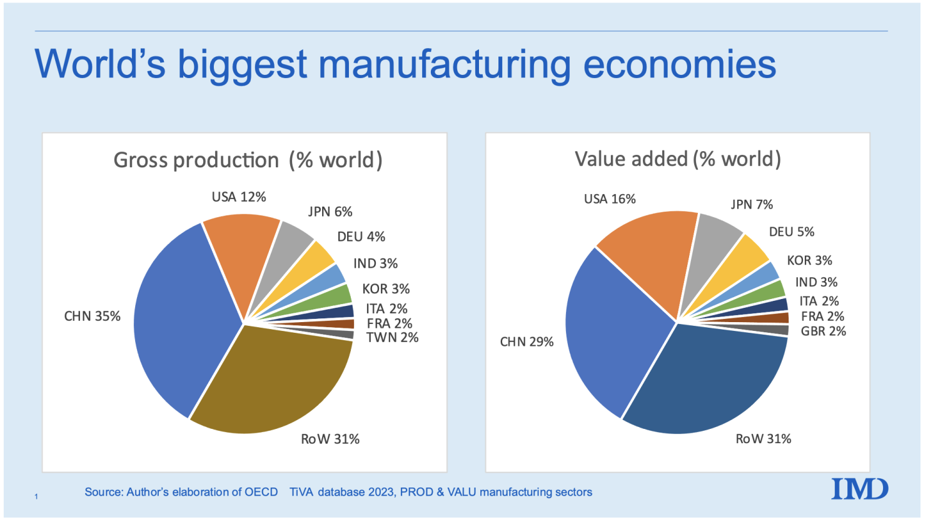

Slide 7
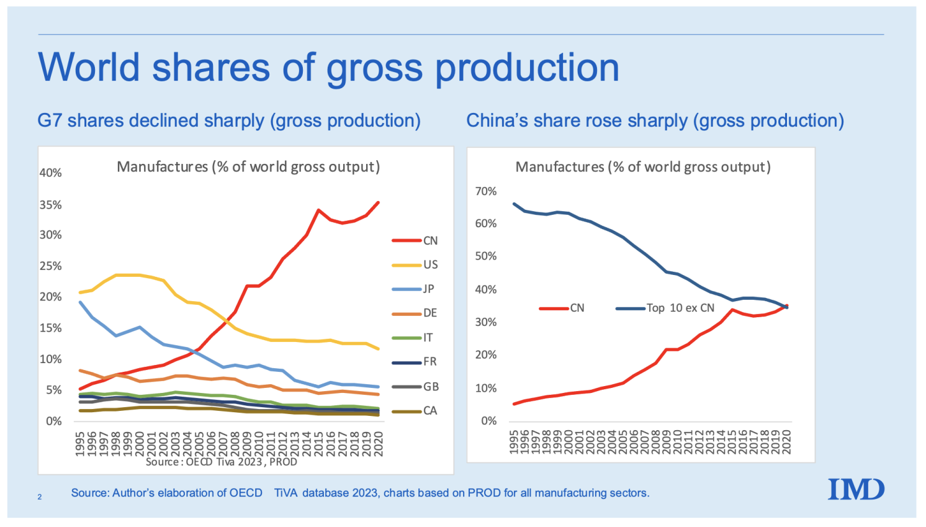

Slide 8
Anti-globalization and income inequality in developed world

Slide 9
The four grievances of US toward the WTO and globalization
The multilateral approach of negotiation weakened the leverage of the US as the only hegemony----The Trump administration implemented a series of unilateral tariffs on multiple members
The independent Appellate Body damaged US power to enforce trade restrictions especially antidumping, countervailing and Section 301actions as it wishes---It has actually shut down the AB
The special and differential treatment to developing members gave unfair advantage to those big emerging members especially China---The US has selected certain developing members which it argues are not eligible for SDT any more
The insufficient rules regulating the specialties of non-market economies gave unfair advantage to them especially or only China---The US decided to reform the existing rules or copy what China has been doing

Slide 10
Developed members are pushing for
WTO reform
US, EU and Japan started the issue of WTO reform on MC11 in Argentina in 2017 in the form of trilateral ministerial statement
They have released seven statements focusing on non-market behavior of the third parties particularly industrial subsidies
The US has never submitted a systematic and constructive proposal of WTO reform but it has very strong position on selected issues especially DSM
The EU is the most active member in terms of designing the reform agenda of the WTO which is intended to preserve the general functions of the WTO
China is the most active developing member in the discussions about WTO reform as it has to repond to those proposals targeting at China
Other developing members are basically silent except the issue of SDT and Appellate Body

Slide 11
Three kinds of thoughts on WTO reform
One extreme of the spectrum is the US which is the most anxious one to push for WTO reform because of its strong grievances over the current system
The US wants a revolution rather than a reform of the WTO
The first purpose of the US is to preserve or take back its freedom to impose unilateral trade restrictions to protect its declining manufacturing by significantly weakening the dispute settlement mechanism
The second purpose is to constrain the competitiveness of China by strengthening rules on industrial subsidies and policies
The third purpose is to increase the market access of large developing members by denying their right to enjoy SDT

Slide 12
Three kinds of thoughts on WTO reform(cont)
The other extrem of the spectrum is China along with some developing members such as India
Their main purpose is to keep the status quo because the current system is fairly beneficial to them
The most important goal is to maintain the two-phase dispute settlement mechanism and to revive the Appellate Body
They want to sustain SDT for developing members which still could self-designate their status
They have somewhat different thoughts about further trade liberalization

Slide 13
Three kinds of thoughts on WTO reform(cont)
The other extrem of the spectrum is China along with some developing members such as India
Their main purpose is to keep the status quo because the current system is fairly beneficial to them
The most important goal is to maintain the two-phase dispute settlement mechanism and to revive the Appellate Body
They want to sustain SDT for developing members which still could self-designate their status
They have somewhat different thoughts about further trade liberalization

Slide 14
Three kinds of thoughts on WTO reform(cont)
In the middle of the spectrum is the EU along with some developed members such as Canada
Their main purpose is to keep the US in the system while to push China to reform
They prefer an independent Appellate Body because they need it balance US hegemony and defend their interest against US unilateral protectionism
They want stronger WTO rules to regulate state interventions in order to compete with China in the Chinese market as well as the whole world market
They would give SDT to developing members but want to attach some conditions to the preferential treatments

Slide 15
China’s basic attitude toward WTO reform
The WTO is good in general and in principle, but in need of necessary reform rather than revolution or restoration
China is not responsible for the current problems and challenges facing the WTO, but contributing to the achievements of the WTO
The core purpose of WTO reform is supposed to sustain the existing principles and framework, to enhance the efficiency and effectiveness of the WTO, and to expand the WTO rulebook to cover new relevant issues
In 2018 and 2019, China released its Position Paper and Proposal on WTO Reform

Slide 16
China is actually the most active developing country in the WTO
China made critical contributions to the conclusion of ITA II
China was the only BRICS country joining the Environmental Goods Agreement negotiations
China gave up almost all SDT in Trade Facilitation Agreement
China has taken part in all plurilateral negotiations on electronic commerce, domestic regulation of services, investment facilitation and MSMEs
China is the only BRICS country joining the MPIA( multi-party interim arbitration ) which is a temporary substitute for Appellate Body
China is the only BRICS country joining all environmental discussions in the WTO and launched the initiation of plastic pollution
All these actions have demonstrated that China has been benefiting from the WTO and has no any intention to destroy it

Slide 17
Area 1: urgent challenges facing the WTO
Appointment of Appellate body members
  Confirm the support of AB mechanism and propose to deal with its technical shortcomings
  China cherishes an independent international judiciary because it is not a hegemon
Abuse of national security exception
  Export controls in the name of national security are dismantling the global supply chain
  Import restrictions in the name of national security are clearly against the common sense and likely to cause a domino effect
Unilateral measures against WTO rules
  Members affected by unilateral measures should have the right to initiate prompt and effective remedies to rebalance the rights and obligations

Slide 18
Area 2: update and expand WTO rules
Unbalanced disciplines on agriculture
  The remaining Doha issues on agriculture should not be forgotten
  While developing countries get more developed, their need for agricultural policy space is rising correspondently
Abuse of trade remedies
  Clarify the definition and classification of subsidies
  Contain the use of trade remedies to support freer trade
Fishery subsidies
  Actively support the conclusion of the negotiation

Slide 19
Area 2: update and expand WTO rules (cont)
E-commerce
  Focus on cross-border trade in goods and related trade in services
  Development dimension of E-commerce is emphasized
  Focus on the balance between regulatory right and internet sovereignty and business and technology development
New issues
  Investment facilitation
  Inclusiveness for MSMEs
  Discussions rather than negotiations

Slide 20
Area 3: enhance the efficiency of the WTO
Improve notification mechanism
  Both developed and developing members should improve the quality of notification, including counter-notification
Improve the daily operations of the WTO
  Improve the procedures
  Adjust the frequency of meetings
  Secretariat should do more research
  Increase the presence of developing countries in the Secretariat

Slide 21
Area 4:increase inclusiveness in terms of different development stages and models
Sustain the right of S&D for developing countries
  The existing S&D is not excessive but inadequate
  It is necessary to conclude Doha negotiations on S&D to make it more enforceable
  Developing countries should actively assume responsibilities appropriate to their development level
Uphold the principle of fair competition
  SOEs are equal players in the market and should not be discriminated
  SOEs are not inherently public bodies under SCM agreement
  National security reviews on SOEs’ investment should be impartial and non-discriminatory

Slide 22
Discussions on WTO reform in China
WTO reform has become a hot topic since 2019
There have been a lot of discussions on this issue among scholars, retired government officials and government agencies
The basic consensus is that China should actively take part in the WTO reform, mainly driven by the concern that China would be excluded from the international economic governance and by the dissatisfaction with the slowness of reform and opening in the recent years

Slide 23
The prospect of China’s engagement in WTO reform
The development of US-China trade war or dialogue will have significant impact on China’s approach toward WTO reform
The contradictory attitude of US toward WTO is also affecting China’s choice: why would we bother to make new rules without an enforcement mechanism?
The government has more political concerns about faster reform and opening up
Although China’s position paper seems a little conservative, flexibilities could be developed from China’s proposal

Slide 24
MC12 and the future of WTO reform
June 13 to 17, the 12th Ministerial Conference was successfully concluded with 10 outcome documents
The results are much better than previous expectations and give a breathing space to the WTO facing a bunch of bad news
DG Ngozi played a critical role in stimulating the sense of urgency and mediating different interests
China and the US had good cooperation in the ministerial
India showed an uncommon constructive attitude in the negotiation
The outcomes are not so significant for members’ economic and political interest

Slide 25
Main outcomes of MC12
Agreement on fisheries subsidies prohibits support for illegal, unreported and unregulated (IUU) fishing and bans support for fishing in overfished stocks.
Ministerial Declaration on the WTO response to the current and future pandemics including a waiver of certain requirements under TRIPS concerning the use of compulsory licences to produce COVID-19 vaccines.
Ministerial Declaration on the emergency response to food insecurity and a Ministerial Decision on exempting World Food Programme (WFP) humanitarian food purchases from export prohibitions or restrictions.
Work Programme on electronic commerce, WTO members agreed to maintain their current practice of not imposing customs duties on electronic transmissions
MC12 outcome document committed members to work towards reform of the organization to improve all its functions through an open, transparent and inclusive process. The review will be carried out through the WTO's General Council and its subsidiary bodies, with the goal of submitting possible reform proposals to MC13.Ministers also agreed to talks on addressing concerns with respect to the WTO's dispute settlement system with the view to securing a fully functioning system by 2024.

Slide 26
Outcome of MC13 in 2024
Abu Dhabi Ministerial Declaration
Extension of duty free on electronic transmission
Ministerial Decision on Dispute Settlement Reform: “We instruct officials to accelerate discussions in an inclusive and transparent manner, build on the progress already made, and work on unresolved issues, including issues regarding appeal/review and accessibility to achieve the objective by 2024 as we set forth at MC12. ”
“We reaffirm our commitment made at our Twelfth Session to work towards necessary reform of the WTO to improve all its functions and acknowledge the progress made in this regard.”

Slide 27
Progess of Joint Statement Initiatives
On 6 July 2023, over 110 WTO members participating in the talks on investment facilitation for development (IFD) announced the conclusion of the negotiations on the text of the Agreement following three years of intense text-based negotiations(starting from December 2017). On MC13, 125 members concluded the agreement but failed to include it into WTO
On 2 December 2021, 67 WTO members adopted a Declaration announcing the successful conclusion of negotiations on services domestic regulation aimed at increasing transparency, predictability and efficiency of authorization procedures for service providers hoping to do business in foreign markets.(starting from December 2017). On MC13, it was incorporated into WTO
The MSME package of recommendations and declarations, adopted in December 2020, was sponsored by 97 WTO members
A group of 71 WTO members agreed at the 11th Ministerial Conference in December 2017 to initiate exploratory work towards future WTO negotiations on trade-related aspects of e-commerce. They agreed to "seek to achieve a high standard outcome that builds on existing WTO agreements and frameworks with the participation of as many WTO members as possible".

