Slide 1
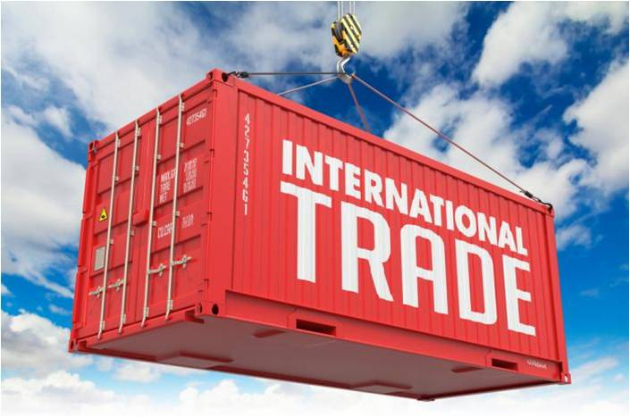

Seminar One: introduction to the world trade organisation
Globalisation, WTO Law and India’s Participation
Dr Amrita Bahri,
WTO Co-Chair for Mexico;
Assistant Professor of Law, ITAM
Amrita.bahri@itam.mx

Slide 2

Economic Globalization
Definition: ‘the closer integration of the countries and peoples of the world ….brought about by the enormous reduction of costs of transportation and communication, and the breaking down of artificial barriers to the flow of goods, services, capital, knowledge and people across borders.’

Slide 3
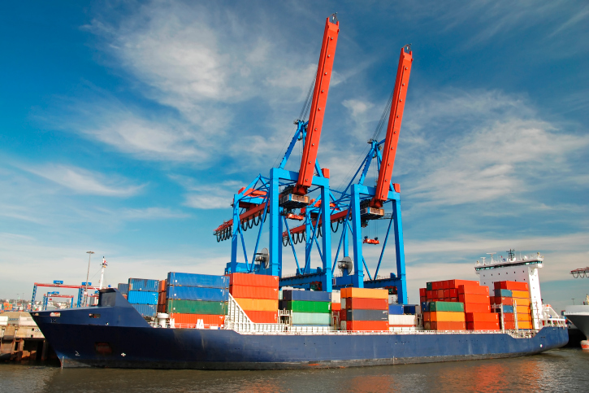

What drives economic globalisation?

Slide 4
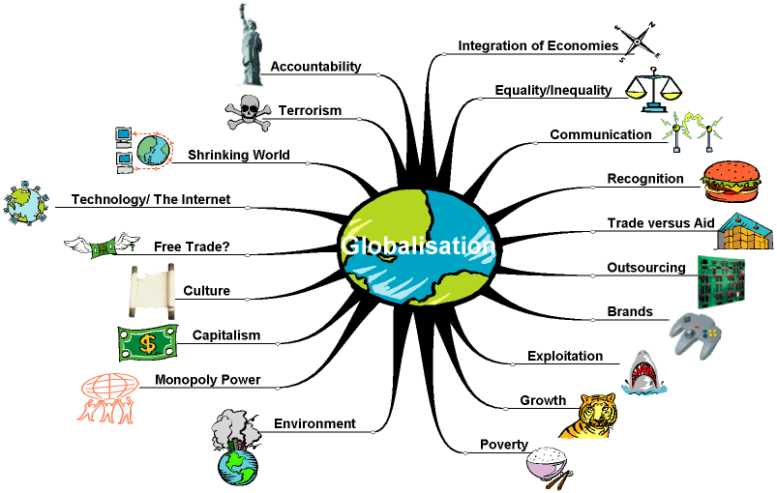

Slide 5
Questions??
Discuss three concrete examples of how economic globalisation has positively affected your lives?
Discuss three concrete examples of how economic globalisation has negatively affected your lives?

Slide 6
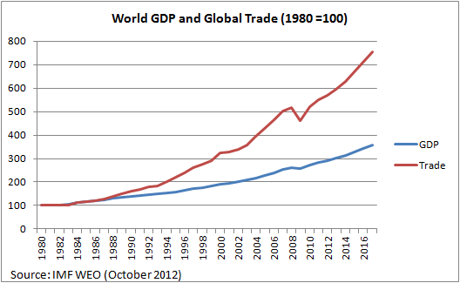

Slide 7
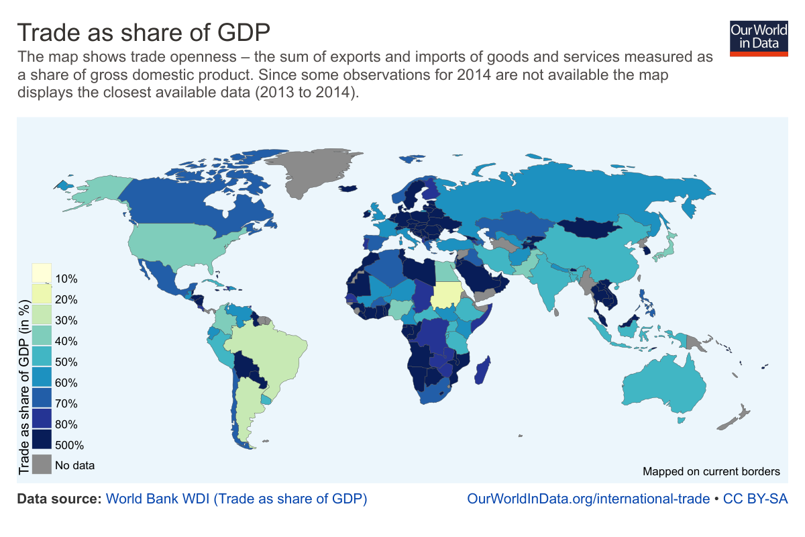

Slide 8
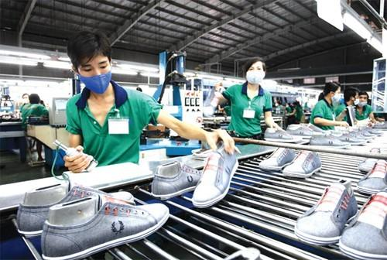
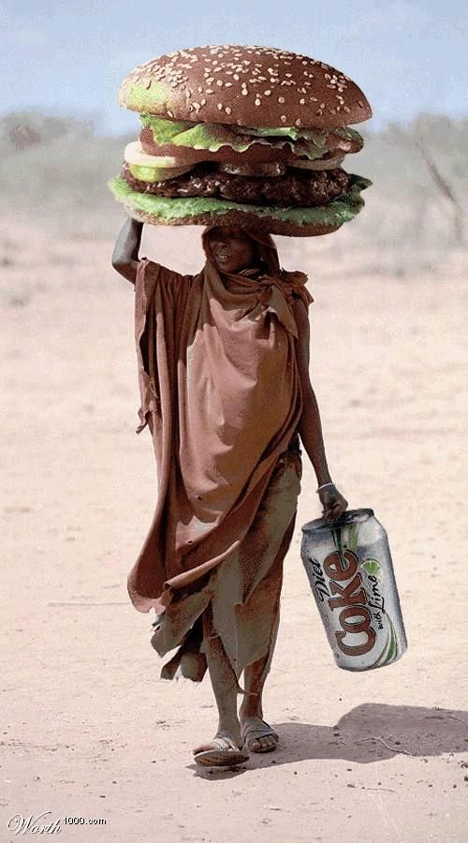

Telling Examples of Economic Globalisation

Slide 9
Economic Globalisation: A Blessing or Curse?
See Darwins Nightmare Documentary
https://www.youtube.com/watch?v=qJhHLUbdUjg

Slide 10
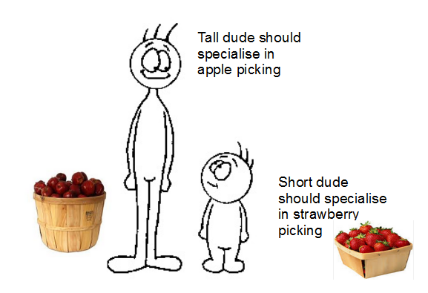
Benefit 1: Absolute Advantage Versus Comparative Advantage (profitable division of labour)

Slide 11

Benefit 2: Cross Border Friendships and Peace
‘If goods do not cross borders, soldiers will.’

Slide 12

Benefit 3: Mobility

Slide 13
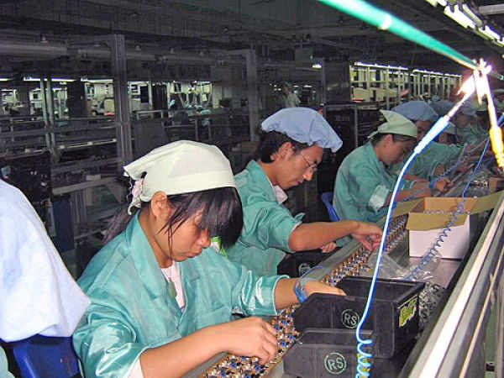
Benefit 4: Employment

Slide 14

Benefit 5: Standard of Life

Slide 15

Benefit 6: Economic Growth

Slide 16
Then, Why Protectionism???

Slide 17

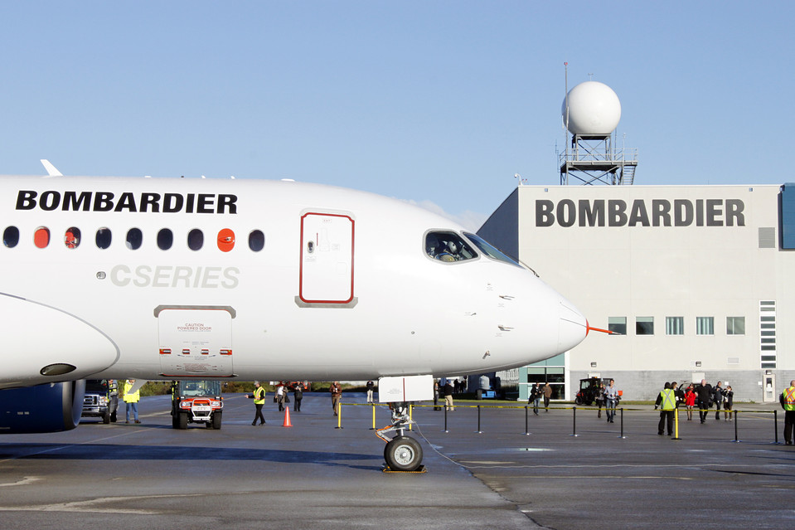
Protectionism Reason 1: Threat to Domestic Industry

Slide 18

Protectionism Reason 2: Loss of Employment

Slide 19

Protectionism Reason 3: Generating revenue

Slide 20
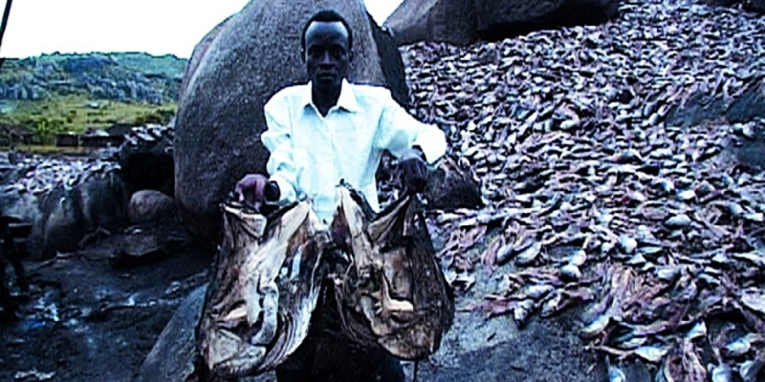
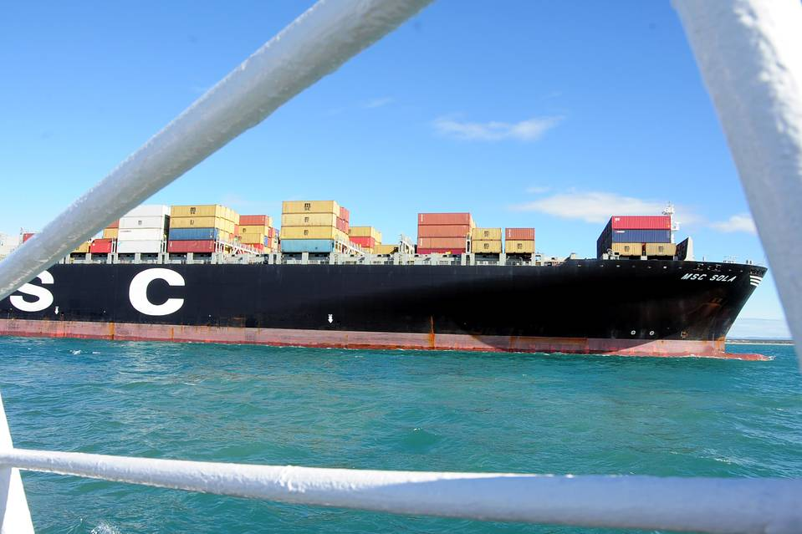
Protectionism Reason 4: National Security and Self Sufficiency

Slide 21

Protectionism Reason 5: Public morals

Slide 22

Protectionism Reason 6: Public health

Slide 23
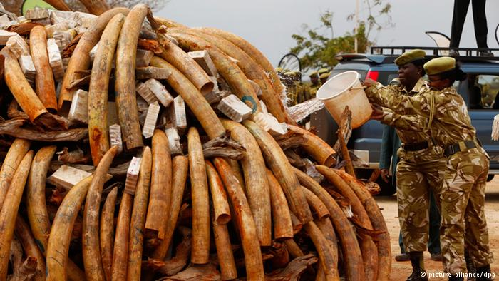
Protectionism Reason 7: Environment and Ecology

Slide 24

International Trade is like a free-for-all highway

Slide 25
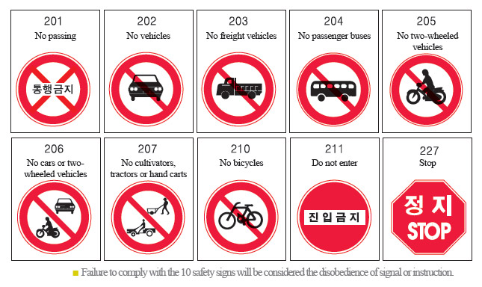
What is needed to ensure that there is a room for poor rickshaws on a hundred-lane highway?

Slide 26
Types of Trade Agreements
Multilateral – 2 or more – for strengthening the economies through exchange of goods and services
Bilateral – 2 – for smooth exchange of good and services between two countries
Regional/preferential –2 or more – for preferential exchange of goods and services between member countries
Regional/Free trade agreements – between 2 or more – for free exchange of goods and services between member countries without any tariff or non tariff barriers

Slide 27

International Rules for International Trade

Slide 28
https://www.wto.org/english/thewto_e/countries_e/org6_map_e.htm
WTO Membership: 164

Slide 29
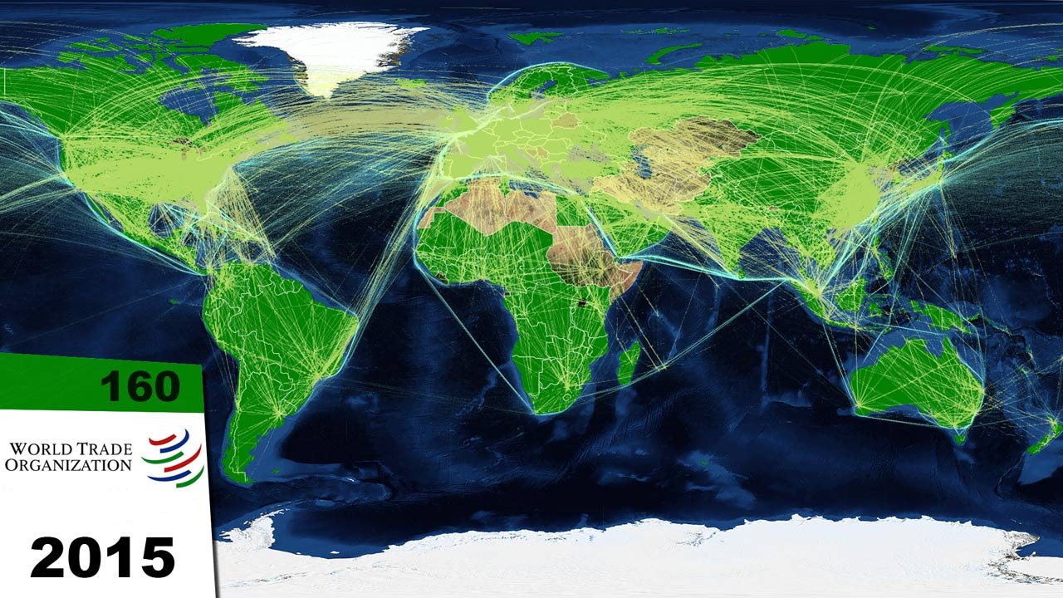
International Trade and Globalisation

Slide 30
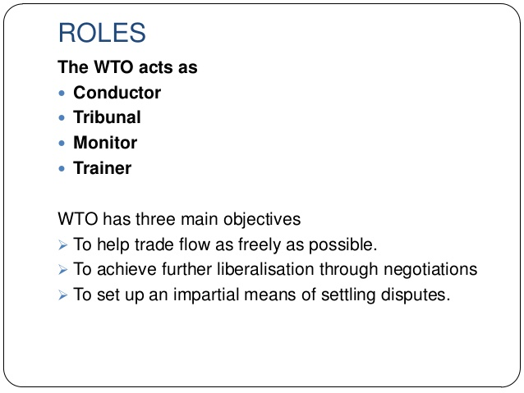

Slide 31
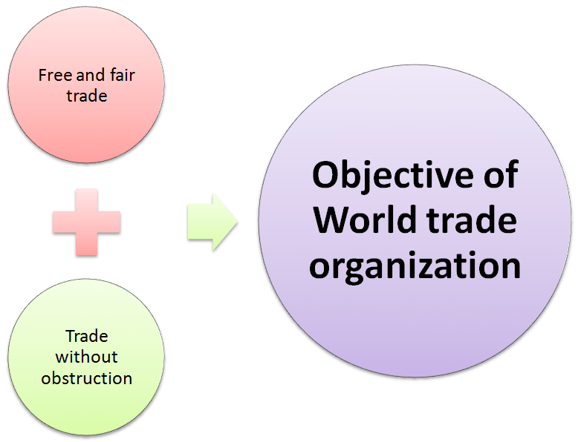
WTO’s Objectives (set out in the Preamble)
High standard of living and low poverty
Attainment of full employment
Growth of real income and effective demand
Expansion of production of, and trade in goods and services
Sustainable economic development (environmental and social concerns <developing countries>)

Slide 32
Instruments to Achieve these Objectives (Set out in the Preamble, WTO AGREEMENT )
The reduction of tariff barriers or other barriers to trade
The elimination of discriminatory treatment in international trade relations
These were also the main instruments under GATT 1947

Slide 33
Functions of WTO (Article III, WTO Agreement)
Broadly, the function is:
To provide the common institutional framework for the conduct of trade relations among its Members related to the agreements and associated legal instruments included in the Annexes.
Specifically, 6 key functions:
The implementation of WTO agreements
The negotiation of new agreements
The settlement of disputes
Trade policy review
Cooperation with other organisations
Technical assistance to developing countries – IMPLICIT

Slide 34
WTO’s Substantive Rules
Non-discrimination (MFN and NT) READ ART. I AND III, GATT 1994
Market Access READ ART. XXVIII GATT 1994
Rules on conflict between trade liberalisation and societal values and interests (General Exceptions) READ ART. XX GATT 1994
Rules promoting harmonisation of national regulation in specific fields READ PREAMBLE OF SPS, TBT, TRIPS AGREEMENTS
No unfair trade READ ART. VI AND XVI GATT1994; SCM; AGREEMENT ON INTERPRETATION OF ART. VI
https://www.youtube.com/watch?v=OYFyumds_uI
Exceptions: Waivers and non-application clauses

Slide 35
Procedural Rules of WTO
Rules relating to decision-making READ ART. IX:1, FOOTNOTE 1, GATT 1994
Rules relating to negotiations
Rules relating to dispute settlement READ PREAMBLE, DSU AGREEMENT
These rules are required to implement and administer the substantive rules of WTO

Slide 36
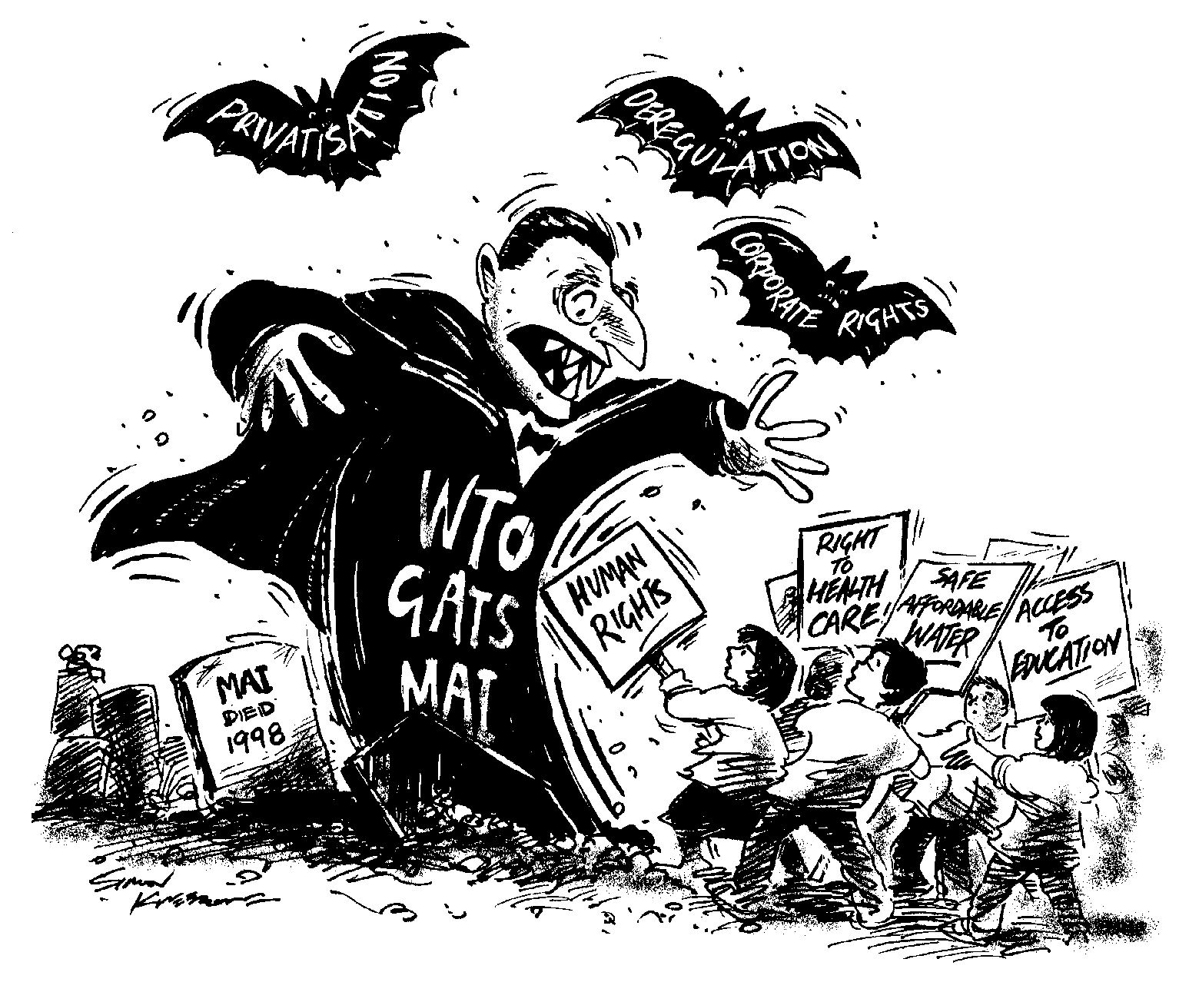
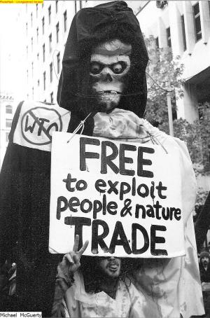
Are you a Globaphobe?

Slide 37

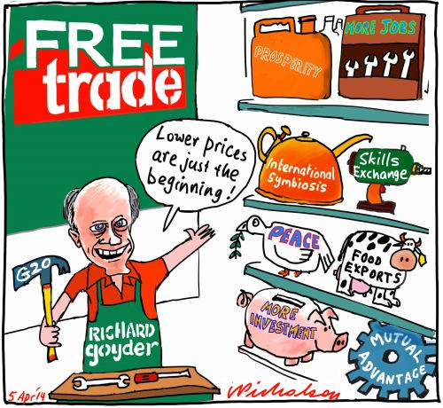

Are you a Globaphile?

Slide 38
Dispute Settlement: Overview
Goal: secure compliance
Application: covered agreements
Actors: Members, DSB, Panels, AB, Secretariat
Standing: all Members have interest in system
Role of DSS: security & predictability
  Enforce (not add or subtract) rights and obligations, clarify provisions
Legal effect of reports: de facto precedents

Slide 39
Object and Purpose of DSU
Art 1.1, DSU – one integrated system for all WTO disputes
Art 1.2 – special and additional rules in specific Agreements (prevail in case of a conflict)
Art 3.2, DSU Agrmt – Objective
Art 23.1 and 23.2 (a) – compulsory, exclusive jurisdiction
Art 23.1, DSU Agrmt – Obligation of Members towards multilateral dispute settlement
Art 23.2 – no unilateral determinations and actions (US wasn’t best at it!)
Art 3.7 – Settlement through consultations if possible
Art 3.2 r/w Art 19.2 – cannot add or diminish rights, only clarify and enforce them

Slide 40
Methods of Dispute Settlement
Consultations by negotiations (Art 4)
Adjudication by Panels and ABs ((Art 6 to 20)
Arbitration as ADR (Art 25)
Good offices, conciliation and mediation as ADR (Art 5)
Arbitration to determine issues during adjudication (Art 21.3 c and Art 22.6)

Slide 41
Access to WTO dispute settlement system
Only WTO members can sue or be sued
Cause of Action – Art XXIII:1, GATT 1994
Three Types of complaints:
(a)Violation,
(b)Non violation and
(c)Situation complaints
Nullification or impairment of benefit or hindrance of objective – presumed in violation complaints
No requirement of a legal interest in dispute – EC-Bananas III
Measures: Four types of subject can be challenged:
(a)Measures by private parties (with govt intervention)
(b)Measures that are no longer in force (with current effect on the operation of agreement)
(c)Specific national legislation (Section 302 and 304, US Trade Act 1974)
(d)Application of national legislation and procedures
Confidentiality of information and proceedings – Art 18, DSU (but full right to compose delegations and hire lawyers)

Slide 42
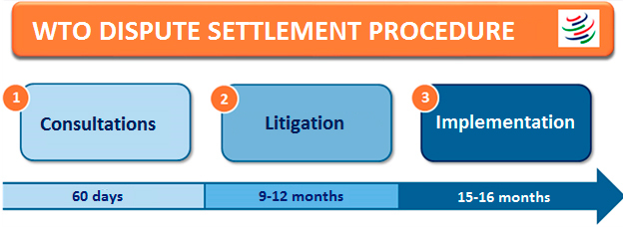
Dispute Settlement Process

Slide 43
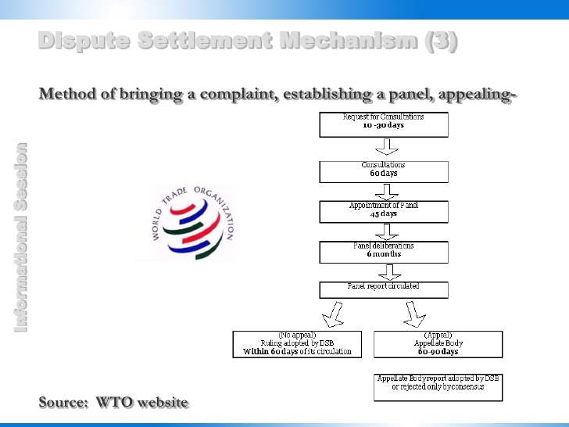

Slide 44
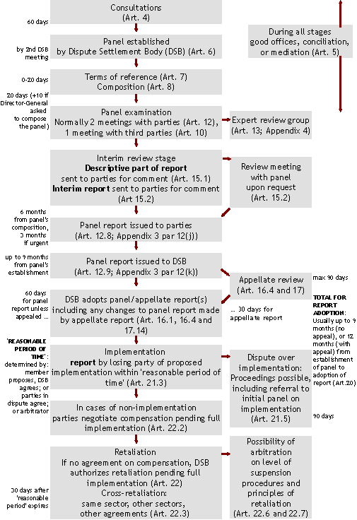

Slide 45
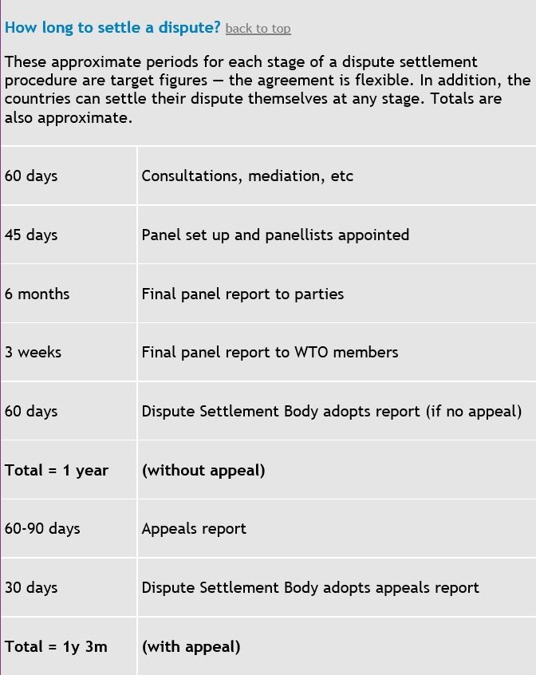

Slide 46
Stages
Consultations: 60 days
Panel: 9 months +
Appeal: 60 or 90 days
Implementation
  Reasonable period of time to comply: 15 months
  Compliance panel, appeal
  Suspension of benefits

Slide 47
Remedies
Permanent remedy: Withdrawal of inconsistent measure or amendment in the law - Art 3.7 DSU
Art 3.7 r/w Art 19.1 r/w Art 21.1, DSU – Immediate compliance
Art 21.3 (c) – determination of reasonable period of time for compliance
reasonable period of time:
  Proposed by Member & DBS approved
  Agreement of parties
  Arbitration (15 months is guideline)
Surveillance: status reports at DSB meetings
Temporary measures pending compliance - Art 22.1
  Compensation (voluntary, negotiated, prospective)
  Suspension of concessions (retaliation and cross retaliation) Art 22.2

Slide 48
US-Gambling
US measures were inconsistent with GATS, and it did not comply with the report after loosing the WTO battle.
Antigua requested authorisation to suspend concessions under GATS and TRIPS both
Retaliation in GATT AND GATS would impact 49 percent people as they rely on imported goods and services from US, AND not affect US as much as it is 0.02 percent of their total exports.
Hence, cross retaliation was necessary in this case – suspended its obligation to protect US copyrights, patents, trademarks, industrial designs and data protection to an amount of 3.4 billion USD an year (equal to level of impairment as per Art 22.4)

Slide 49
Questions?
Which of these remedies is most effective? Why?
Problems with:
-withdrawal of measure
-suspension of concession
-compensation
Can you suggest an alternate remedy?

Slide 50
Participation of Countries at WTO DSU (1995-2015)
Country | Complainants | Respondents | Third Party | Total Participation
USA | 122 | 147 | 143 | 412
EU | 99 | 85 | 174 | 358
Japan | 24 | 15 | 179 | 218
China | 17 | 42 | 147 | 206
Canada | 39 | 23 | 125 | 187
India | 24 | 25 | 131 | 180
Brazil | 31 | 16 | 118 | 165
Republic of Korea | 20 | 17 | 119 | 156
Australia | 8 | 16 | 104 | 128
Mexico | 25 | 15 | 85 | 125

Slide 51
Participation of Middle Income Countries at WTO DSU (1995-2015)
Country | Complainants | Respondents | Third Party | Total Participation
China | 13 | 33 | 121 | 167
India | 21 | 22 | 108 | 151
Brazil | 27 | 15 | 95 | 137
Mexico | 23 | 14 | 75 | 112
Thailand | 13 | 3 | 71 | 87
Turkey | 2 | 9 | 67 | 78
Guatemala | 9 | 2 | 34 | 45
Ecuador | 3 | 3 | 31 | 37
Indonesia | 10 | 13 | 13 | 36
Honduras | 8 | 0 | 26 | 34
Peru | 3 | 5 | 19 | 27
Philippines | 5 | 6 | 14 | 25
Vietnam | 3 | 0 | 19 | 22

Slide 52
Participation Challenges: Developing Countries
lack of the monitoring capacity to monitor foreign trade practices, identify trade barriers and ensure compliance
Paucity of in-house legal and economic expertise and experience in WTO Law
Insufficient financial resources for hiring overseas trade lawyers and economic consultants
Paucity of political, diplomatic and subject-matter expertise within the government to gather information and coordinate tasks
Poor information channels and ineffective governance structures lead to problems in gathering information and evidentiary documents
Inadequate powers of retaliation and bargaining lead to difficulties in negotiating or ensuring compliance even after a favourable ruling
Fears of adverse diplomatic and economic retaliation from stronger market powers and powerful trade partners.
Insufficient knowledge and awareness about the benefits of WTO DSU provisions
Capacity-gap between the developing and the developed world

Slide 53
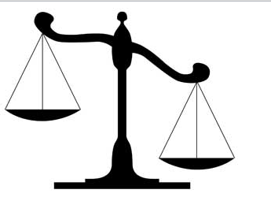








Capacity Gap
Developing Countries
Developed Countries
Finance
Information-generation
Legal expertise
Managerial workforce
Administrative co-ordination
Political willingness & support
Compliance enforcement capacity

Slide 54
How can this gap be bridged? TWO OPTIONS
The first option: changes at the international level (which can include changing WTO rules)
Second option: find solutions at the domestic level.

Slide 55
First Option: What has been done at international level?
Relaxed and favourable reciprocity and time requirements,
Legal assistance extended by the Secretariat and ACWL (Art 27.2, DSU)
Differential market access: the Enabling Clause.
Delayed timelines for ratification commitments
Representation in dispute settlement panels
Training at legal affairs division
Technical assistance provided by secretariat
And many more……… https://www.wto.org/english/thewto_e/whatis_e/tif_e/dev1_e.htm

Slide 56
First Option contd..: What more can be done at international level?
Introduction of retrospective and mandatory financial compensation as a remedy
Creation of a fast track and simplified procedure of adjudication for cases with established precedents.
creation of a WTO Fund which can provide them with financial assistance during dispute settlement proceedings
appointment of a special WTO prosecutor for developing countries
More technical and administrative assistance
training of adjudicators on special and differential treatment provisions contained in the WTO agreements
allowing direct applicability of WTO Law in national courts for enabling developing countries to self-enforce favorable awards.
And the list does not end here……….

Slide 57
Second Option: What can done at domestic level?
Some prominent proposals:
1. Establishment of domestic monitoring centers, think tanks, research centers
2. Creation of legal service centres, law schools, pro bono work by law firms
3. Engagement of private sector for identifying and challenging trade barriers
4. Increased third party participation at WTO DSU
5. Creation of information-sharing channels between government departments and between government and industry
6. Establishment of inter-ministerial framework of governance and dedicated WTO dispute settlement unit within the appropriate government
Leaders of these strategies: Brazil, China and India
Focus: Government-industry coordination (PPP)

Slide 58
PPP at WTO DSU
Four Features of WTO DSU
Cost Implications
Domestic and International Levels
Public Private Partnership
Three Central Issues
1. Why?
2. How?
Inter-governmental process
Private Interests and resources
3. Any Downsides?

Slide 59
Public Private Partnership: Potential Stages of WTO Dispute Settlement Proceedings
Pre-Litigation
Stage 1: Identification of foreign WTO-inconsistent policy
Stage 2: Private sector's cost-benefit analysis for removal of impugned measure
Litigation
Stage 4: Administration and preliminary examination of a trade issue
Stage 7: Preparation and litigation of a case at the WTO
Post- Litigation
Stage 8: Calculation of retaliation threats for arbitration
Stage 9: Generation of public and political foreign support for impugned policy removal
Stage 3: Convince domestic government to investigate and litigate the dispute at the WTO
Stage 5: Investigation and internal consultation
Stage 6: Initiation of bilateral or multilateral consultations

Slide 60

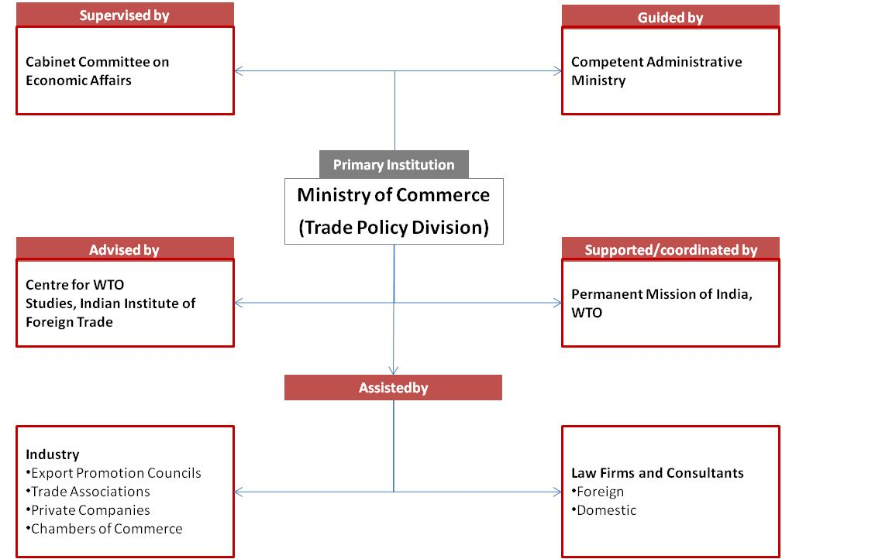
India: Key Participating Actors

Slide 61
EC-Bed Linen
Measure at Issue: India requested consultations with the EC in respect of antidumping proceedings initiated by the EC against the imports of cotton-type bed-linen products from India. India alleged that the anti-dumping duties, GATT 1994. The Panel and the Appellate Body partially upheld the claims made by India
An instance where an export promotion council coordinated with the government throughout:
The barrier was identified by TEXPROCIL
‘TEXPROCIL participated in the investigations, consultations, in meetings with the Panel, and in preparation of the legal documents for the litigation.
It provided all the required information’.
It also played a proactive role at the enforcement stage of the dispute. TEXPROCIL continued to monitor the EC’s progress in implementing the award. On finding that the award was not being implemented, TEXPROCIL again approached the Ministry of Commerce with the evidence of non-implementation and convinced the Government to initiate compliance proceedings against the EC.
TEXPROCIL hired the Brussels based Vermulst Verhaeghe & Graafsma law firm for preparing and presenting the case at WTO, and paid a substantial amount of their legal fees.

Slide 62
Turkey-Cotton Yarn
Measure at Issue: India challenged Turkey’s safeguard measures on imports of cotton yarn from all origins. After formal consultations with India, Turkey withdrew these measures and the dispute therefore phased out at the consultation stage.
PPP Example:
The private sector identified the barrier
TEXPROCIL preliminarily investigated the matter and filed an application with the Ministry of Commerce
The matter was investigated with the help of the commercial inputs provided by the private sector and their lawyers.
The request for consultation was prepared with the assistance of TEXPROCIL’s hired lawyers and the commercial facts provided by the Industry.
The national delegation during formal consultations at Ankara also comprised a representative from TEXPROCIL and its lawyers
The complete information and commercial analysis was provided by TEXPROCIL
The lawyers in the matter were hired and initially paid for by TEXPROCIL.

Slide 63
Formal System of PPP
Benefits
V/S
Problems
Transparency
Awareness
Regulation
Defined procedures
Confidence/confidentiality rights
Cost and complexity
Procedural burden
Evidential burden
Confrontational/litigious option

Slide 64
Informal Public Private Coordination
Benefits
V/S
Problems
Flexibility
Non-litigious
Tailor-made procedures
Need based
Regulatory concerns
Lack of Confidence/confidentiality concerns
Lack of Awareness
Transparency concerns

Slide 65
PPP is Good………..Aircraft Disputes
Canada-Aircraft and Brazil-Aircraft: between Canadian and Brazilian Governments or between Bombardier and Embraer?
Protection of Embraer was economically and politically important
Delegation of WTO litigation work from public to private
Benefit: Enhanced financial and evidential resources required for WTO litigation (capacity-building)
Hold On……..EC-Measures Affecting Soluble Coffee
Government of Brazil and Brazilian Soluble Coffee Industry Association (ABICS) working in partnership during bilateral negotiations
The EU’s conditional proposal of lifting alleged tariffs from Brazilian coffee exports; accepted by the Brazilian Government
Wider harm: no voice raised against the tariffs on Brazilian import of sugar, cereals, dairy products, tobacco, meat and some fruits (all of which are important Brazilian exports)
A clash between special interest and wider economic and social interests

Slide 66

Threat of “Private Capture”

Slide 67
How to regulate dispute settlement partnerships?
Benefits
V/S
Problems
Transparency in decision-making
Supervision of partnerships
Defined procedures of resource exchange
Confidence/confidentiality rights
Cost and complexity
Procedural burden on the resource-constrained governments
Who regulates? Whom? How? When?
Confrontational edge
Is the EU heading the right way?
App Competition;
Unconference in June 2016 on achieving better transparency

Slide 68


