Slide 1

Indonesia-Japan Economic and Trade Relations: Updates, Focus on Small & Medium Enterprises/SMEs
Dr. Riza Noer Arfani
Pusat Studi Perdagangan Dunia
Universitas Gadjah Mada
Webinar “Toyota Way: Value, Ethics and Business” (July 10th 2020)

Slide 2
Context 1a: Economic Cooperation - Government to Government (G to G)
Key Scheme: Indonesia-Japan Economic Partnership Agreement (IJEPA)
  Performance of Trade in Goods and Services
  FDI (Foreign Direct Investment) Measures and Trade Facilitation
  Indonesian Workers Dispatching to/in Japan (Nurse and Caregivers)
  Capacity Building for Indonesian Business Competitiveness and Supporting Industries, incl. SMEs
  Market Development and Consumers/People Purchasing Power
Other Schemes:
  ASEAN and APEC-driven Schemes: AFTA/AEC, ABAC (APEC Business Advisory Council), etc.
  TPP or CP-TPP-driven Schemes: “High Quality” Trade Agreements
  WTO-driven Schemes: Multilateral, Plurilateral Agreements
Key Issues and Challenges
  How to Link G to G schemes with other Schemes (B to B and/or P to P)
  Market and Industrial Governance, i.e. particularly with regards to domestic “Supply and Value Chains” management (in the framework of integrating to regional/global production and commodity networks)

Slide 3
Context 1b: Economic Cooperation - Business to Business (B to B)
Japanese Business and FDIs—driven Schemes
  Leading industrial and commodity sectors (such as transportation/automotive, electronics, machinery, power generation, etc.)
  Backward and forward linkages of those sectors: vertical integration and fragmentation of production of Japanese lead firms (especially in automotive and electronics sectors)
  Japanese government-supported facilitation measures (e.g. via JICA, HIDA, etc.)
  Roles of Japanese Business Clubs (such as Jakarta Japan Club/JJC)
  Eminent Persons Groups (EPGs), i.e. to explore role and missions of “Japanese Lobby” in Indonesia
Other Schemes
  Indonesian Business-driven Schemes, i.e. to include Japanese local subsidiary companies/enterprises/franchisers
  Indonesian state-owned enterprises (SOEs) schemes
  Japanese SMEs-driven schemes
Key Issues and Challenges
  How to develop and enhance business networks among “horizontal” supply and commodity chains

Slide 4
Context 1c: Economic Cooperation - People to People (P to P)
Schemes to Develop
  Japan-ASEAN think tanks-based and university to university (U to U) cooperation schemes, such as ERIA, U to U MoUs/MoAs, Practices of Business Communities (such as ASEAN Nagoya Clubs/ANC), etc.
  ASEAN-Japan EPG, i.e. to widen its perspectives towards a more varied community/business groups
  Trans-national supply/commodity chains which involve Japanese lead firms and their local subsidiaries, suppliers, etc. (e.g. “Company to Company” Management Training, Product Standards and Design Training, Corporate Culture and Business Ethics Training, such as Toyota Production System/TPS or Toyota Way, Just-In-Time Management, Kaizen, etc.)
Key Issues and Challenges
  Integration of P to P schemes to B to B and G to G ones
  Alternative to Integrate #1: Government-driven (Ministry of Foreign Affairs and Trade/Industry)
  Alternative to Integrate #2: Business-driven (via e.g. Toyota Networks and Initiatives)
  Alternative to Integrate #3: Academic/SMEs-driven (e.g. collaborations of UGM (through its SMEs Supervisory Programs/Program Pendampingan UMKM with Toyota/TMMIN and PT YPTI)

Slide 5
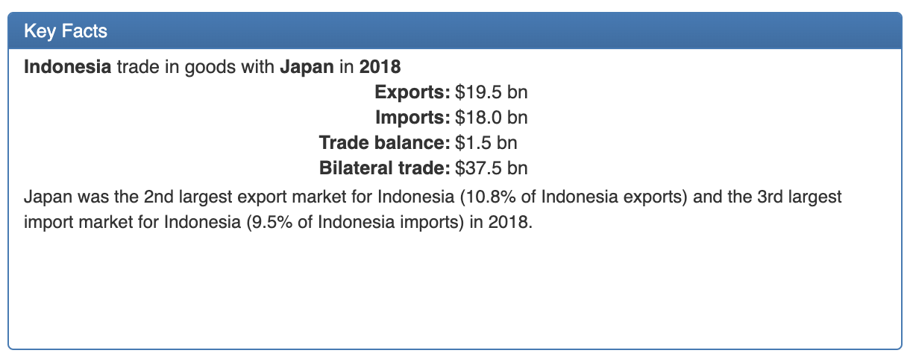
Context 2a: Trade Relations (IDN-JPN Trade Baselines as of 2018)
Source: UN Comtrade-WITS (2020)

Slide 6
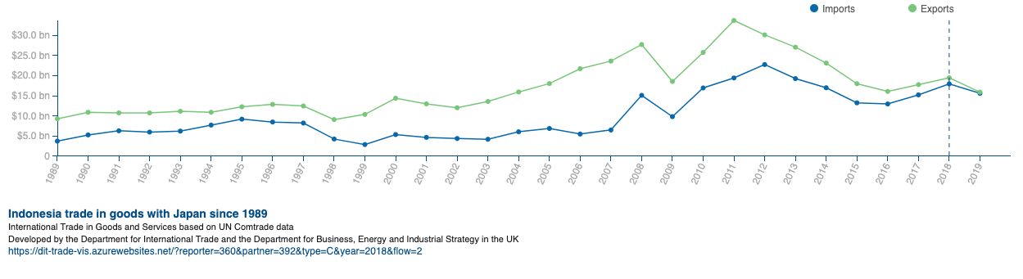
Context 2b: Trade Relations (IDN-JPN Trade Statistics, since 1989)
Source: UN Comtrade-WITS (2020)

Slide 7
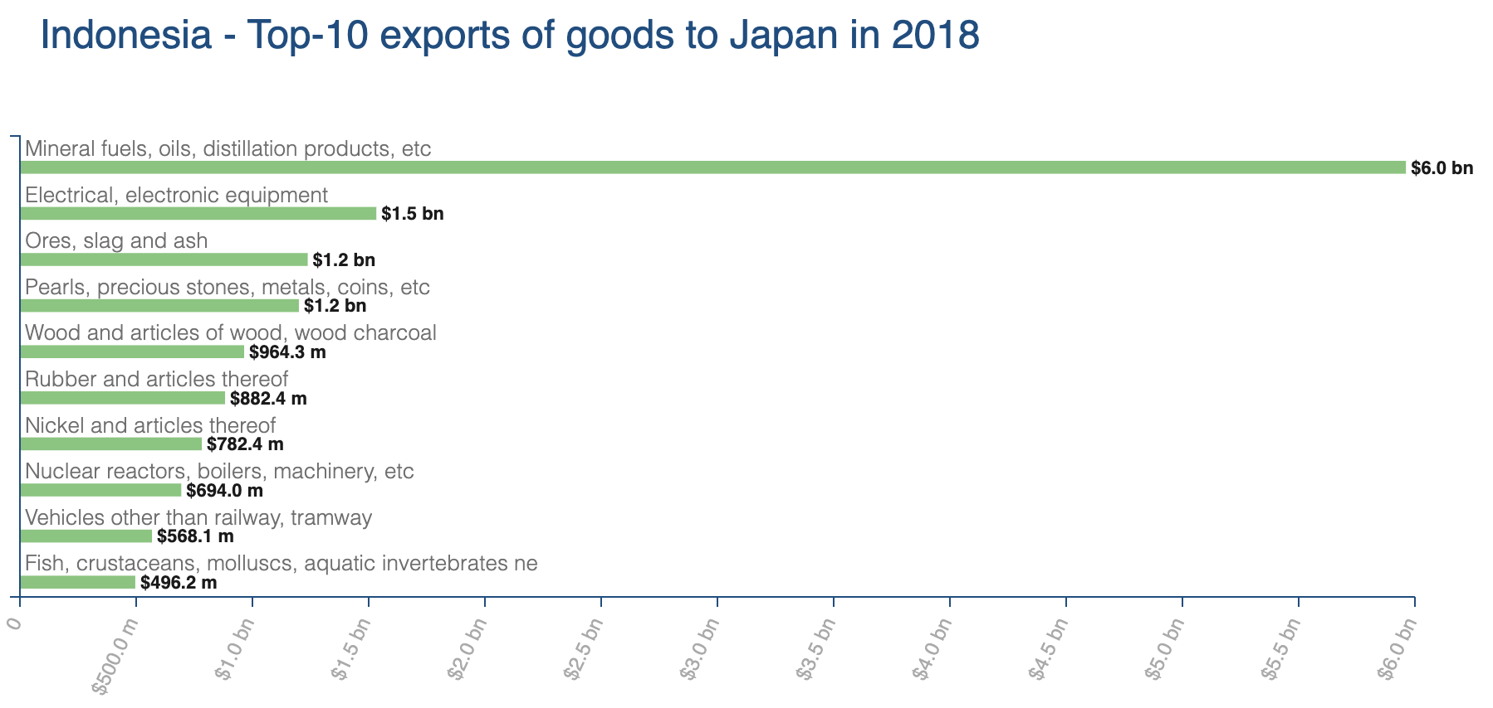
Context 2c: Trade Relations (IDN Exports to JPN)
Source: UN Comtrade-WITS (2020)

Slide 8
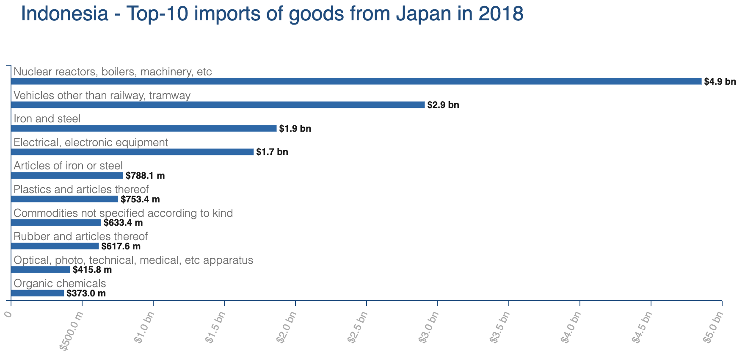
Context 2d: Trade Relations (IDN Imports from JPN)
Source: UN Comtrade-WITS (2020)

Slide 9
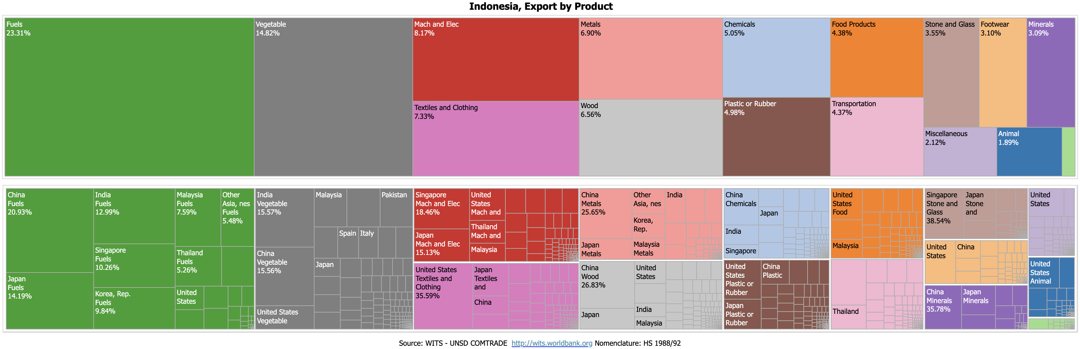
Context 2e: Trade Relations (where JPN located in IDN Exports)
Source: UN Comtrade-WITS (2020)

Slide 10
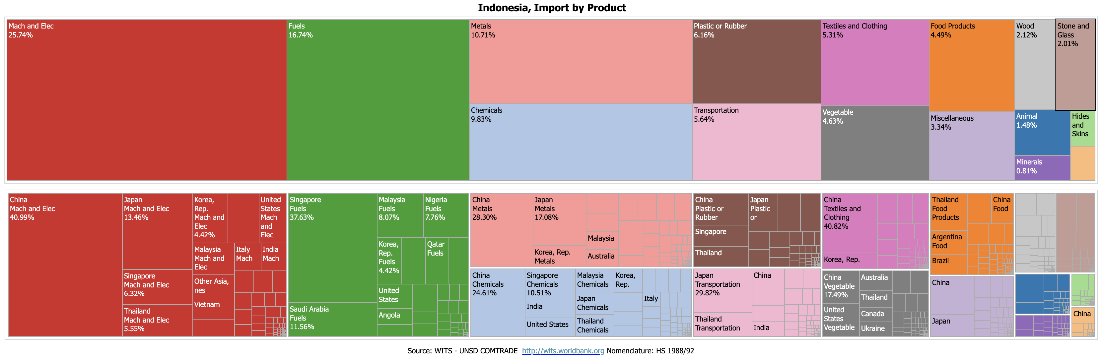
Context 2f: Trade Relations (where JPN located in IDN Imports)
Source: UN Comtrade-WITS (2020)

Slide 11
SMEs as Part of Economic and Trade Diplomacy
G to G diplomatic efforts need back-up plans for multi-track diplomacy (Track 1 (G to G), 2 (B to B), 3 (P to P), etc.)
SMEs are the backbones for Track 2 and 3, and possibly other tracks (given their central functions in the supply/commodity chains)
Industrial linkages (forward, intermediary and backward) could serve as the hubs for SMEs involvement in IDN-JPN economic and trade diplomacy

Slide 12
SMEs as the Focus (case on automotive industry/Toyota)
IDN SMEs
(e.g. 2nd and 3rd tiers Suppliers in Automotive)
IDN Subsidiary Companies/Local Partners of JPN Lead Firms
(e.g. TMMIN, Astra Groups)
JPN SMEs (e.g. in Automotive)
JPN Lead Firms (e.g. Toyota Motor Corporation/TMC)

Slide 13
Your SMEs: How to Fit In?
Potential SMEs Mapping Queries
Sectors/Commodities | Japanese Regional/Global Supply and Commodity Chains
 | Forward-Linkages Branding, Design and R&Ds, Digitalization, Social Media Content Development | Intermediary-Linkages Sales and Distribution, Marketing, Logistics, E-Marketing | Backward-Linkages Parts and Components Suppliers, Basic R&D Supports,
Automotive (to include Machinery, Metal, Glass and Plastic Works, etc.)
Electronics (to include electrical parts, etc.)
Power Generation (to include, renewable sources, etc.)
Consumer Products (to include textiles, footwear, retail stores, etc.)
Services Industry (Culinary, Restaurants, Business, Education, Tourism, etc.)
E-commerce/Digital Economy (to include startups in IT industry)

Slide 14
Recap: Queries
How IDN SMEs connect to JPN global/regional production networks and supply/commodity chains?
What are the key challenges?
  Capacity building: export/import, licensing, product standards and quality, packaging, branding and copyrights/patents, market intelligence
  Entrepreneurship/corporate culture
  Business environment, government relations
What are the essential needs to upgrade? How UGM contribute?
  Apprenticeships: PSPD/CWTS UGM Trade Labs
  SMEs Supervisory Programs: UGM Supporting Facilities (e.g. Product Testing, E-Market and Digitalization, Patent/Copyrights, Financial Management, etc.)

Slide 15
どうもありがとうございます

