Slide 1
Tunisia's export opportunities
Focus: Africa and EU presented by:
Prof Wilma Viviers (North-West University, South Africa) and Prof Leila Baghdadi (University of Tunis, Tunisia)
TRADE-DSM is a registered trade mark of the North-West University, South Africa

Slide 2
Content
Context
TRADE-DSM - overview
Outcomes – globally, Africa and EU
Next steps

Slide 3
1. Context
Bilateral research project funded by:
Tunisian Ministry of Higher Education and Scientific Research and
SA National Research Foundation (2019 - 2021) to:
  demonstrate the TRADE-DSM (Decision Support Model) methodology to identify bilateral export opportunities between Tunisia and SA
  extend desktop research to SME level and policymakers - in both SA and Tunisia
  This presentation: FOCUS only on TUNISIA

Slide 4
2. Methodology: TRADE-DSM
Identifies export opportunities – product-country opportunities with highest ‘untapped’ export potential.. from Tunisia’s perspective
Scientific and structured approach – using sequential filtering process (4 filters) and approx. 6 million pieces of information to determine products and destination countries to focus export activities
Typical areas of application
- Government departments (trade and industry, agriculture etc.)
- Trade and investment promotion agencies and
- Private sector companies (specifically for export strategy development).
Range of countries for which models currently exist
- China, Australia, New Zealand, Netherlands, Belgium, Thailand, Czech Republic, Greece, Mexico, USA (State of Louisiana)
– in Africa: South Africa, Botswana, Rwanda, Cameroon– and now for Tunisia

Slide 5
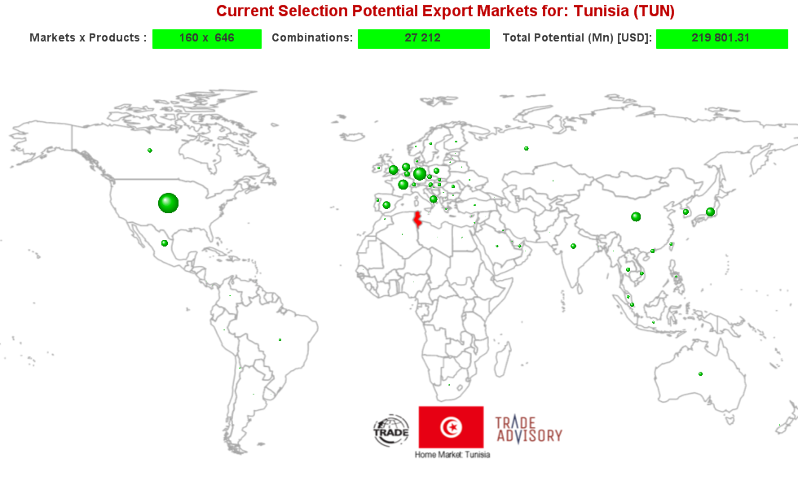
3. High level outcomes
Globally US$ 219 billion potential
646 products that Tunisia already exports
– 160 markets ~ 27 212 combinations (that meet DSM requirements)
Major geographic regions | No | Value¹ (US$ Mn)
Northern America | 828 | 53,566.67
Western Europe | 2,694 | 52,483.23
Eastern Asia | 2,171 | 30,895.93
Southern Europe | 3,778 | 18,465.15
Northern Europe | 2,911 | 16,585.99
Eastern Europe | 3,313 | 16,236.75
South-Eastern Asia | 2,046 | 13,553.14
Central America | 900 | 6,187.85
Western Asia | 3,169 | 4,904.69
Oceania | 637 | 2,313.81
South America | 1,135 | 2,011.77
Northern Africa | 709 | 1,198.70
Southern Africa | 597 | 459.69
1) Ranked descending by value of ‘untapped’ potential

Slide 6
Focus on Africa

Slide 7
3. High TRADE-DSM level outcomes
– focus on Africa region-level
53% of value of ‘untapped’ potential associated with Northern Africa
36% of number of opportunities associated with Western Africa

Slide 8
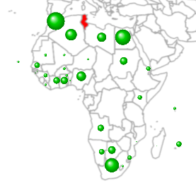
3. High level TRADE-DSM outcomes
– focus on African markets
36 markets (of 54) meet all TRADE-DSM key filters,
for which Tunisia has existing export capability for 590 different products
resulting in 2999 possible combinations (that meet DSM requirements)
with combined ‘untapped’ potential valued at
USD 2.2 billion (or 1% of global potential)
Major geographic regions | No | Value¹ (US$ Mn)
Northern Africa | 709 | 1,198.70
Southern Africa | 597 | 459.69
Western Africa | 1,072 | 431.89
Eastern Africa | 503 | 120.08
Middle Africa | 118 | 65.19
1) Ranked descending by value of ‘untapped’ potential

Slide 9
3. High level TRADE-DSM outcomes
– focus on African markets
For 2999 possible combinations (that meet DSM requirements),
Opportunities summarised across 27 industry sectors
(as opposed to products)
For the combined ‘untapped’ potential valued at
USD 2.2 billion
(or 1% of global potential)
Note
Aspects such as onshore/offshore/value chains
impacting on possible opportunity utilisation decisions
for these sectors will be considered in further research iterations
1) Ranked descending by value of ‘untapped’ potential

Slide 10
3. High level TRADE-DSM outcomes
– focus on Africa top 15 markets
TOP 15 markets that meet all TRADE-DSM key filters,
for which Tunisia has existing export capability for 571 different products
with combined ‘untapped’ potential valued at USD 2.09 billion
Rank | Country
1 | Morocco
2 | Egypt
3 | South Africa
4 | Algeria
5 | Nigeria
6 | Libye
7 | Botswana
8 | Sudan
9 | Ghana
10 | Ivory Coast
11 | Angola
12 | Namibia
13 | Senegal
14 | Mauritius
15 | Kenya
Note: Sudan and Botswana have zero existing imports from Tunisia

Slide 11
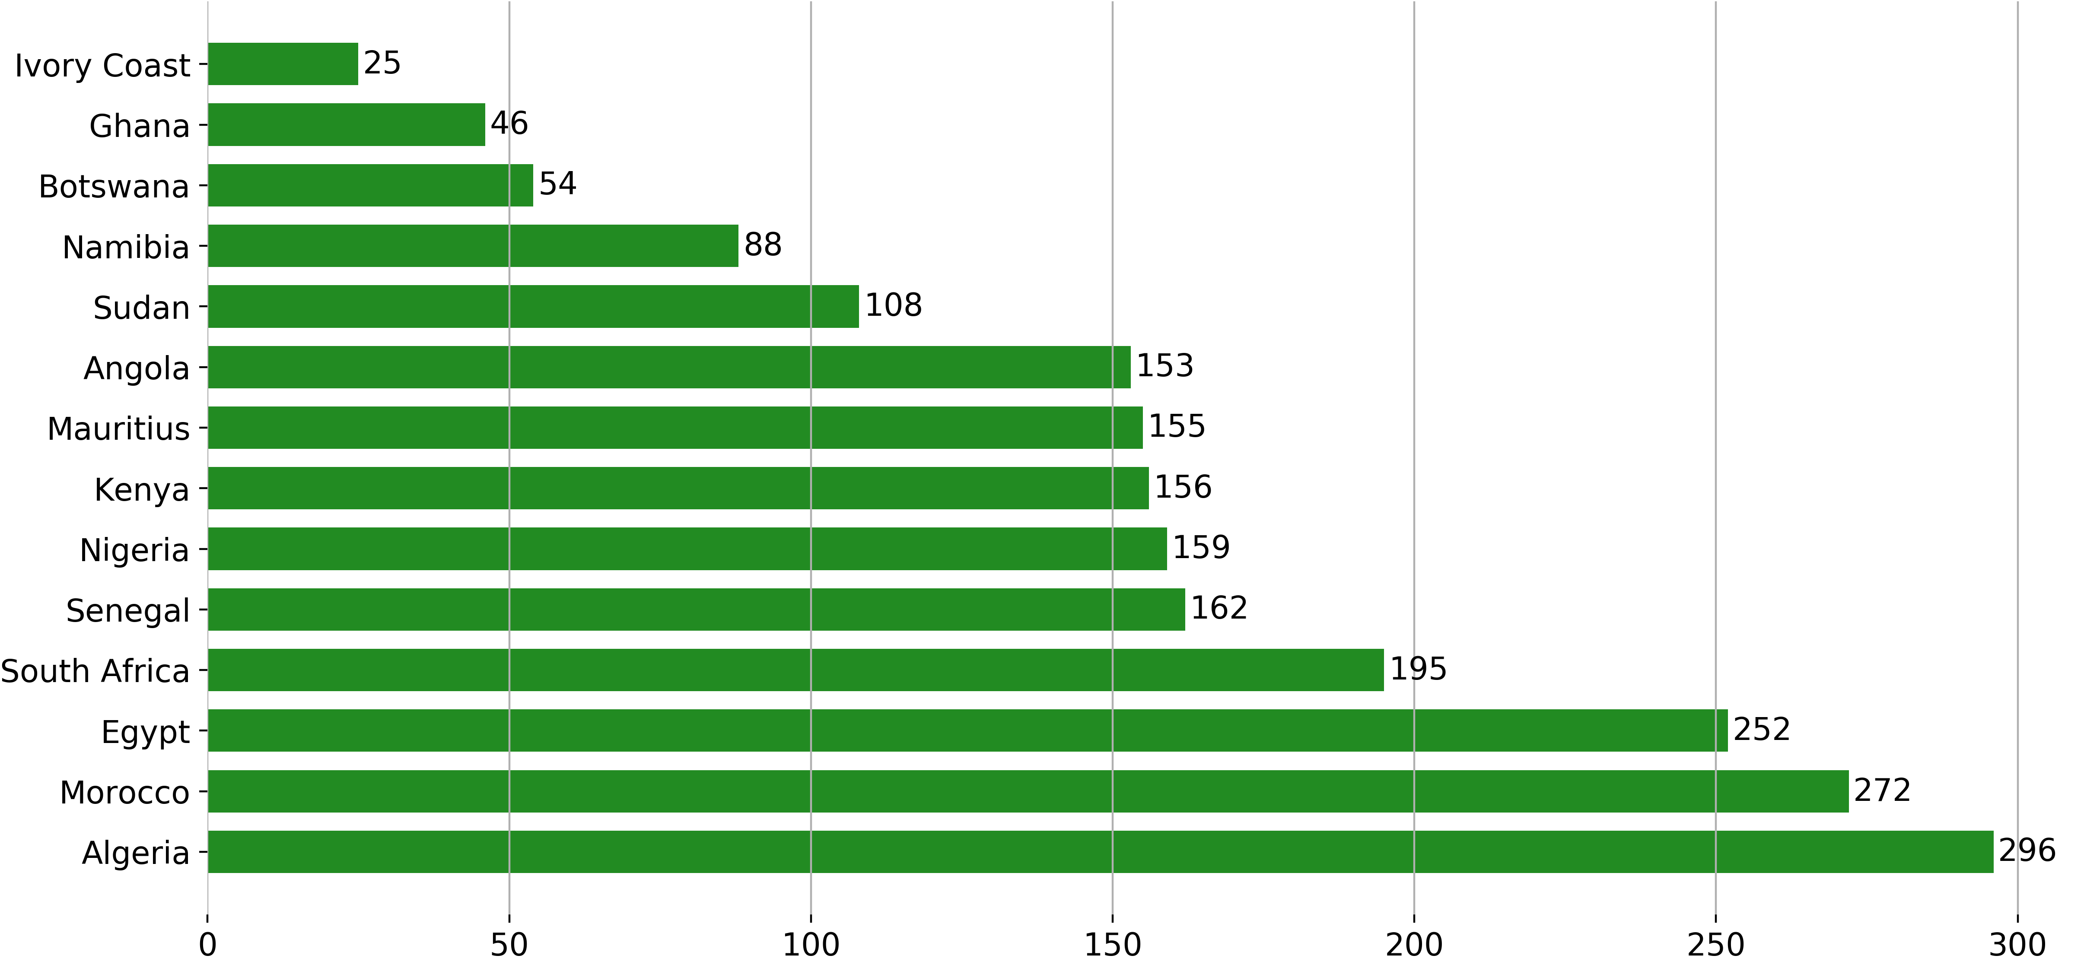
Unveiling opportunities for a successful industrial policy – focus on Africa
A different methodology is used to identify new products based on a mix of various methodologies (product space methodology, import demand, centrality indices and various other parameters) for the top 15 markets identified by TRADE-DSM

Slide 12
EU in summary

Slide 13
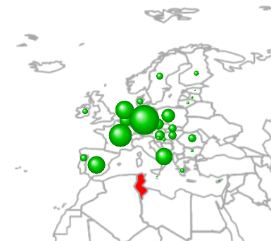
3. High level outcomes
– focus on EU markets
27 markets¹ meet all TRADE-DSM key filters,
for which Tunisia has existing export capability for 641 different products
resulting in 9277 possible combinations (that meet DSM requirements)
with combined ‘untapped’ potential valued at
USD 85.8 billion (or 39% of global potential)
1) Excluding United Kingdom
EU member countries (top10) | No | Value² (US$ Mn)
Germany | 577 | 21,712.62
France | 563 | 13,142.34
Netherlands | 504 | 8,612.83
Spain | 492 | 7,679.74
Italy | 482 | 7,388.53
Poland | 479 | 4,628.64
Belgium-Luxembourg | 366 | 4,301.14
Czech Republic | 350 | 2,984.81
Austria | 359 | 2,510.53
Hungary | 356 | 1,739.07
2) Ranked descending by value of ‘untapped’ potential

Slide 14
3. High level outcomes
– focus on EU markets
For 9277 possible combinations*
(that meet DSM requirements),
Opportunities summarised across 27 industry sectors
(as opposed to products)
For the combined ‘untapped’ potential valued at
USD 85.8 billion
(or 39% of global potential)
Note
Aspects such as onshore/offshore/value chains
impacting on possible opportunity utilisation decisions
for these sectors will be considered in further research iterations
* Excluding United Kingdom
1) Ranked descending by value of ‘untapped’ potential

Slide 15
How Tunisian SMEs can benefit ?
Participate ….

Slide 16
Next steps
Aim to reach out to:
  SME exporters – access to information about export markets
  Policymakers - focused export promotion strategies

Slide 17


Please contact us if you want to participate:
THANK YOU!
Leila Baghdadi Wilma Viviers
leilabaghdadi@gmail.com Wilma.Viviers@nwu.ac.za

